Slide 1

Is Your Faith
FIREPROOF?

Slide 2
SIN

Slide 3
PERSECUTION

Slide 4
PRESSURE

Slide 5
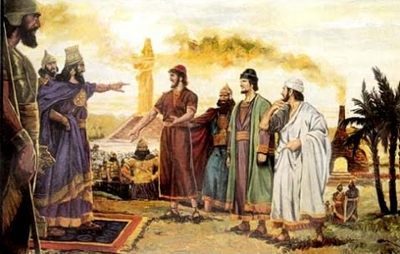

Slide 6


Slide 8
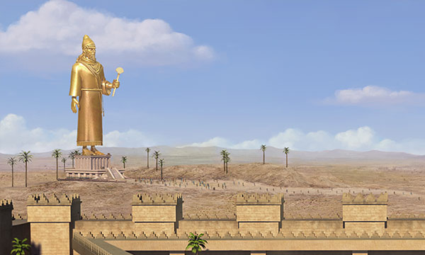

Slide 9
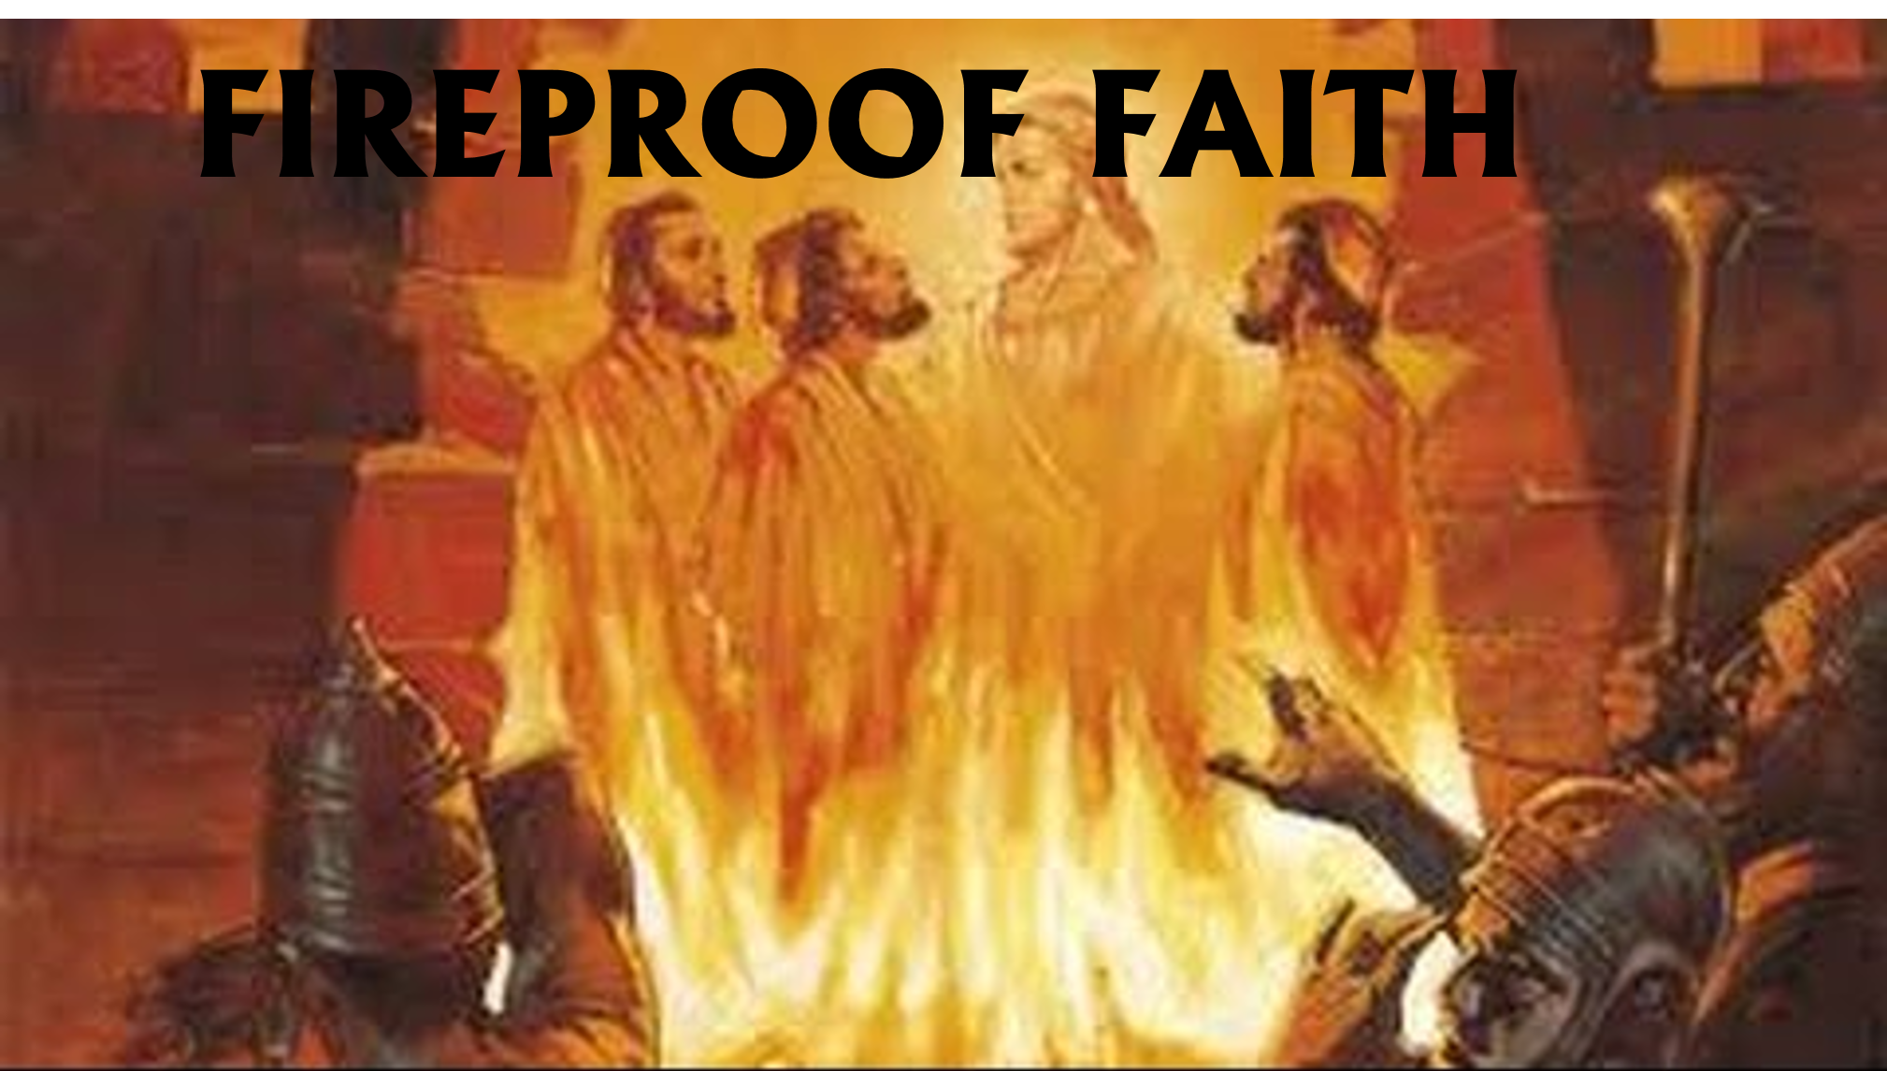
COMMITMENT
Daniel 3:16-18

Slide 10
COURAGE

Slide 11
CONFIDENCE
Daniel 3:16-18

Slide 12
CHRIST
Daniel 3:19-27

Slide 13
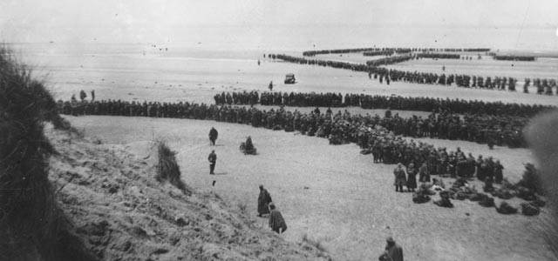
DUNKIRK
1940

Slide 14
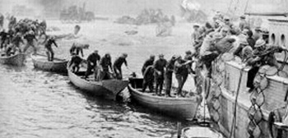
“But If Not…..”

