Slide 1


Slide 2
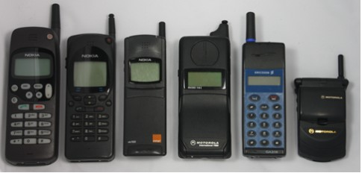

Slide 3



Slide 4
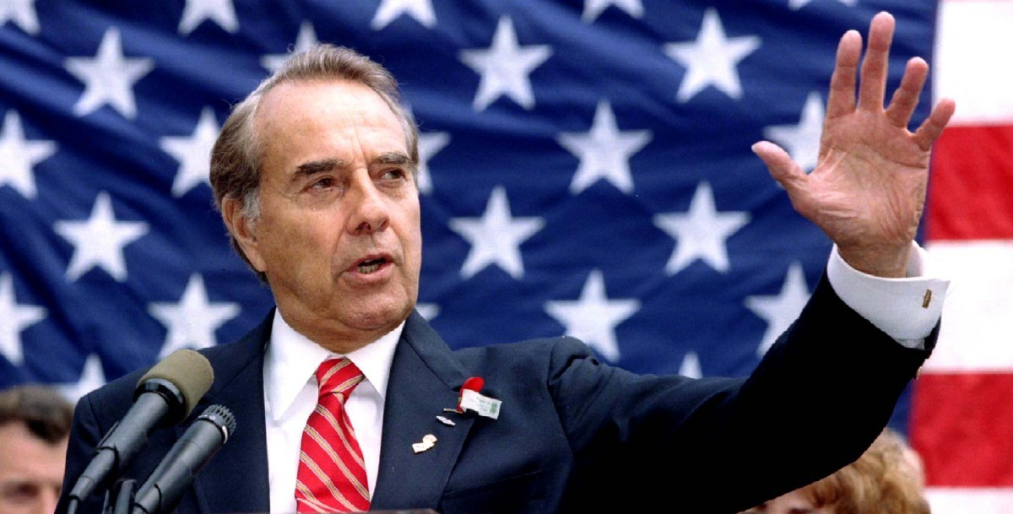

Slide 5
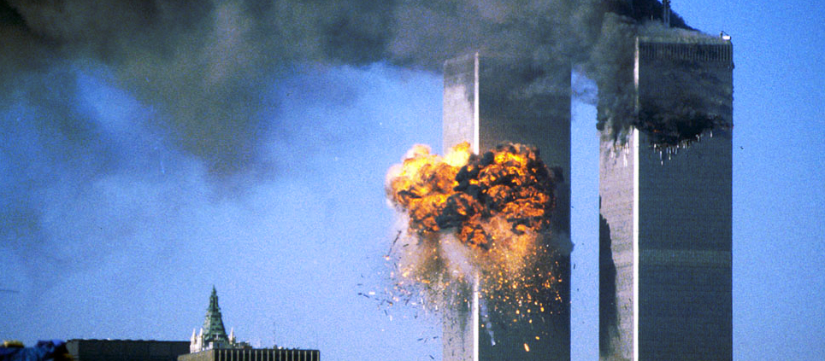
SEPTEMBER 11, 2001

Slide 6
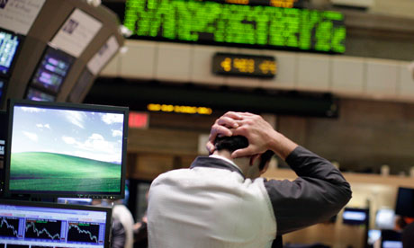
2007 FINANCIAL CRISIS

Slide 7
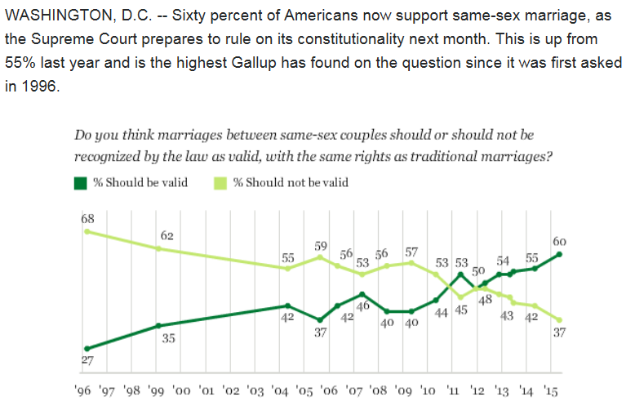
SOURCE:
Gallop, 2015

Slide 8
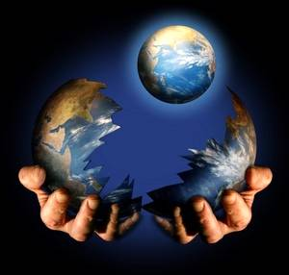

Slide 9


Slide 10
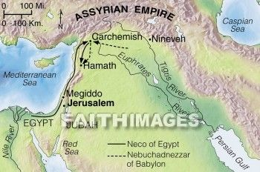
KING NEB
JOSIAH
EGYPT

Slide 12
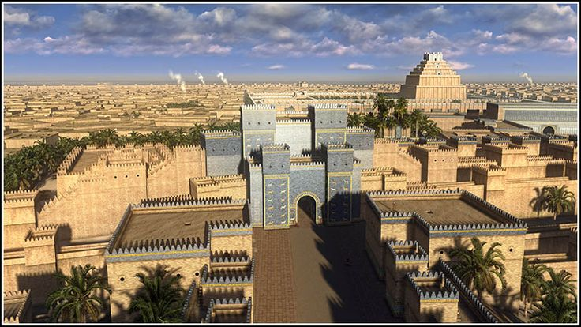

Slide 13
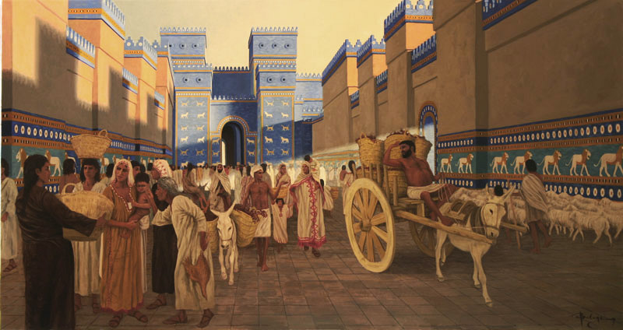

Slide 14
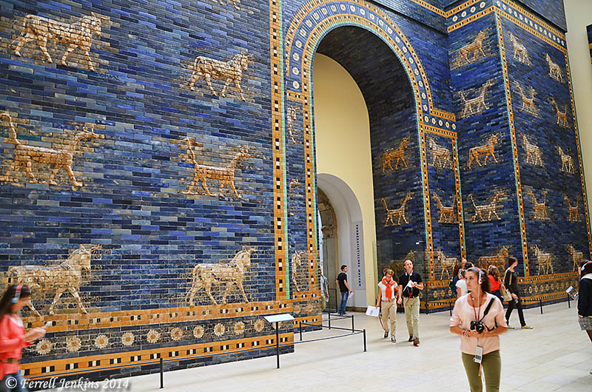
Ishtar Gate, Bergamom Museum, Berlin

Slide 15
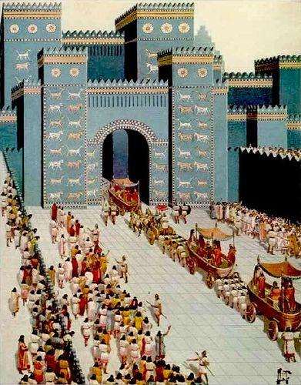

Slide 16
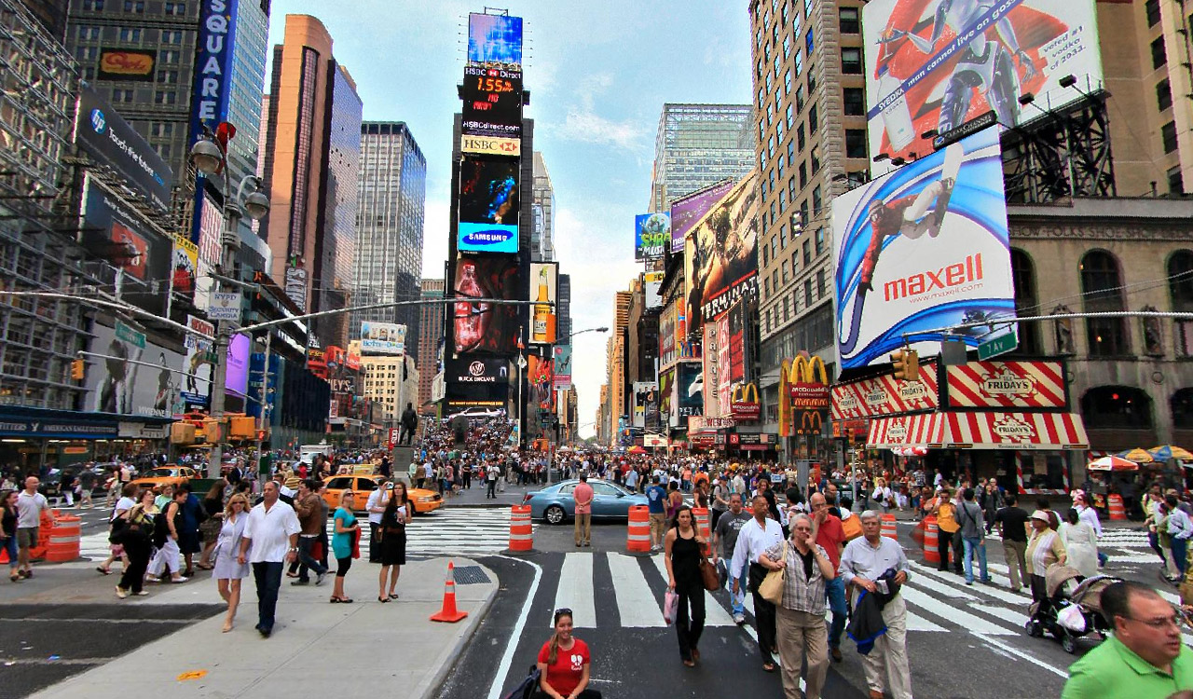

Slide 17
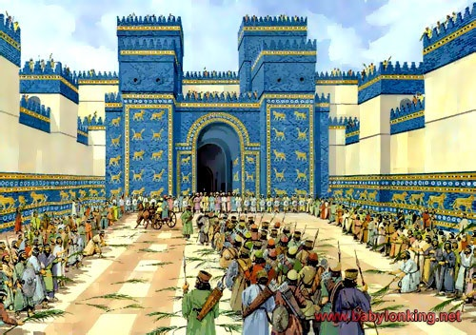

Slide 18
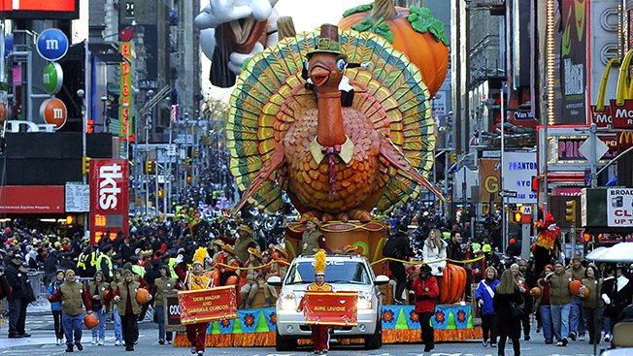

Slide 19
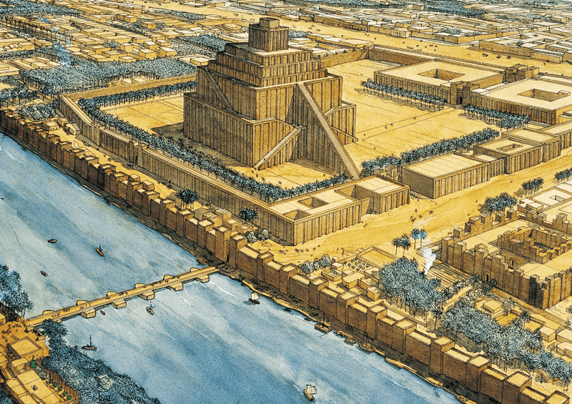

Slide 20
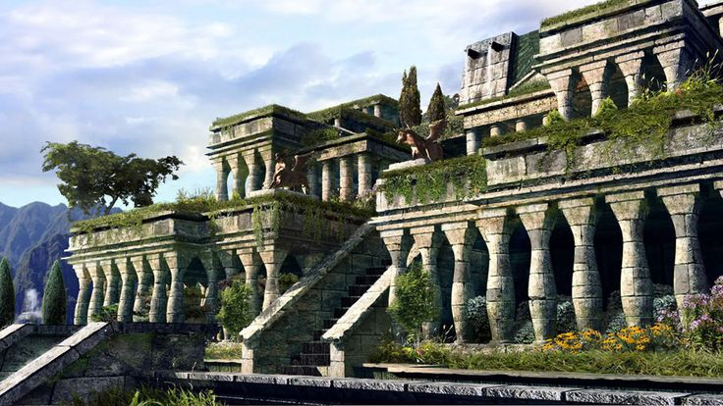

Slide 21
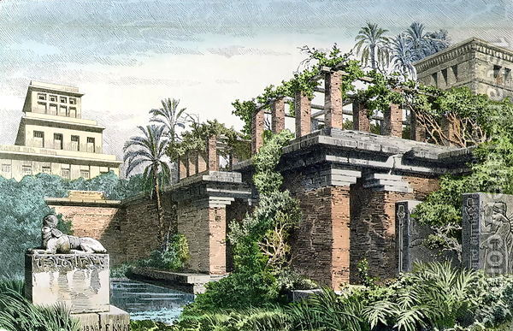
Hanging Gardens/ Tower of Babel

Slide 22
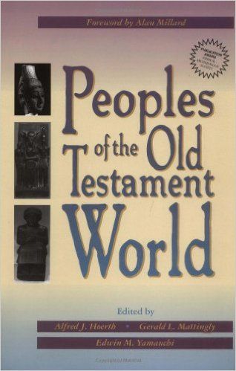
“The Babylonians transmitted and in some cases even originated most of the cultural and religious foundations for the OT world. They and their predecessors the Sumerians established the philosophical and social infrastructure of Israel’s neighbors.” (Bill Arnold, 43)

Slide 24
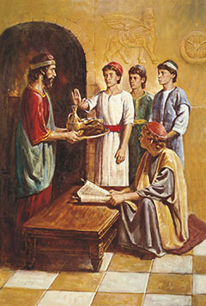
DANIEL
“My God is King”
BELTASHAZZAR
“May Bel Protect his life”

Slide 25
Hananiah
“YHWH is Gracious”
Shadrach
“I am fearful of God”

Slide 26
Mishael
“Who is as God”
Meshach
“Who is what Aku is”

Slide 27
Azariah
“Whom YHWH Helps”
Abednego
“Servant of Nebo”

Slide 29

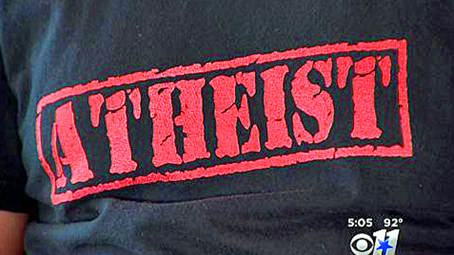

Slide 30
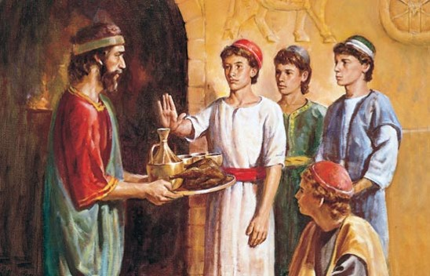
Calm

Slide 31
Committed

Slide 32
Courageous

Slide 33
Courteous

Slide 34
Confident

Slide 35
Confirmed!

