Slide 1
When Someone has
SINNED
Against You
Matthew 18:15-20

Slide 2


Slide 3
INTERNAL
Trust
Grace
Patience
EXTERNAL

Slide 4


Slide 5
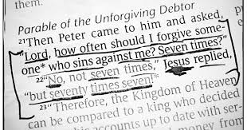
When Someone Sins Against You. Matthew 18

Slide 6

When Someone Has Something Against you. Matthew 5

Slide 7

When Someone Is Overtaken by Sin. Galatians 6

Slide 8
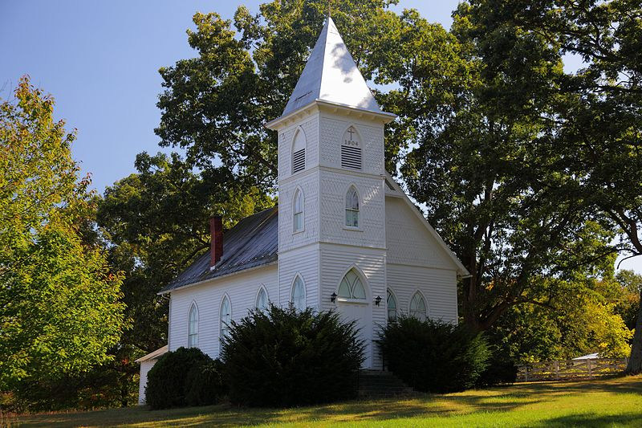
When Someone Causes Division in the Church. Romans 15

Slide 9

When A Pastor Has Sinned. 1 Timothy 5

Slide 10
Why We Need Others
Blinded by Satan. 2 Timothy 2:24
Need a Seeing Eye. Luke 6:39
We Want It All.

Slide 11
Admonish
Greek neutheteo
A change in will
2 Thess 3:15 “warn him…..”

Slide 12
Rebuke
Greek epitimao
A change in behavior
2 Tim 4:2 “reprove, rebuke, exhort”

Slide 13
Reprove
Greek elegcho
Expose or bring to light
Matt 18:15 “go and show him his fault”

Slide 14
Instruct
Greek paideuo
bring up, train
2 Tim 2:25 “gently instruct”

Slide 15


