Slide 1
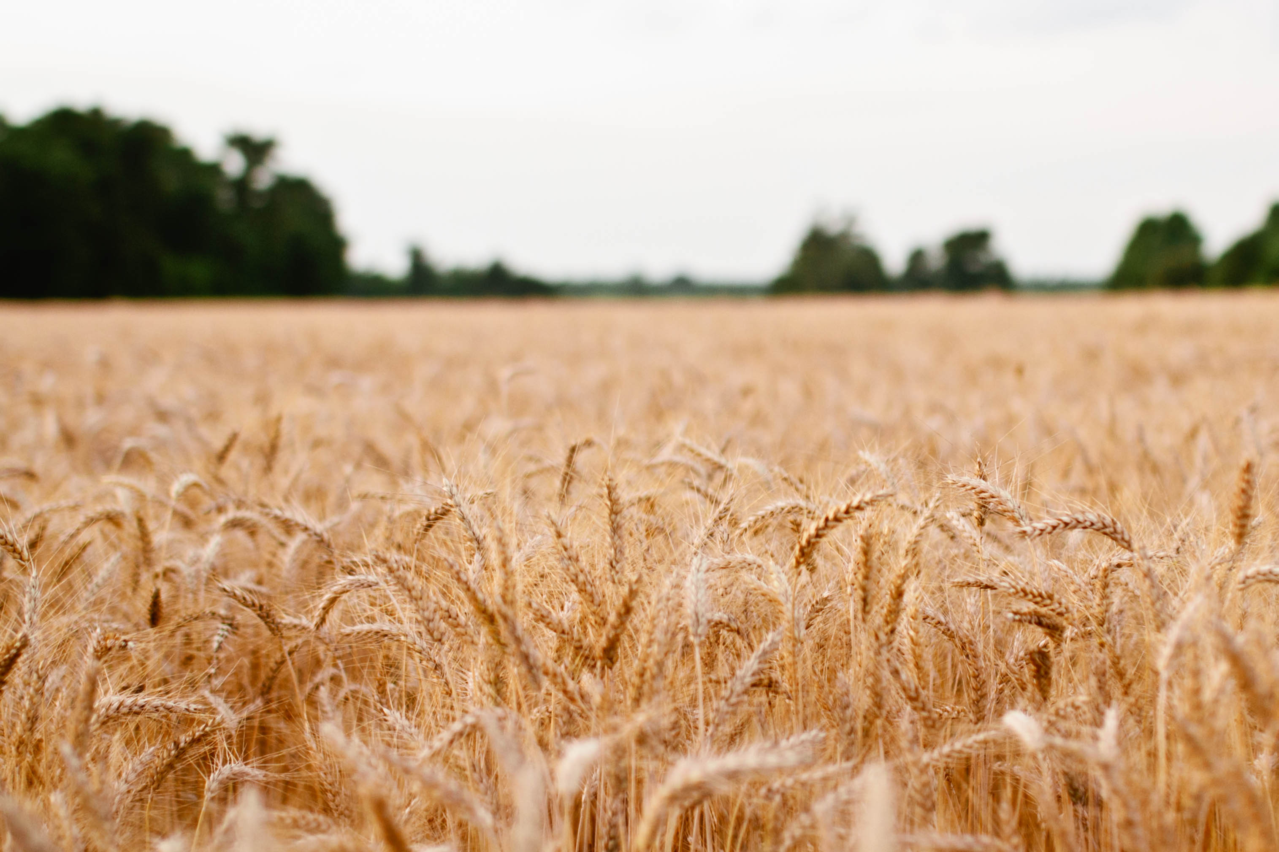
“Each one must give as he has decided in his
heart…for God loves a cheerful giver”
2 Corinthians 9:7

Slide 2
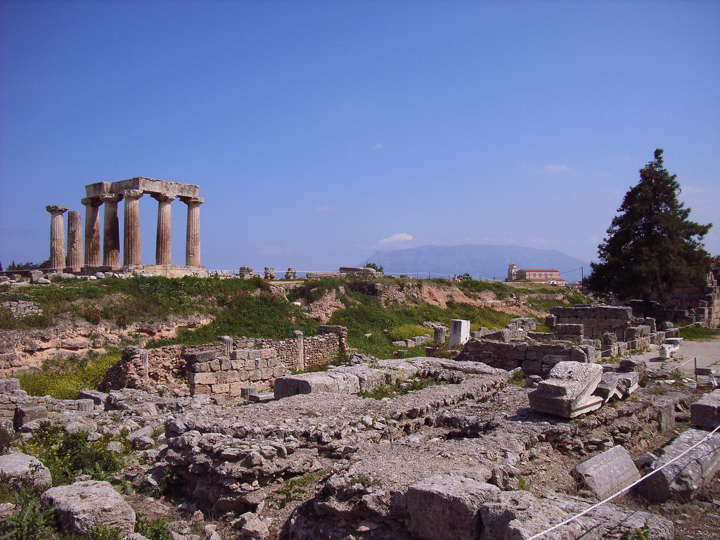
The Church at Corinth

Slide 3
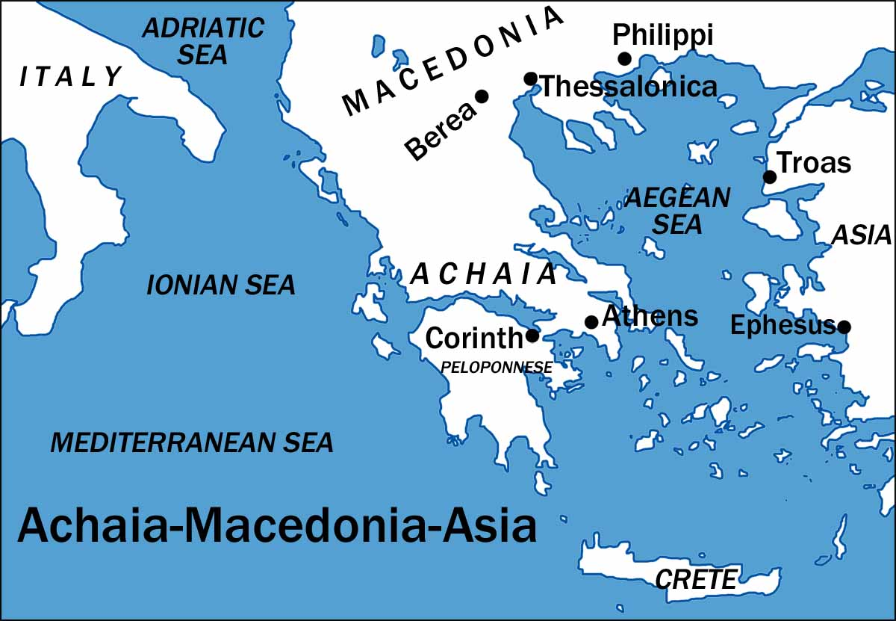

Slide 4


Slide 5
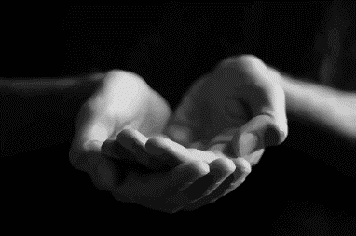
Grace Giving – 1 Cor 8-9
Cheerful!
Worshipful
Local
Intentional
Proportional
Regular

Slide 6
