Slide 1

CONNECTING with MINISTRY
Philippians 2:19-30

Slide 2

Passion
Prayer
Pastors
People
Produce

Slide 3
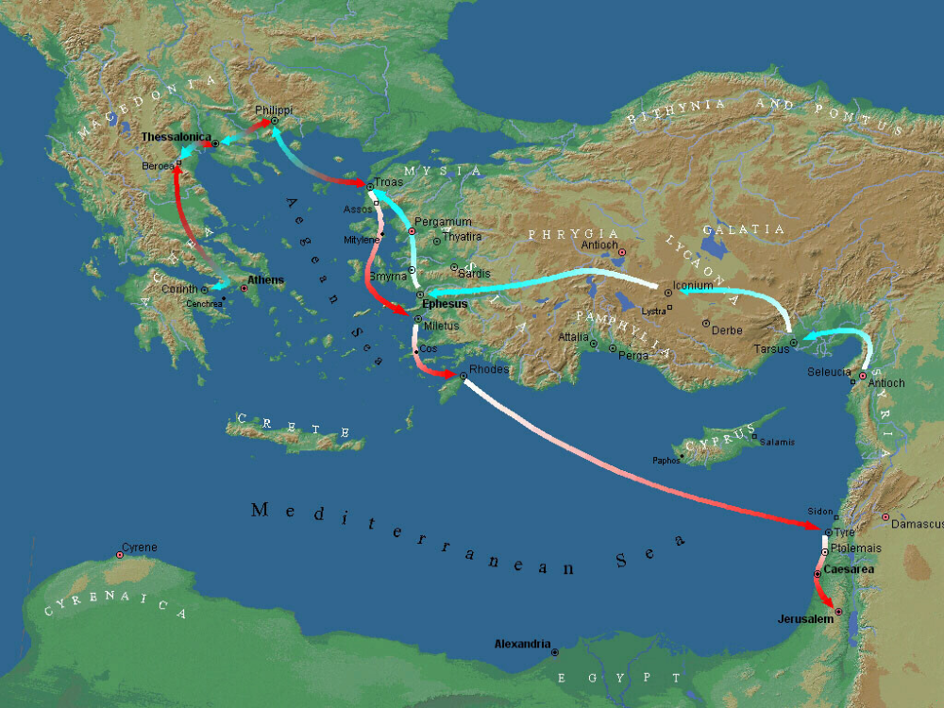
Thessalonica
Troas
Berea
Lystra, Tim’s Home
Corinth
Ephesus
Rome

Slide 4
Thessalonica
Berea
GREECE
Corinth
ISRAEL

Slide 5
Passion
Prayer
Pastors
People

Slide 6
Passion
Prayer
Pastors
People
Produce

Slide 7
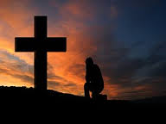

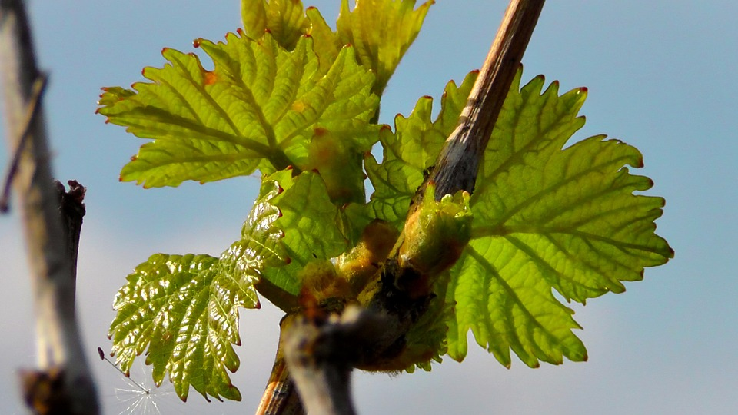
Personal Aspect to our Connection with God
Renewed by the Word
Knowing Christ
Yielded to Christ

Slide 8
Practical Ideas for 2016 Quiet Time
Our Daily Bread. Print copies available at FBC. Online available at www.ourdailybread.com
Word of Life Quiet Time. Available by free daily e-mail www.family-times.net
Read through the Bible. Various reading plans available at www.biblegateway.org under the tab “study”
Charles Stanley online devotionals www.guidelines.org

