Slide 1
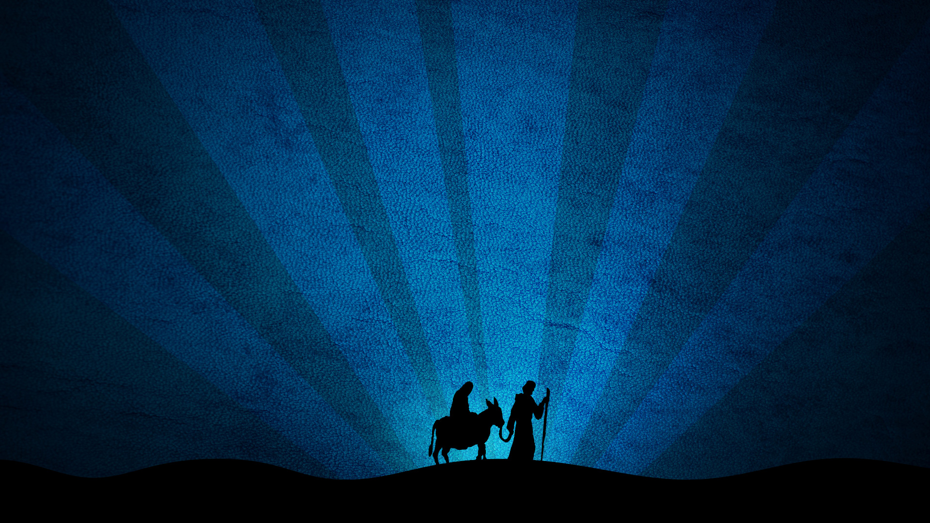
Jesus
B.C.

Slide 2
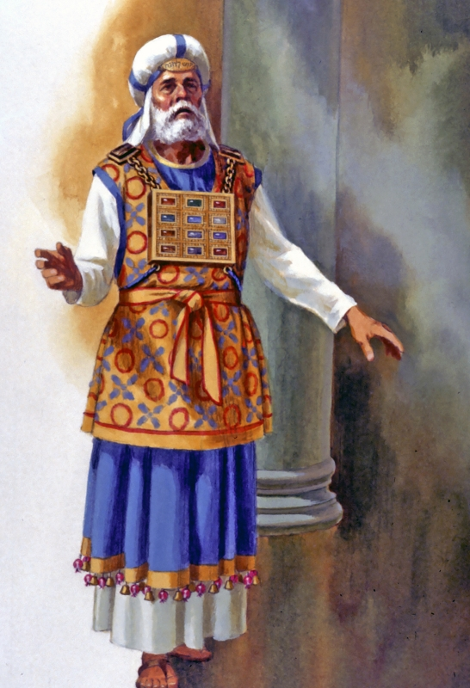
Purity
of a Priest

Slide 3
Purposes
of a Priest

Slide 4
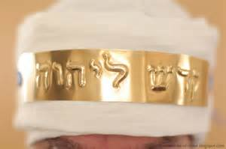

Slide 5
Practices
of a Priest

Slide 6
Jesus Our Great High Priest
Purity
Hebrews 5:4-6
Genesis 14:17-20
Psalm 110:4

Slide 7
Jesus Our Great High Priest
Purposes
1 Peter 3:18
Acts 13:39

Slide 8
Jesus Our Great High Priest
Practices
Hebrews 9:11-12
Ephesians 5:2
Hebrews 7:27
Hebrews 9:14, 25

