Slide 1
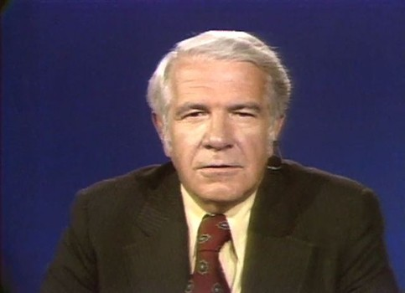


Slide 2
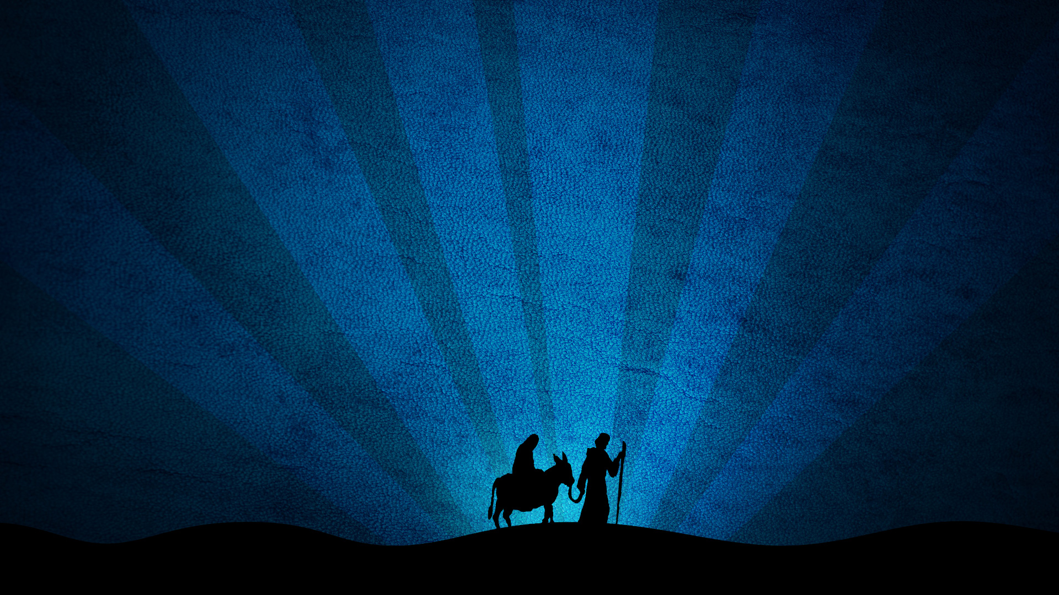
Jesus
B.C.

Slide 3
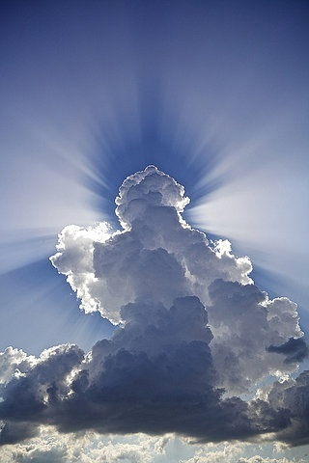
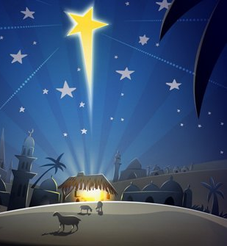
God
Man
“the precious blood of Christ, like that of a lamb without blemish or spot”
1 Peter 1:18-19
“made like his brothers in every respect, so that he might become a merciful and faithful high priest in the service of God” Hebrews 2:17

Slide 4
Eternal
“But you, O Bethlehem Ephrathah, who are too little to be among the clans of Judah, from you shall come forth for me one who is to be ruler in Israel, whose coming forth is from of old, from ancient days.” (Micah 5:2, ESV)

Slide 5
Eternal
“In the beginning was the Word, and the Word was with God, and the Word was God.”
(John 1:1, ESV)

Slide 6
Eternal
“Jesus said to them, “Truly, truly, I say to you, before Abraham was, I am.”
(John 8:58, ESV)

Slide 7
Eternal
“He is the image of the invisible God, the firstborn of all creation. For by him all things were created, in heaven and on earth, visible and invisible, whether thrones or dominions or rulers or authorities—all things were created through him and for him. And he is before all things, and in him all things hold together.”
(Colossians 1:15–17, ESV)

Slide 8
Eternal
“For God did not send his Son into the world to condemn the world, but in order that the world might be saved through him.”
(John 3:17, ESV)

Slide 9
Eternal
“who, though he was in the form of God, did not count equality with God a thing to be grasped,” (Philippians 2:6, ESV)

Slide 10
God from Heaven
“He who comes from above is above all. He who is of the earth belongs to the earth and speaks in an earthly way. He who comes
from heaven is above all.”
(John 3:31, ESV)

Slide 11
God from Heaven
“For the bread of God is he who comes down from heaven and gives life to the world.”
(John 6:33, ESV)

Slide 12
God from Heaven
“He said to them, “You are from below; I am from above. You are of this world; I am not of this world.” (John 8:23, ESV)

Slide 13
One with the Father
“I and the Father are one.”
(John 10:30, ESV)

Slide 14
One with the Father
“For in him the whole fullness of
deity dwells bodily,”
(Colossians 2:9, ESV)

Slide 15
OT Titles of Jesus
Jehovah

Slide 16
OT Titles of Jesus
Elohim

Slide 17
OT Titles of Jesus
Angel of Jehovah

Slide 18
Foreshadowed in OT
The Second Adam
The Priest greater than Aaron
A better sacrifice than Abel
A Father greater than Isaac
A Savior greater than Joseph

Slide 19
Foreshadowed in OT
A conqueror greater than Joshua
A Kinsman-Redeemer like Boaz
A High Priest after the order of Melchizedek
A Prophet greater than Moses
The King in the lineage of DAVID

Slide 20
Foreshadowed in OT
Covering for Adam and Eve’s nakedness
Ark in whom we find refuge
Pillar of Fire to Guide us and the Cloud to Cover us
Lamb of Atonement
Tabernacle to enter into God’s Presence
Serpent lifted up on the pole
LAMB of GOD who TAKES AWAY the SIN of the WORLD

Slide 21
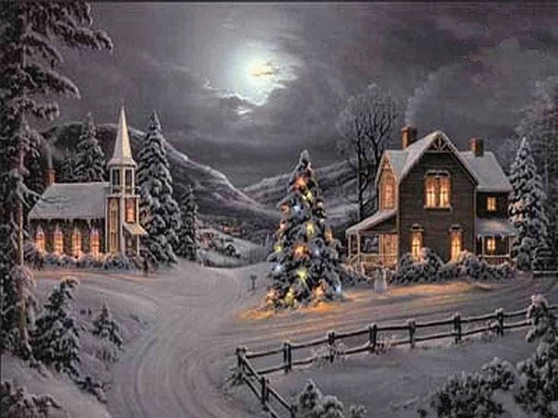

Slide 22
