Slide 1


The Commands of
“Warnings”

Slide 2
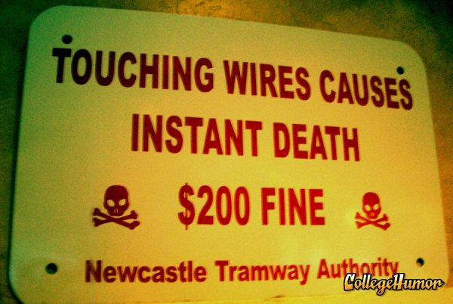

Slide 3
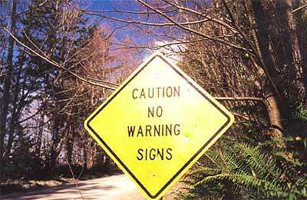

Slide 4
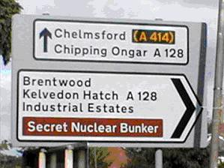

Slide 5


Slide 6
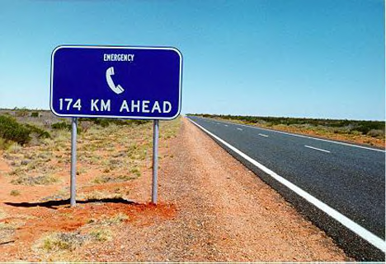

Slide 7
The Commands of
“Warnings”

Slide 8
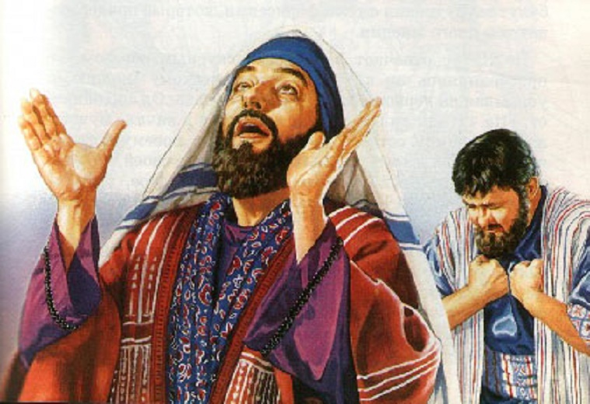
Matt 6:1 Guard Against False Piety

Slide 9


Slide 10
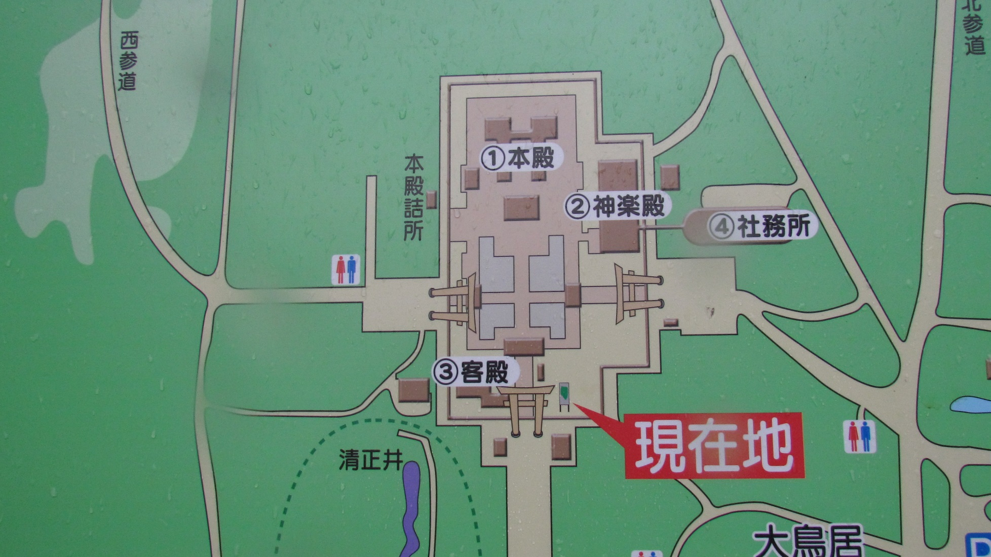

Slide 11

Matt 6:25 Don’t Be Anxious

Slide 12

Matt 7:6
Handle Holy Things with Care

Slide 13

Matthew 7:15

Slide 14

Matthew 10:28
Do not be Afraid of Persecution

Slide 15

Matthew 22:21
Give God what Belongs to Him

Slide 16

Matthew 24:4-5
Do Not Be Deceived

Slide 17
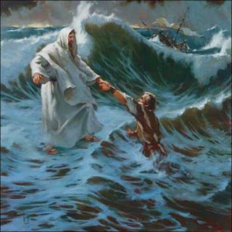
John 14:27 Fear Not

Slide 18
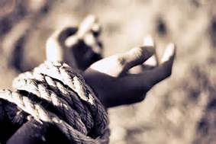
Revelation 2:10
Do not be Afraid to Suffer

Slide 19

Revelation 3:2-3, 11
Strengthen What is Left,
Hold on the What You Have

Slide 20
The Commands of
“Warnings”

Slide 21

Character
Coming to Christ
Christ as Lord
Loving Others
Warnings
Preaching the Gospel

