Slide 1
Immigration
Refugees and
Christian Compassion

Slide 2
Biblical Terms. Sojourners
Genesis 32:4 (ESV) “Thus you shall say to my lord Esau: Thus says your servant Jacob, ‘I have sojourned with Laban and stayed until now.
Genesis 47:4 (ESV) ⁴ They said to Pharaoh, “We have come to sojourn in the land, for there is no pasture for your servants’ flocks, for the famine is severe in the land of Canaan. And now, please let your servants dwell in the land of Goshen.”
Ruth 1:1 (ESV) ¹ In the days when the judges ruled there was a famine in the land, and a man of Bethlehem in Judah went to sojourn in the country of Moab, he and his wife and his two sons.

Slide 3
Biblical Terms. Strangers/ Aliens
“If a stranger shall sojourn with you and would keep the Passover to the Lord, let all his males be circumcised. Then he may come near and keep it; he shall be as a native of the land. But no uncircumcised person shall eat of it. There shall be one law for the native and for the stranger who sojourns among you.”” (Exodus 12:48–49, ESV)
“So then you are no longer strangers and aliens, but you are fellow citizens with the saints and members of the household of God,” (Ephesians 2:19, ESV)

Slide 4
OT Economic Provisions
“When a stranger sojourns with you in your land, you shall not do him wrong. You shall treat the stranger who sojourns with you as the native among you, and you shall love him as yourself, for you were strangers in the land of Egypt: I am the Lord your God.” (Leviticus 19:33–34, ESV)
“(the sojourner has not lodged in the street; I have opened my doors to the traveler),” (Job 31:32, ESV)
“Do not neglect to show hospitality to strangers, for thereby some have entertained angels unawares.” (Hebrews 13:2, ESV)

Slide 5
OT Economic Provisions
HOSPITALITY. Throughout Scripture, the responsibility of caring for the traveller and those in need is largely taken for granted. Although examples are found right through the Bible, the only specific commands about providing hospitality concern the Christian’s responsibility towards his fellow believer.
  D. W. Baker, Hoshea, ed. D. R. W. Wood et al., New Bible Dictionary (Leicester, England; Downers Grove, IL: InterVarsity Press, 1996), 484.

Slide 6
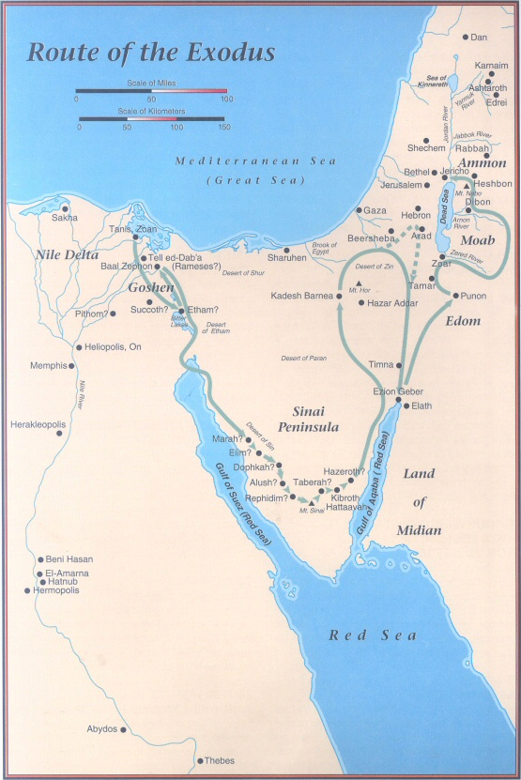
Passage Refused
Edom. Num 20:17
Amorites. Num 21:22
Heshbon. De. 2:27 (Sihon later defeated)

Slide 7
NT Commands
“One gives freely, yet grows all the richer; another withholds what he should give, and only suffers want. Whoever brings blessing will be enriched, and one who waters will himself be watered.” (Proverbs 11:24–25, ESV)
“Heal the sick, raise the dead, cleanse lepers, cast out demons. You received without paying; give without pay.” (Matthew 10:8, ESV)
“give, and it will be given to you. Good measure, pressed down, shaken together, running over, will be put into your lap. For with the measure you use it will be measured back to you.”” (Luke 6:38, ESV)
“But I say to you, Do not resist the one who is evil. But if anyone slaps you on the right cheek, turn to him the other also.” (Matthew 5:39, ESV)

Slide 8
NT Commands
“You have heard that it was said, ‘You shall love your neighbor and hate your enemy.’” (Matthew 5:43, ESV)
“Put on then, as God’s chosen ones, holy and beloved, compassionate hearts, kindness, humility, meekness, and patience,” (Colossians 3:12, ESV)
“And let us not grow weary of doing good, for in due season we will reap, if we do not give up. So then, as we have opportunity, let us do good to everyone, and especially to those who are of the household of faith.” (Galatians 6:9–10, ESV)
“But if anyone has the world’s goods and sees his brother in need, yet closes his heart against him, how does God’s love abide in him?” (1 John 3:17, ESV)

Slide 9
The Audience?
Christian thinking. Col 3 12-15
The Church (Universal. Local. 2 Cor 9:1-14)
Not the government

Slide 10
Nations are God’s Idea
“nation” 645x
First. Gen 10:5
Gen 12:2 “great nation”
Jer 12:17. Nations Responsible
Isa 66:18-21. Nations in Kingdom. Zech 8:22; 14:1-6
Rev 5:8-10. Throne

Slide 11
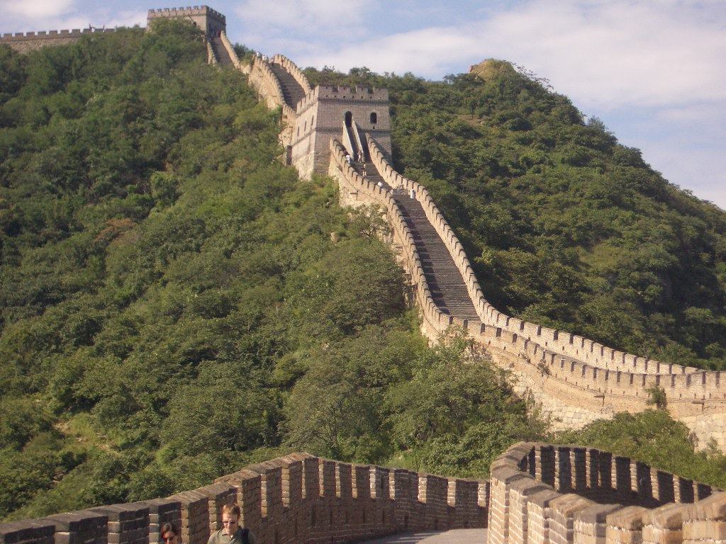
Borders are God’s Idea
“Do not move the ancient landmark that your fathers have set.” (Proverbs 22:28)
“Do not move an ancient landmark or enter the fields of the fatherless” (Prov 23:10)
“And he made from one man every nation of mankind to live on all the face of the earth, having determined allotted periods and the boundaries of their dwelling place,” (Acts 17:26, ESV)

Slide 12

Laws are God’s Idea
1 Peter 2:13-15
Romans 13:1-4
1 Tim 1:9
James 2:9, 11

Slide 13
Why?
Restraint and punishment of sin
Functioning of society
Allowance to “be fruitful and multiply”
Accomplish God’s plan to demonstrate his grace in redemption

Slide 14
Four Spheres of Government
CIVIL
CHURCH GOV.
FAMILY GOVERNMENT
SELF GOVERNMENT

Slide 15
SELF GOVERNMENT
Exodus 20:3-17
Proverbs 4:23-26
1 Corinthians 9:27
2 Peter 1:6
SELF GOVERNMENT
Notes:
“No nation can hope to survive without self governed men and women who seek to follow the laws of their Lord. A nation without self governed individuals will seek to establish a repressive civil government in order to keep undisciplined people in check.” Gary Demars God and Government p. 13
Illus. : Pooper scooper laws, James cutting through neighbors yards
REDA ARTICLE “Better safe than sorry”

Slide 16
FAMILY GOVERNMENT
1 Corinthians 11:3
Proverbs 22:6
Deuteronomy 6:4-9
1 Timothy 5:3-4
1 Timothy 5:8
1 Timothy 5:16
FAMILY GOVERNMENT
SELF GOVERNMENT

Slide 17
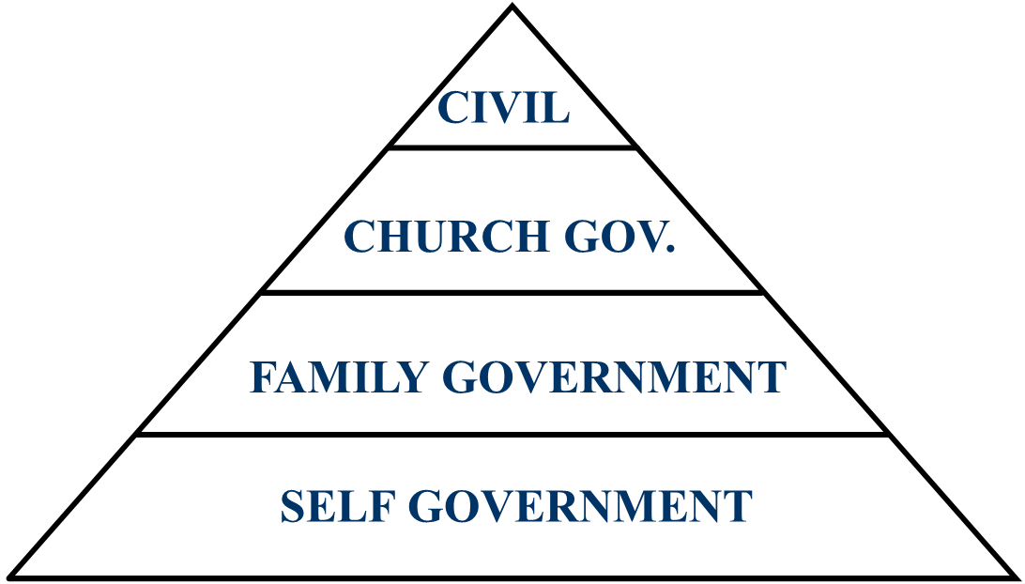
CHURCH GOVERNMENT
Matthew 16:18
Matthew 28:19-20
Hebrews 13:7,17,24
1 Peter 5:1-2

Slide 18
CIVIL GOVERNMENT
Matthew 22:21
1 Peter 2:13-14
Acts 4:19-20; 5:27-29, 42
Romans 13:1-7
PUNISHMENT | WAR
COMMERCE | TAXES
TRADE

Slide 19
What About Isis?
Punishment of evil is a responsibility of the civil government
Example: Citizens do not enforce their own justice.

Slide 20
What About Refugees?
Christians. Compassion
Churches. Compassion
Government. Protect citizens, enforce justice.
Current government ignores the plight of the persecuted church while also ignoring the reality of radical Islam

Slide 21
What About Immigration?
Borders are God’s idea
Laws are God’s idea
A Christian can be compassionate toward someone in the USA illegally, while petitioning our government to correct its negligence of security and economy.

Slide 22
Why do Liberals support Amnesty, Open borders and refugees?
Are they more compassionate?
Not compassionate, just lacking in justice
Socialism, manipulation of the poor
Rejection of God’s Law
One world government

Slide 23
Summary
Nations, Laws, Borders are God’s design
Personal Christian responsibility is different from Government’s responsibility
Personal compassion locally
Mission compassion globally
No nation can long survive without Laws, Borders or Justice.

