Slide 1


The Commands of
“Jesus Taught us How to Preach”

Slide 2
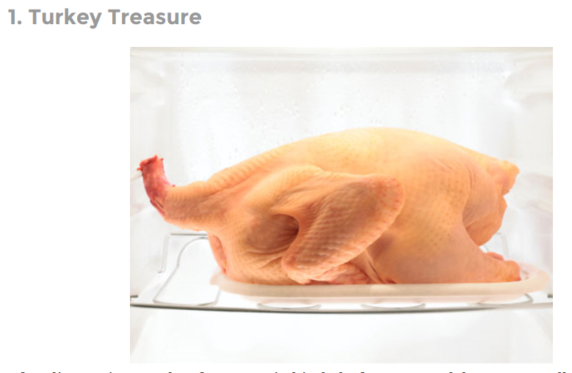

Slide 3


Slide 4
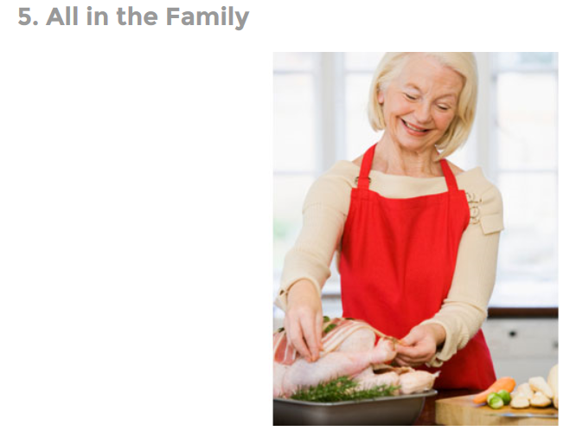

Slide 5
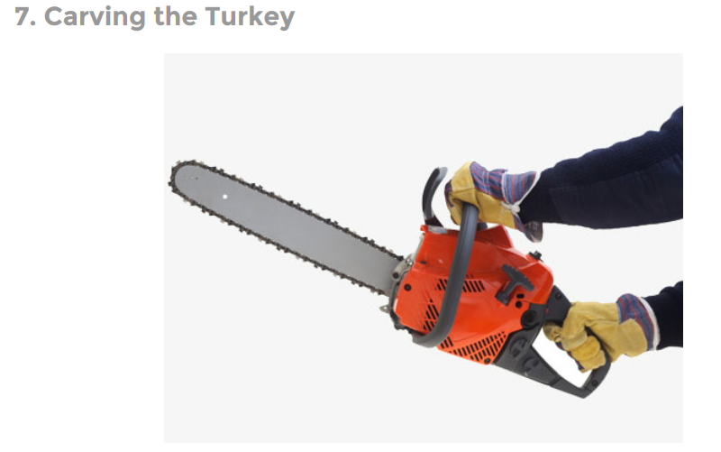

Slide 6


Slide 7
The Commands of
“Jesus Taught us How to Preach”

Slide 8

Character
Coming to Christ
Christ as Lord
Loving Others
Cautions
Preaching the Gospel

Slide 9
Central Command:
“go and make disciples”

Slide 10
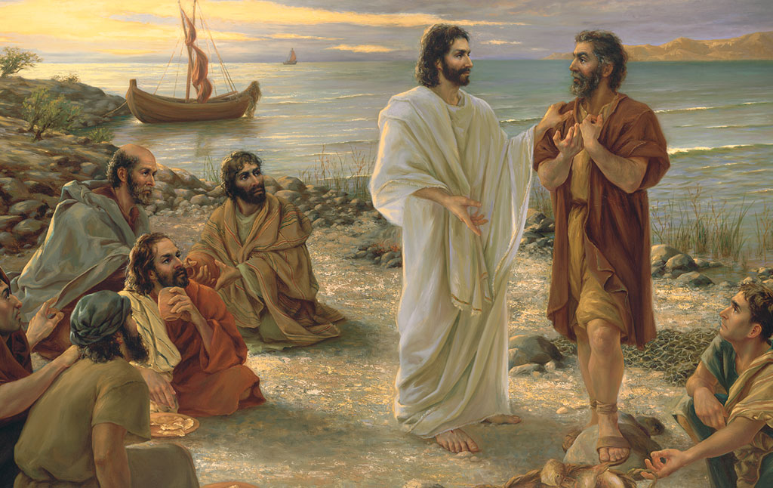
Central Command:
“go and make disciples”
Selflessly

Slide 11
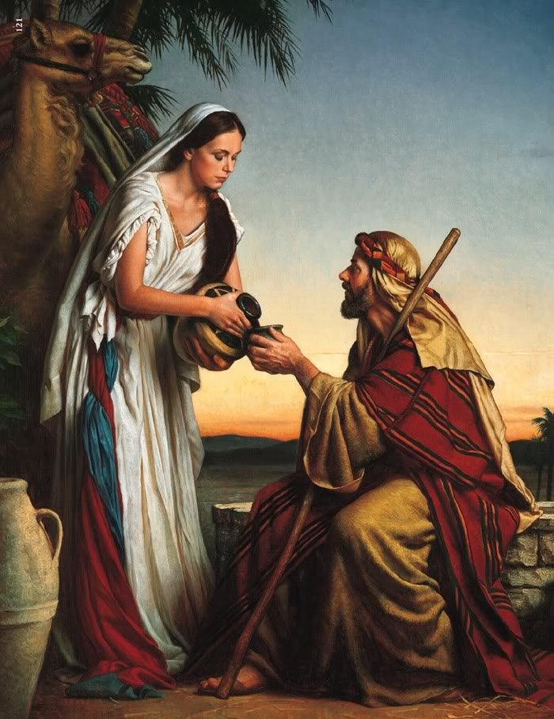
Central Command:
“go and make disciples”
Tenderly

Slide 12

Central Command:
“go and make disciples”
Prayerfully

Slide 13

Central Command:
“go and make disciples”

Slide 14

Central Command:
“go and make disciples”

Slide 15
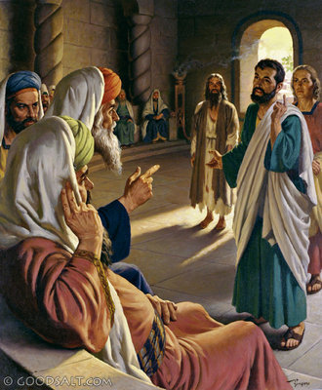
Central Command:
“go and make disciples”
Preparedly

Slide 16

Central Command:
“go and make disciples”
Globally

Slide 17
The Commands of
“Jesus Taught us How to Preach”

