Slide 1
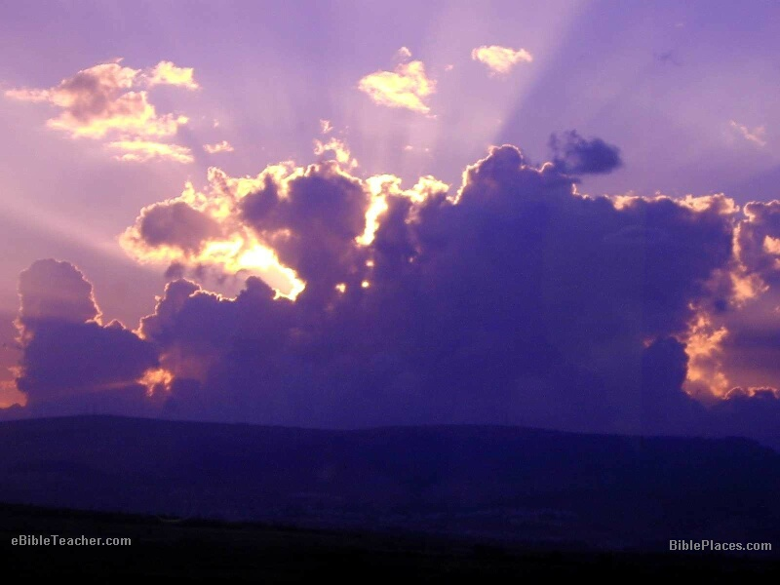
REVELATION
Your Kingdom Come

Slide 2
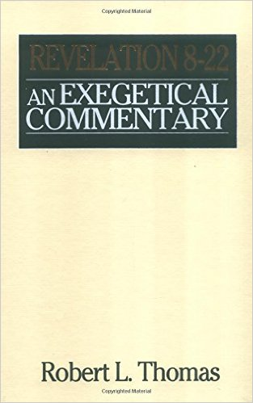
“Revelation is The most question-provoking book of the New Testament”
Dr. Robert Thomas, The Master’s Seminary

Slide 3
Some Symbols in Revelation
The candlesticks (1:12)
The stars (1:16)
The precious stones (4:3; 21:19‑ 20)
The horsemen (6:1‑8)
The locusts (9:3)
The measuring rod (11:1)
Babylon (17:5)
Adapted from Merrill C. Tenney, Interpreting Revelation, p. 13.

Slide 4
Judgment of the Tribulation
1/3 of the earth burned (8:7)
1/3 of the sea turned to blood (8:8)
1/3 of the sea creatures killed
1/3 of the ships destroyed
1/3 of fresh water bitter (8:10)
1/3 of the earth in darkness (8:12)
Everything in the sea dies (16:3)
Destruction of Babylon (17-18)
Second Coming/ Armageddon (19-20)

Slide 5
Mysteries in Revelation
144,000
Battle of God/ Magog
Two Witnesses
AntiChrist

Slide 6

Upcoming Sermons
4-5. The Throne (9/6)
Seal, Trumpet and Bowls (9/13 Fogle)
144,000 (9/20 Fogle)
Judgment of the Wicked (9/27)
Eternal State (10/4)

Slide 7
REVELATION
Your Kingdom Come

Slide 8
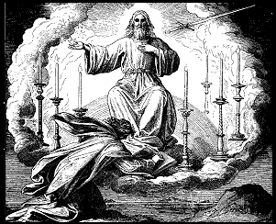
The Preterist View
REVE-
LATION
AD 70
THIS AGE
This view is taught by Dominion Theologians. The word “Preterist” is the Latin word for “past.”

Slide 9
The Idealist View
REVELATION
A SYMBOL OF THE BATTLE BETWEEN GOOD AND EVIL
THIS AGE
Those holding this view do not expect any of Revelation’s prophecies to ever be fulfilled.

Slide 10
The Historicist View
REVELATION
THIS AGE
This view was popular with the early Reformation writers.

Slide 11
The Futurist View
Chps
1-3
REVELATION
THIS AGE
The normal, literal interpretation of the Bible produces this view. This was the view of the early church & our view at Word of Life.

Slide 12
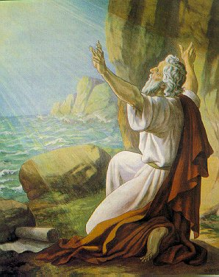
Introduction
Date & Place of Writing
  Date: A.D. 95
  Place: Isle of Patmos (1:9)

Slide 13
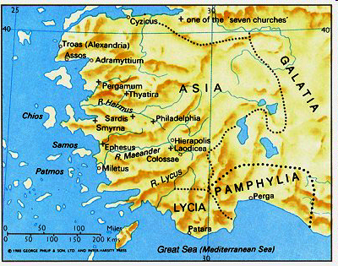

Slide 15
Outline of Revelation
Chp 1
Chaps 2-3
Chapters 4-22
The things which you have seen
The things which are
The things which shall take place after these things
Past
Present
Future

Slide 16
Why Study Prophecy?
To be Closer to Jesus. 1:1
Because God Wants you to Know. 1:1
To Receive God’s Blessing. 1:3
Because the End is Near. 1:3

Slide 17
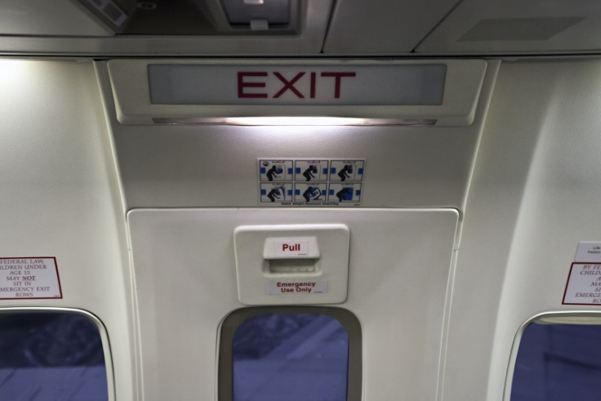

Slide 18
REVELATION
Your Kingdom Come

