Slide 1
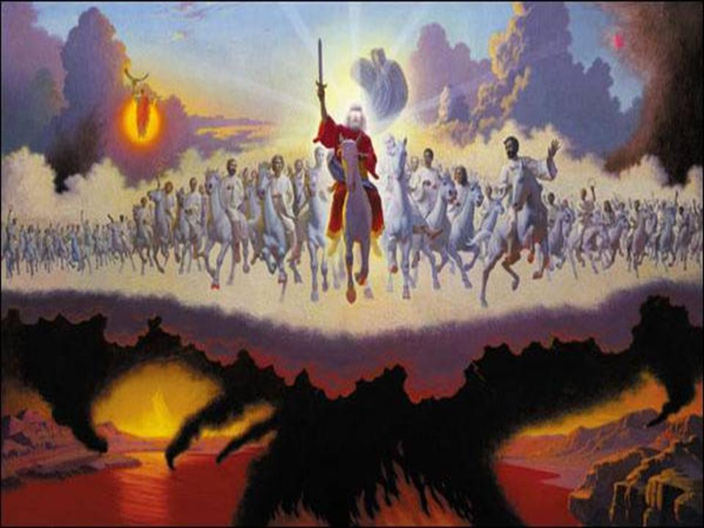
Daniel Chapter 9 Countdown to Armageddon

Slide 2
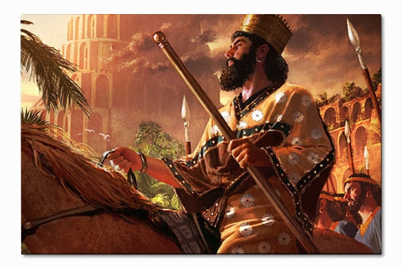
Chronology
Daniel 8:1 3rd year of Belshazzar
Daniel 9:1 First year of Darius

Slide 3
66 Years Since Beginning of Captivity
13 Years
605 BC
551 BC
539 BC
Captivity
Nebby
BABYLON
Dan 8:1
Belshazzar
BABYLON
Dan 9:1
Darius (Cyrus)
PERSIA

Slide 4
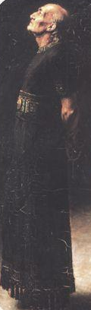
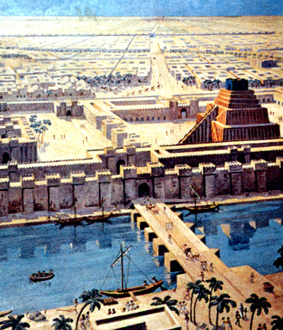
Daniel would be in his early 80’s now and has been in Babylon for the past 67 years.

Slide 5
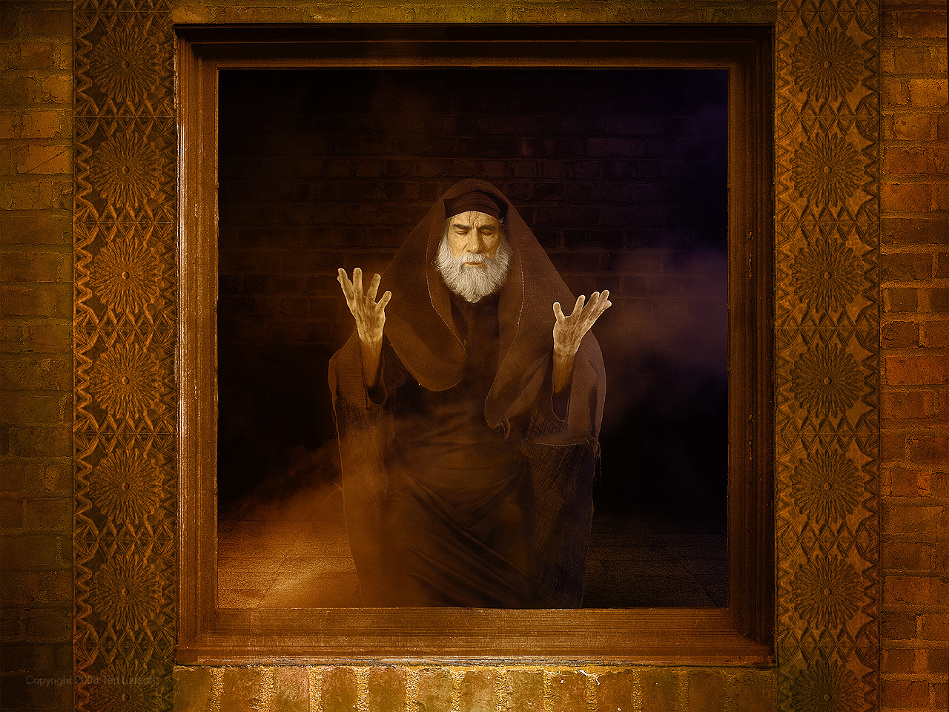
Circumstance of Daniel 9
Jeremiah 29:10-14

Slide 6
The Outline of Daniel
I. The Personal History of Daniel. (1) (Hebrew)
II. The Prophetic History of the Gentiles. (2-7) (Aramaic)
III. The Prophetic History of Israel. (8-12) (Hebrew) A. Daniel’s Vision of the Ram, Goat, and Little Horn. (8)
B. Daniel’s Vision of the Seventy Weeks. (9)
C. Daniel’s Vision of Israel’s Future. (10-12)

Slide 7
Fulfillment of Jeremiah’s Prophecy of a 70 year Captivity (Jer. 15:11-12; 29:10)
Daniel 9 occurs in 538 BC
605 BC
70 years
536 BC
First Deportation II Kings 24:1-4; Daniel 1:1-4
Temple Reconstruction Begins Ezra 3:8

Slide 8
Circumstance of Daniel 9
Jeremiah 29:10-14
70 years coming to an end
BUT 70x7 more to come!
Why 70 years of captivity?

Slide 9
Units of Seventy
70 x 7 Sabbatical Years Violated
Leviticus 25:1-7 Leviticus 26:33-43 II Chronicles 36:21
70 Years of Babylonian Captivity
Jeremiah 25:11-12 Jeremiah 29:10-14
70 x 7 Sabbatical Years Remaining
Daniel 9:24-27
490 years
490 years
Daniel’s Day
Past
Future

Slide 10
Content of Daniel 9
Confessing. 9:20
Israel/ Jerusalem/ Temple. 9:17-20
God’s answer. 9:21-23

Slide 11
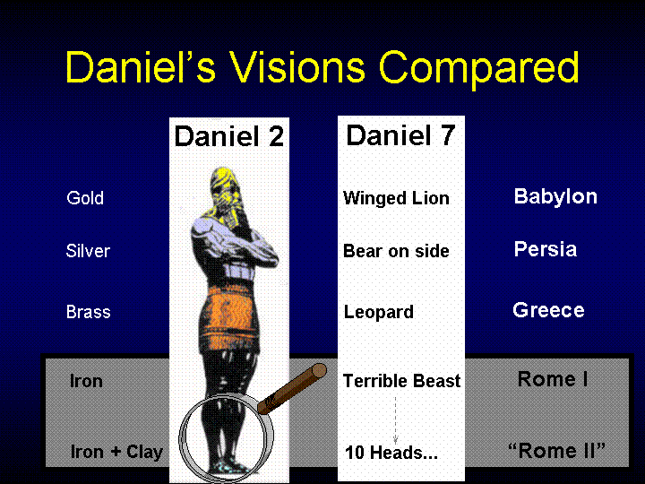

Slide 12
Here are the six events to be completed at the end of the 490 year period. (9:24)
1. “To Finish the Transgression.”
2. “To Make an End of Sin”
3. “To Make Atonement for Iniquity”
4. “To Bring in Everlasting Righteousness”
5. “To Seal Up Vision and Prophecy”
6. “To Anoint the most Holy”
Cross related
Deal with the removal of sin.
Deal with the bringing in of righteous-ness
Kingdom related

Slide 13

An Overview (9:24)
This program announced to Daniel covers a 490 year period of time.

Slide 14
Units of Seventy
70 x 7 Sabbatical Years Violated
Leviticus 25:1-7 Leviticus 26:33-43 II Chronicles 36:21
70 Years of Babylonian Captivity
Jeremiah 25:11-12 Jeremiah 29:10-14
70 x 7 Sabbatical Years Remaining
Daniel 9:24-27
490 years
490 years
Daniel’s Day
Past
Future

Slide 15
God’s Program for the First 69 Weeks. (9:25)
The 490 year period begins with the commandment to rebuild Jerusalem.
This commandment was given by King Artaxerxes on March 5, 444 BC (Nehemiah 2:1-8).

Slide 16
PHASE One - 69 Sevens 9:25
The initial part is made up of two time periods of: 49 years (7 sevens) + 434 years (62 sevens) = 483 years (or 69 sevens).
The 49 years refers to the time it took to rebuild Jerusalem.

Slide 17
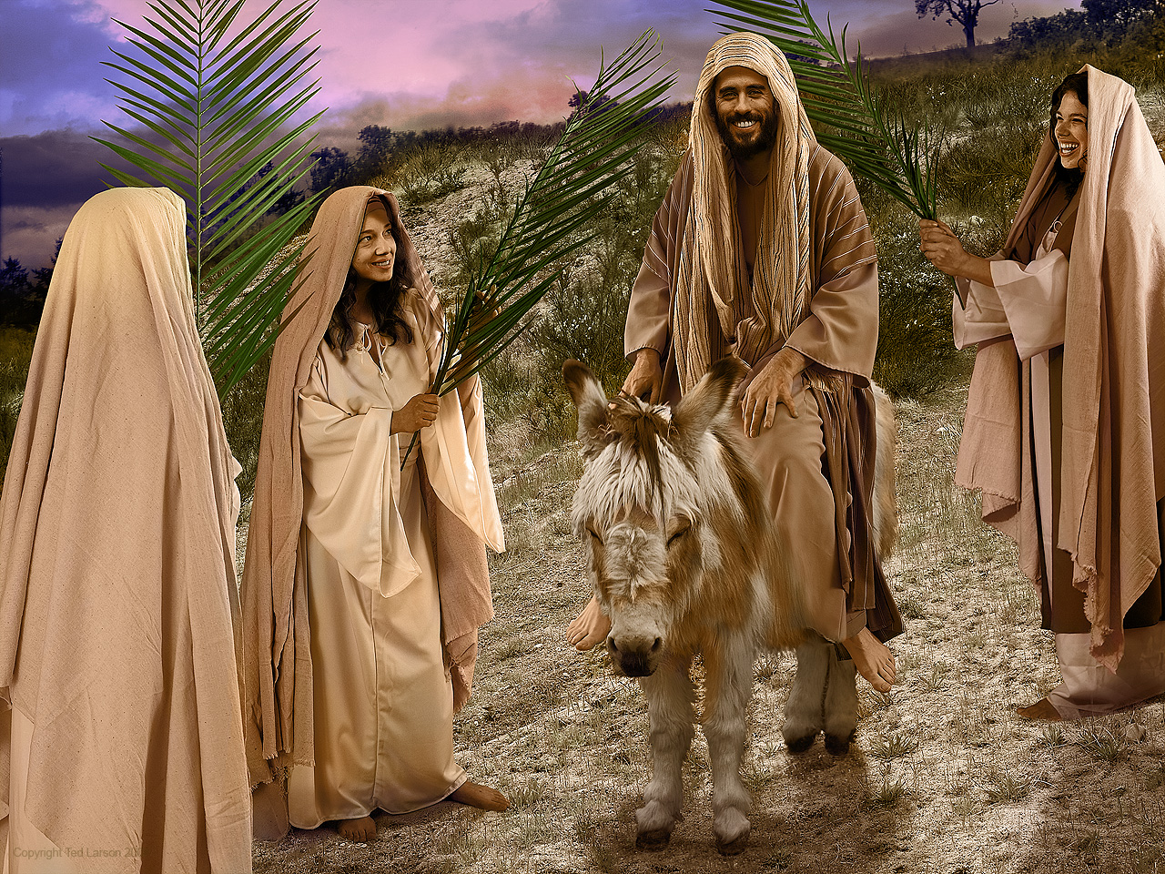
The 69 Sevens END
The first 483 years (69 sevens) ends with the coming of Messiah the Prince.
This coming of Messiah was fulfilled literally by the appearance of Jesus Christ at the Triumphal Entry on March 30, 33 AD (Luke 19:35-44).

Slide 18
Advanced math!!
From March 5, 444 BC to “Messiah” = 483 lunar years.
483 x 360 = 173,880 days
From 444 BC to AD 33 = 476 solar years
476 x 365 = 173,740 days + 116 “leap year” days + 24 days (March 5-30) =
173,880 days!!

Slide 19
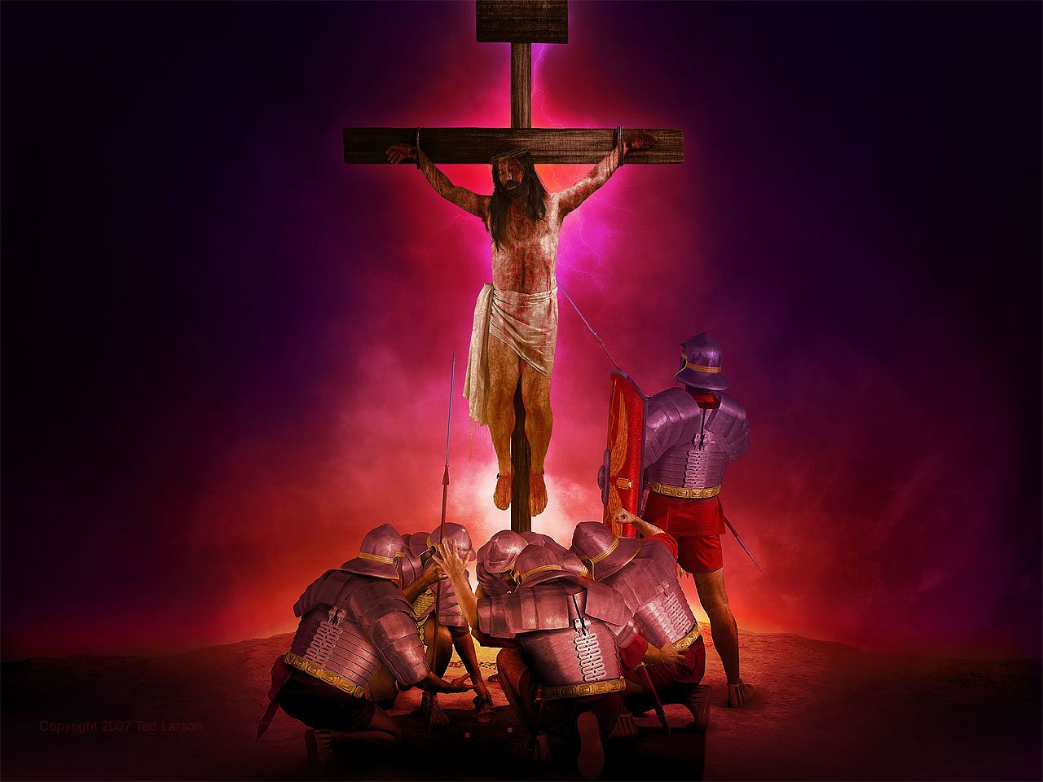
Note that this happens “after” the 69th week and not “in” the 70th week.

Slide 20
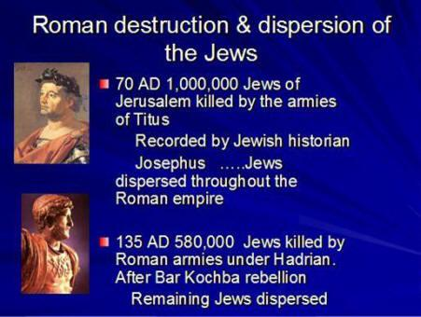
Titus
Hadrian

Slide 21
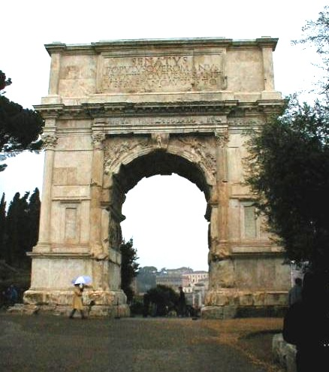
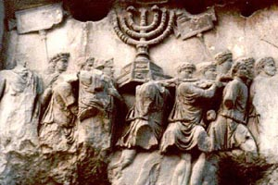
Left: The Arch of Titus in Rome commemorating the Roman destruction of Jerusalem in 70 AD.
Below: A picture on the Arch of Titus depicting the Romans carrying away the golden lampstand (or menorah) from the Temple.

Slide 22

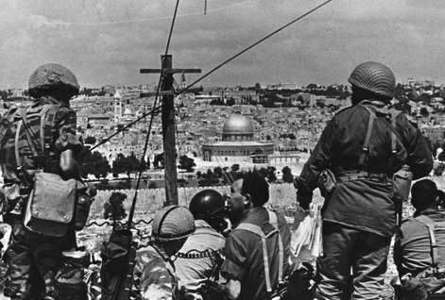
“..war will continue until the end..” 9:26

Slide 23

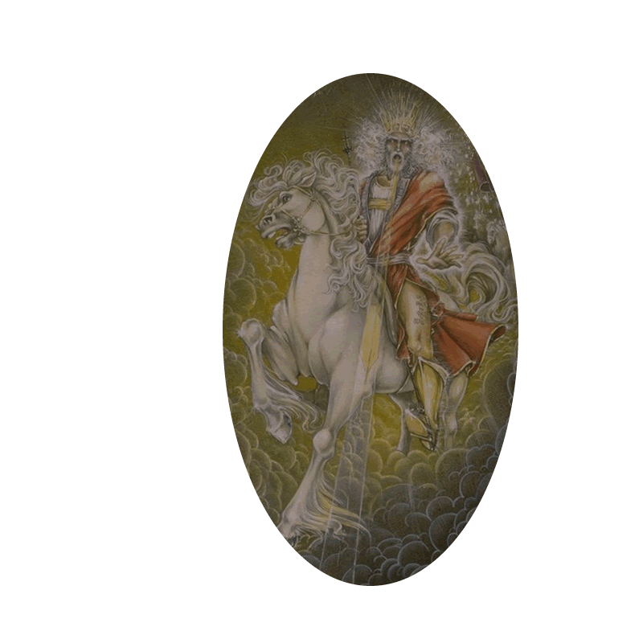
“Seventy weeks have been decreed….
The 70th Week
…New Heavens &
A New Earth!!
Gap:
Church Age
1900+ Years
1 Week
(7 Years)
31/2 31/2
1,000 Year
“Return to Eden”
…to bring in everlasting righteousness.”

Slide 24
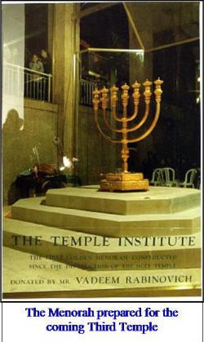
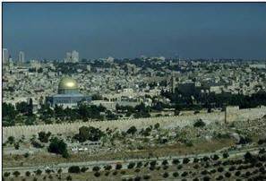
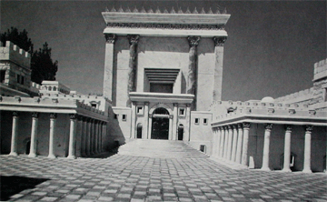
Today, the Islamic Dome of the Rock sits on Temple site in Jerusalem.
Design of future Jewish Temple

Slide 25

“Then he shall confirm a covenant with many for one week;
But in the middle of the week he shall bring an end to sacrifice and offering. And on the wing of abominations shall be one who makes desolate, even until the consummation, which is determined, is poured out on the desolate.”
Daniel 9:27

Slide 26
Daniel Chapter 9 Countdown to Armageddon

Slide 27
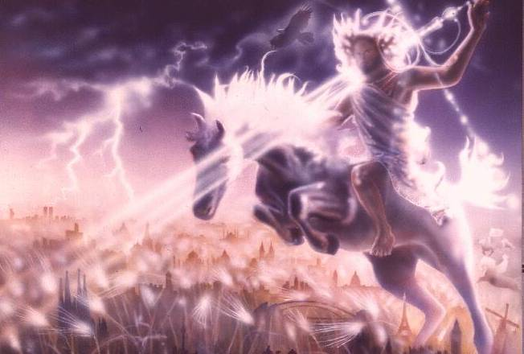
Even so come, Lord Jesus!

