Slide 1
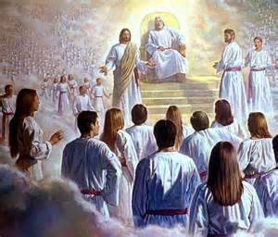
The Believer’s Hope in the Last Days
Daniel 7

Slide 2


Slide 3


Slide 4
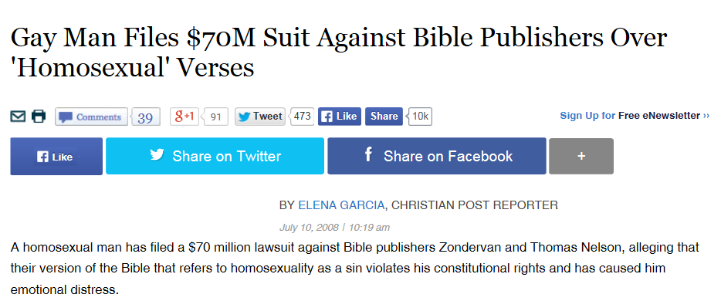

Slide 5


Slide 6


Slide 7


Slide 8
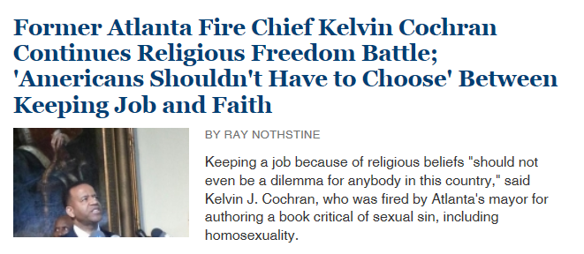

Slide 9


Slide 10
 | Daniel 2 | Daniel 7
King | Nebuchadnezzar (605-562 BC) | Belshazzar (553-539 BC)

Slide 11
 | Daniel 2 | Daniel 7
King | Nebuchadnezzar (605-562 BC) | Belshazzar (553-539 BC)
Age of Daniel | 20’s | 60’s

Slide 12
 | Daniel 2 | Daniel 7
King | Nebuchadnezzar (605-562 BC) | Belshazzar (553-539 BC)
Age of Daniel | 20’s | 60’s
Theme = Kingdoms | 2:28, 39, 44 | 7:17

Slide 13
 | Daniel 2 | Daniel 7
King | Nebuchadnezzar (605-562 BC) | Belshazzar (553-539 BC)
Age of Daniel | 20’s | 60’s
Theme = Kingdoms | 2:28, 39, 44 | 7:17
Image | Statue | 4 Beasts

Slide 14
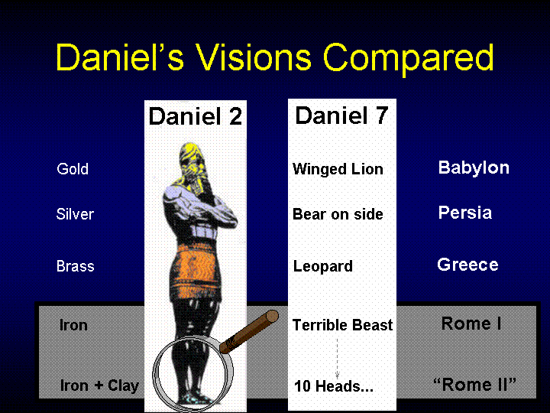

Slide 19
Where are we now?
Between Rome (200 BC-364 AD)
And Revived Roman Empire (Tribulation)
“Times of the Gentiles”

Slide 20
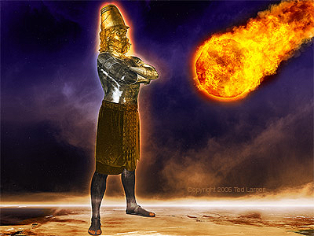

DANIEL
Babylon
Medo-Persia
Greece
Rome
(part 1)
Revived
Roman
Empire
(part 2)
Christ
as a
smashing
stone
4 Kingdoms of History (Daniel 2)
1,000 Year Kingdom | New Heavens and Earth
32AD CHURCH AGE
TRIBULATION
Israel | Babylon | Greece | Persia | Rome | EAST/WEST | Revived Rome
 |  |  |  |  | Rome/ Constantinople
 |  |  |  |  | USA/ Russia
Daniel 8
Daniel 8
605BC
The Times of the Gentiles…. Luke 21:24
Daniel
taken to
Babylon
(Daniel 1)
IMPERIALISM: STAGE 1
United Rome

Slide 21
DANIEL
Babylon
Medo-Persia
Greece
Rome
(part 1)
Revived
Roman
Empire
(part 2)
Christ
as a
smashing
stone
4 Kingdoms of History (Daniel 2)
1,000 Year Kingdom | New Heavens and Earth
32AD CHURCH AGE
TRIBULATION
Israel | Babylon | Greece | Persia | Rome | EAST/WEST | Revived Rome
 |  |  |  |  | Rome/ Constantinople
 |  |  |  |  | USA/ Russia
Daniel 8
Daniel 8
605BC
The Times of the Gentiles…. Luke 21:24
Daniel
taken to
Babylon
(Daniel 1)
IMPERIALISM: STAGE 2
Divided (East-West)

Slide 22
DANIEL
Babylon
Medo-Persia
Greece
Rome
(part 1)
Revived
Roman
Empire
(part 2)
Christ
as a
smashing
stone
4 Kingdoms of History (Daniel 2)
1,000 Year Kingdom | New Heavens and Earth
32AD CHURCH AGE
TRIBULATION
Israel | Babylon | Greece | Persia | Rome | EAST/WEST | Revived Rome
 |  |  |  |  | Rome/ Constantinople
 |  |  |  |  | USA/ Russia
Daniel 8
Daniel 8
605BC
The Times of the Gentiles…. Luke 21:24
Daniel
taken to
Babylon
(Daniel 1)
IMPERIALISM: STAGE 3
One-World Government

Slide 23
DANIEL
Babylon
Medo-Persia
Greece
Rome
(part 1)
Revived
Roman
Empire
(part 2)
Christ
as a
smashing
stone
4 Kingdoms of History (Daniel 2)
1,000 Year Kingdom | New Heavens and Earth
32AD CHURCH AGE
TRIBULATION
Israel | Babylon | Greece | Persia | Rome | EAST/WEST | Revived Rome
 |  |  |  |  | Rome/ Constantinople
 |  |  |  |  | USA/ Russia
Daniel 8
Daniel 8
605BC
The Times of the Gentiles…. Luke 21:24
Daniel
taken to
Babylon
(Daniel 1)
IMPERIALISM: STAGE 4
Ten Nation Confedarcy

Slide 24
DANIEL
Babylon
Medo-Persia
Greece
Rome
(part 1)
Revived
Roman
Empire
(part 2)
Christ
as a
smashing
stone
4 Kingdoms of History (Daniel 2)
1,000 Year Kingdom | New Heavens and Earth
32AD CHURCH AGE
TRIBULATION
Israel | Babylon | Greece | Persia | Rome | EAST/WEST | Revived Rome
 |  |  |  |  | Rome/ Constantinople
 |  |  |  |  | USA/ Russia
Daniel 8
Daniel 8
605BC
The Times of the Gentiles…. Luke 21:24
Daniel
taken to
Babylon
(Daniel 1)
IMPERIALISM: STAGE 5
Anti-Christ

Slide 25
Daniel 7 – New Details
7:5 Empire 2 – one nation stronger
7:7 Ten horns
7:7 Little horn (names for Anti-Christ)
7:9-11 Ancient of Days Subdues the Anti-Christ
Beast thrown into Blazing Fire
7:13-14 Ancient of Days establishes eternal kingdom
7:18 Saints will receive the Kingdom
7:21 Anti-Christ wages war against the saints
7:25 Three and a half years of persecution

Slide 26
Who Will Rescue Us from Trouble?
2 Cor 1:9-10
Rev 6:9-10

