Slide 1
The Nations in Prophecy
Daniel 2

Slide 2


“While all biblical prophetic passages make a unique contribution, there are three main sections of the Bible that contain the essential keys to understanding the future. These three sections are 1) the book of Daniel, 2) the Oliver discourse (Matt 24), and 3) the book of Revelation.” “The End,” 61
Mark Hitchcock,
Author,
Pastor of Faith Bible Church, Edmond, Oklahoma

Slide 3
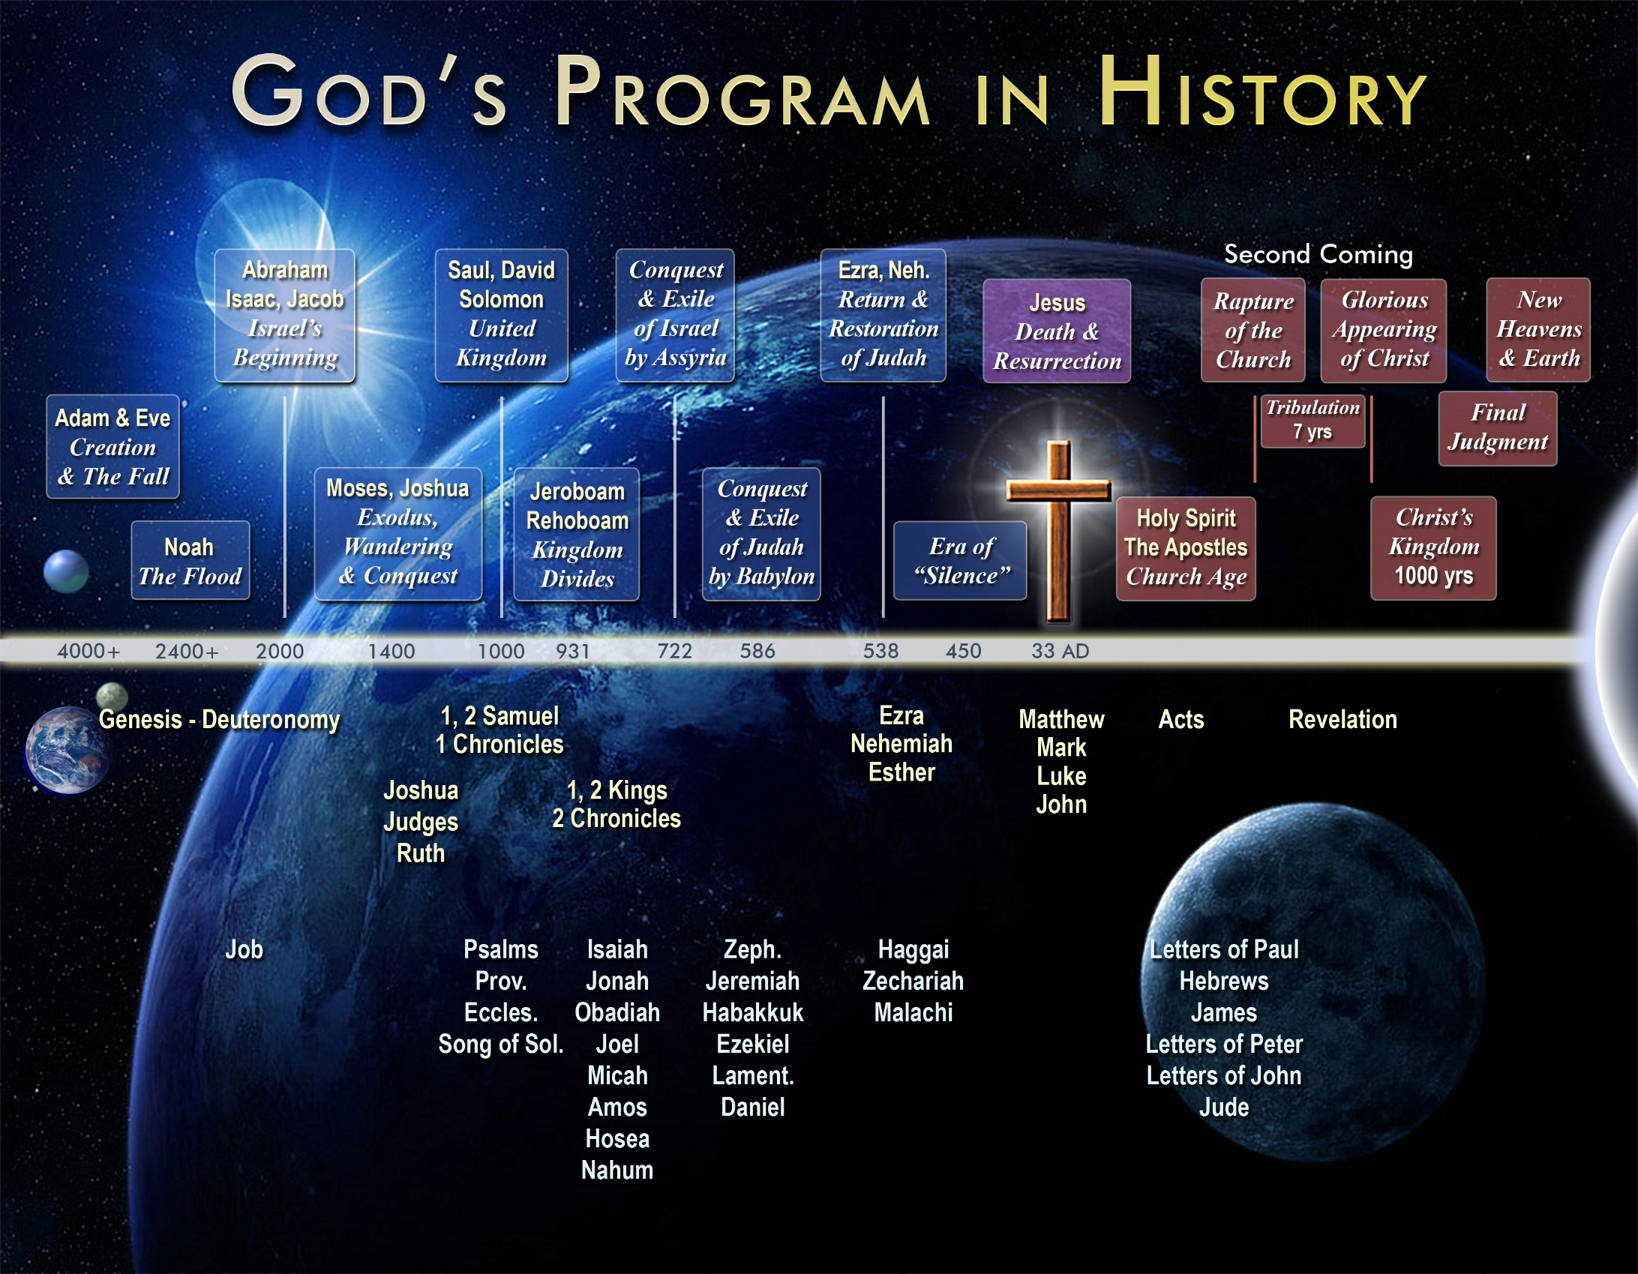

Slide 4
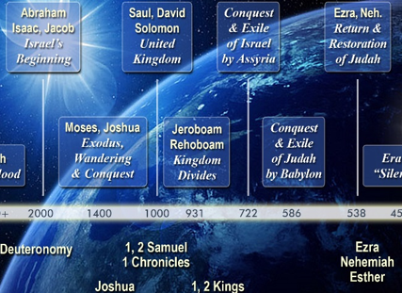

Slide 5

DANIEL
2nd Coming of Christ
Restoration of Israel
4 Kingdoms of History (Daniel 2)
32AD CHURCH AGE
Israel | Babylon | Greece | Persia | Rome | PAPAL | Revived Rome
 |  |  |  |  | Port, Spain, Eng
 |  |  |  |  | USA, EU
Daniel 8
Daniel 8
The Times of the Gentiles…. Luke 21:24
605BC
Daniel
taken to
Babylon
(Daniel 1)

Slide 6
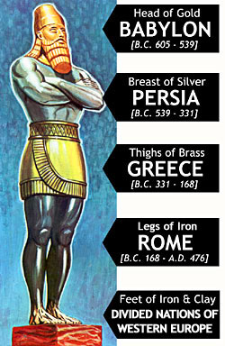
Nebuchadnezzar’s Vision
Daniel 2

Slide 7
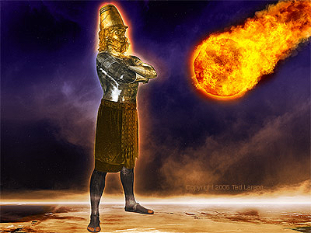
DANIEL
Babylon
Medo-Persia
Greece
Rome
(part 1)
Revived
Roman
Empire
(part 2)
Christ
as a
smashing
stone
4 Kingdoms of History (Daniel 2)
1,000 Year Kingdom | New Heavens and Earth
32AD CHURCH AGE
TRIBULATION
Israel | Babylon | Greece | Persia | Rome | PAPAL | Revived Rome
 |  |  |  |  | Port, Spain, Eng
 |  |  |  |  | USA, EU
Daniel 8
Daniel 8
The Times of the Gentiles…. Luke 21:24
605BC
Daniel
taken to
Babylon
(Daniel 1)

Slide 8
Christ
Psalm 118:22
Isaiah 8:14
Matt 21:42
Eph 2:20-22
1 Peter 2:4-8
“The Stone which the builders rejected”

Slide 9


Skeptics Reject Early Date for Daniel
Dr. John C Whitcomb,
In 1959

Slide 10
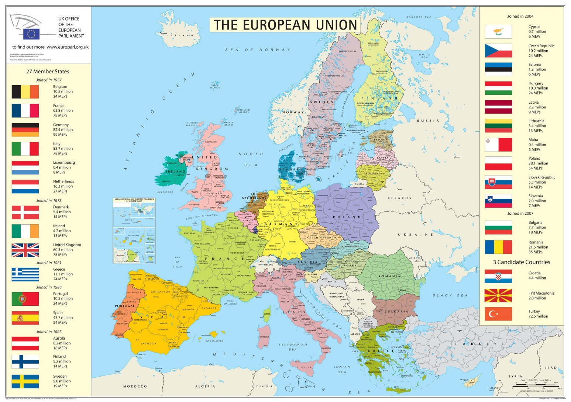

Slide 11
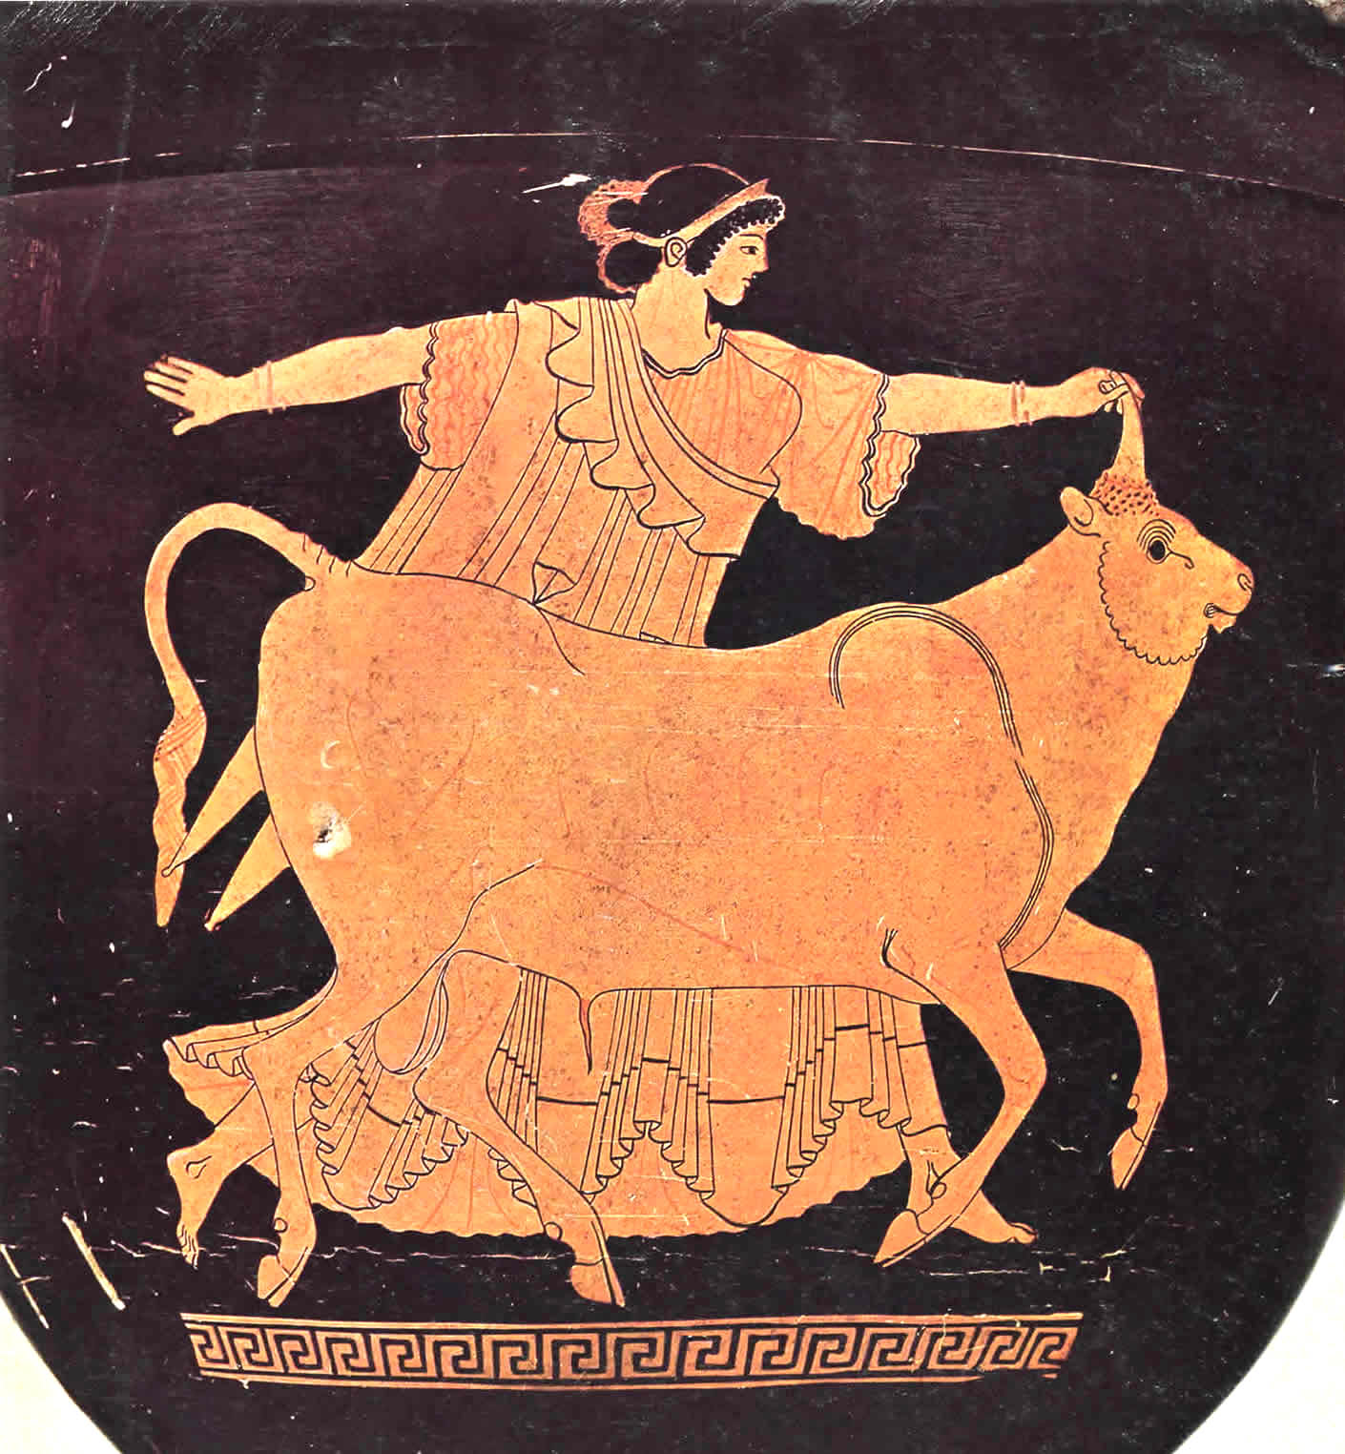
Europa (Greek), Semiramis (Babylonian)

Slide 12

Symbols for the EU

Slide 13
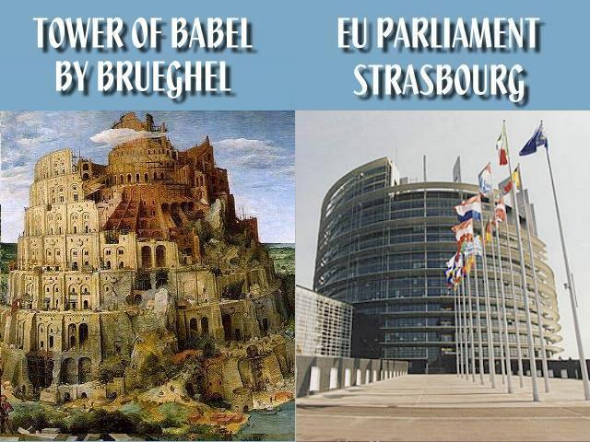

Slide 14
The Nations in Prophecy
Daniel 2

Slide 15
DANIEL
Babylon
Medo-Persia
Greece
Rome
(part 1)
Revived
Roman
Empire
(part 2)
Christ
as a
smashing
stone
4 Kingdoms of History (Daniel 2)
1,000 Year Kingdom | New Heavens and Earth
32AD CHURCH AGE
TRIBULATION
Israel | Babylon | Greece | Persia | Rome | PAPAL | Revived Rome
 |  |  |  |  | Port, Spain, Eng
 |  |  |  |  | USA, EU
Daniel 8
Daniel 8
The Times of the Gentiles…. Luke 21:24
605BC
Daniel
taken to
Babylon
(Daniel 1)

