Slide 1
Faith and Freedom
The Christian Faith:
Source of America’s Freedoms

Slide 2
America’s Freedom and Greatness is built upon a Christian Foundation

Slide 3
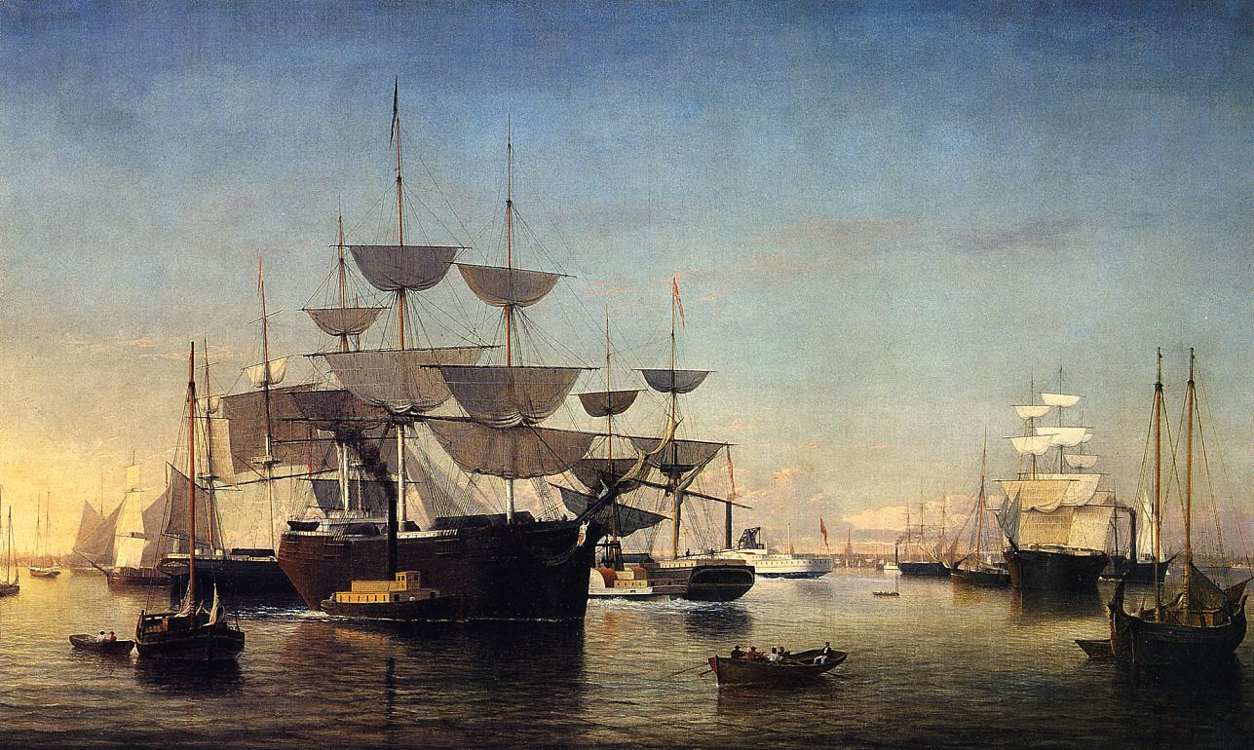
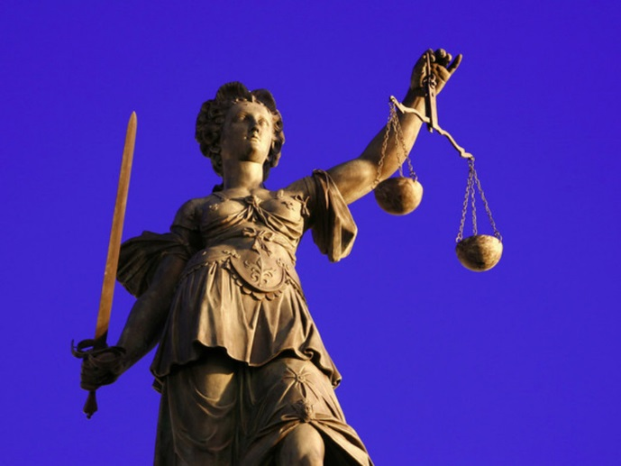

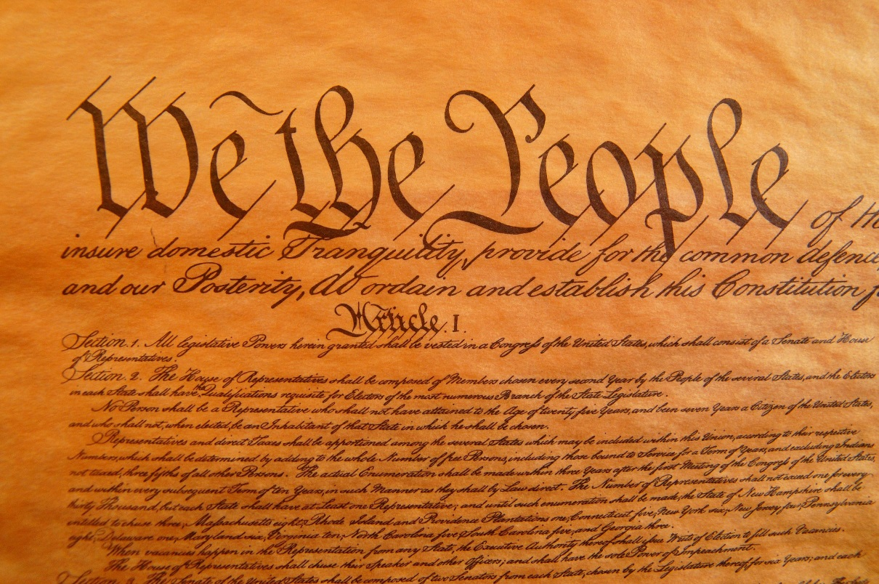
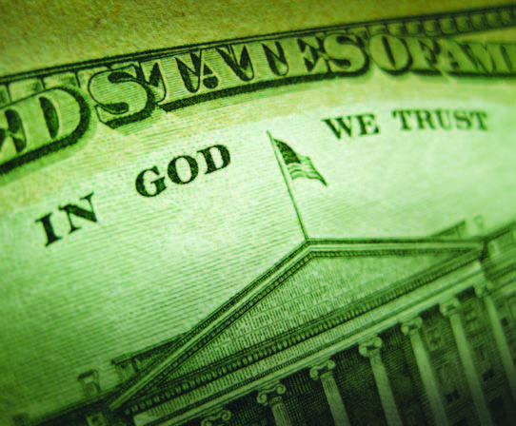

Slide 4
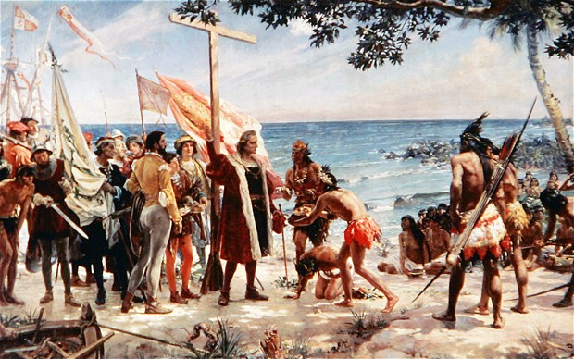

Slide 5
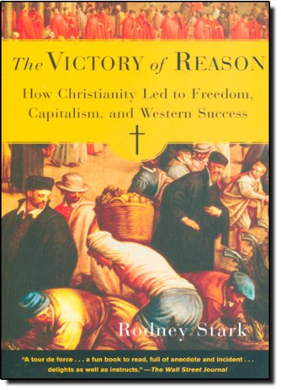

Slide 6
Rodney Stark
“How had the nations that had arisen from the rubble of Rome so greatly surpassed the rest of the world?.... The most convincing answer to those questions attributes Western dominance to the rise of capitalism, which took place only in Europe....

Slide 7
Rodney Stark
Capitalism achieved that miracle through regular reinvestment to increase productivity, either to create greater capacity or improve technology, and by motivating both management and labor through ever-rising payoffs

Slide 8
Rodney Stark
But, if one digs deeper, it becomes clear that the truly fundamental basis not only for capitalism, but for the rise of the West, was an extraordinary faith in reason...... from early days, the church fathers taught that reason was the supreme gift from God and the means to progressively increase understanding of Scripture and revelation....

Slide 9
Rodney Stark
Encouraged by the scholastics and embodied in the great medieval universities founded by the church, faith in the power of reason infused Western culture, stimulating the pursuit of science and the evolution of democratic theory and practice”

Slide 10
Rodney Stark
18th-century political theorists as John Locke explicitly rested on egalitarian axioms derived by church scholars... from earliest days, the major theologians taught that faith in reason was intrinsic to faith in God.

Slide 11
Rodney Stark
As ... Tertullian instructed in the second century, “Reason is a thing of God, inasmuch as there is nothing which God the Maker of all has not provided, disposed, ordained by reason—nothing which He has not willed should be handled and understood by reason.”

Slide 12
Rodney Stark
Consequently it was assumed that reason held the key to progress in understanding scripture, and that knowledge of God and the secrets of his creation would increase over time....

Slide 13
Rodney Stark
Augustine went on at length about the “wonderful—one might say stupefying—advances human industry has made.” All were attributed to the “unspeakable boon” that God has conferred upon his creation, a “rational nature.”

Slide 14
America’s Freedom and Greatness is built upon a Christian Foundation
Advances in economics and personal freedom rooted in Reason
Reason stemmed from a quest to know God’s world and Word

Slide 15
America’s Freedom and Greatness is Diminishing as We Reject our Faith in God

Slide 16
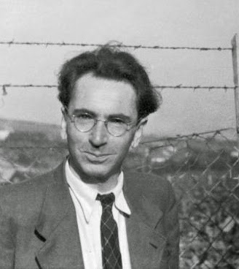
True Freedom is based on a proper understanding of things as they really are
“If we present man with a concept of man which is not true, we may well corrupt him. When we present him as an automation of reflexes, as a mind-machine, as a bundle of instincts, as a pawn of drives and reactions, as a mere product of instincts, heredity, and environment,
Victor Frankl, MD, PhD, Holocaust survivor

Slide 17
True Freedom is based on a proper understanding of things as they really are
we feed the despair to which man is, in any case, already prone. I became acquainted with the last stages of corruption in my second concentration camp in Auschwitz.
Victor Frankl, MD, PhD, Holocaust survivor

Slide 18
True Freedom is based on a proper understanding of things as they really are
The gas chambers of Auschwitz were the ultimate consequence of the theory that man is nothing but the product of heredity and environment—or, as the Nazis liked to say, of ‘Blood and Soil.’
Victor Frankl, MD, PhD, Holocaust survivor

Slide 19
True Freedom is based on a proper understanding of things as they really are
I am absolutely convinced that the gas chambers of Auschwitz, Treblinka, and Maidanek were ultimately prepared not in some Ministry or other in Berlin, but rather at the desks and in the lecture halls of nihilistic scientists and philosophers.”
Victor Frankl, MD, PhD, Holocaust survivor

Slide 20
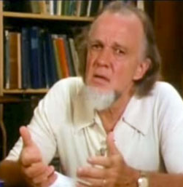
America has been loosing its freedom for a long time
I believe the majority of the silent majority, young and old, will sustain the loss of liberties without raising their voices as long as their own life-styles are not threatened.
Francis Schaeffer, 1976

Slide 21
America has been loosing its freedom for a long time
And since personal peace and affluence are so often the only values that count with the majority, politicians know that to be elected they must promise these things.
Francis Schaeffer, 1976

Slide 22
America has been loosing its freedom for a long time
Politics has largely become not a matter of ideals - increasingly men and women are not stirred by the values of liberty and truth - but of supplying a constituency with a frosting of personal peace and affluence.
Francis Schaeffer, 1976

Slide 23
America has been loosing its freedom for a long time
They know that voices will not be raised as long as people have these things, or at least an illusion of them.
Francis Schaeffer, 1976

Slide 24
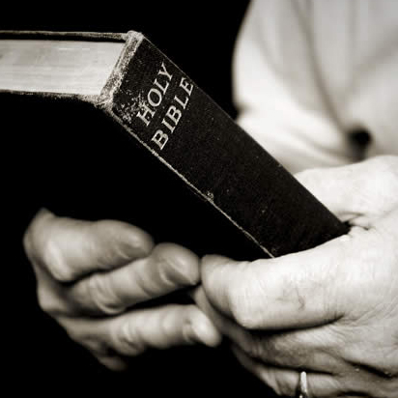
True freedom is based on the knowledge of God
“The fear of the Lord is the beginning of wisdom; all those who practice it have a good understanding. (Psalm 111:10)

Slide 25
True freedom is based on the knowledge of God
“The fear of the Lord is the beginning of wisdom, and the knowledge of the Holy One is insight.” (Proverbs 9:10, ESV)

Slide 26
Without it’s Christian foundation, freedom becomes chaos, chaos become anarchy, and anarchy leads to despotism.

Slide 27
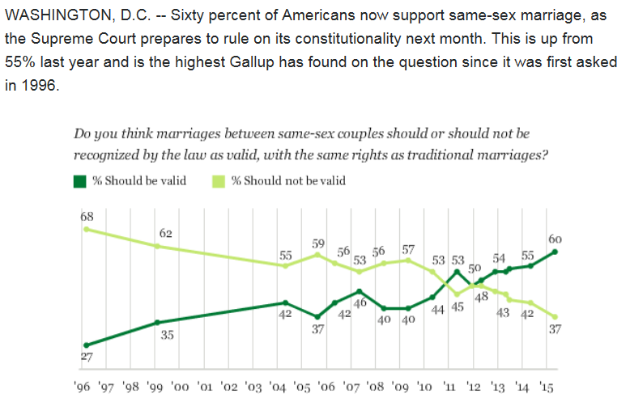
SOURCE: Gallop, 2015

Slide 28
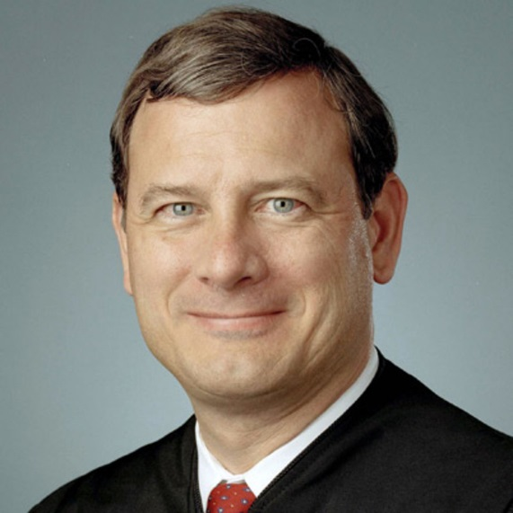
Freedom to Chaos
“The majority’s decision is an act of will, not legal judgment. The right it announces has no basis in the Constitution or this Court’s precedent.
John Roberts, Chief Justice

Slide 29
Freedom to Chaos
As a result, the Court invalidates the marriage laws of more than half the States and orders the transformation of a social institution that has formed the basis of human society for millennia, for the Kalahari Bushmen and the Han Chinese, the Carthaginians and the Aztecs. Just who do we think we are?
John Roberts, Chief Justice

Slide 30
God’s Verdict is Clear
“You shall not lie with a male as with a woman; it is an abomination.” (Leviticus 18:22, ESV)

Slide 31
God’s Verdict is Clear
“Or do you not know that the unrighteous will not inherit the kingdom of God? Do not be deceived: neither the sexually immoral, nor idolaters, nor adulterers, nor men who practice homosexuality, nor thieves, nor the greedy, nor drunkards, nor revilers, nor swindlers will inherit the kingdom of God.” (1 Corinthians 6:9–10, ESV)

Slide 32
God’s Verdict is Clear
“just as Sodom and Gomorrah and the surrounding cities, which likewise indulged in sexual immorality and pursued unnatural desire, serve as an example by undergoing a punishment of eternal fire. Yet in like manner these people also, relying on their dreams, defile the flesh, reject authority, and blaspheme the glorious ones.” (Jude 7–8, ESV)

Slide 33
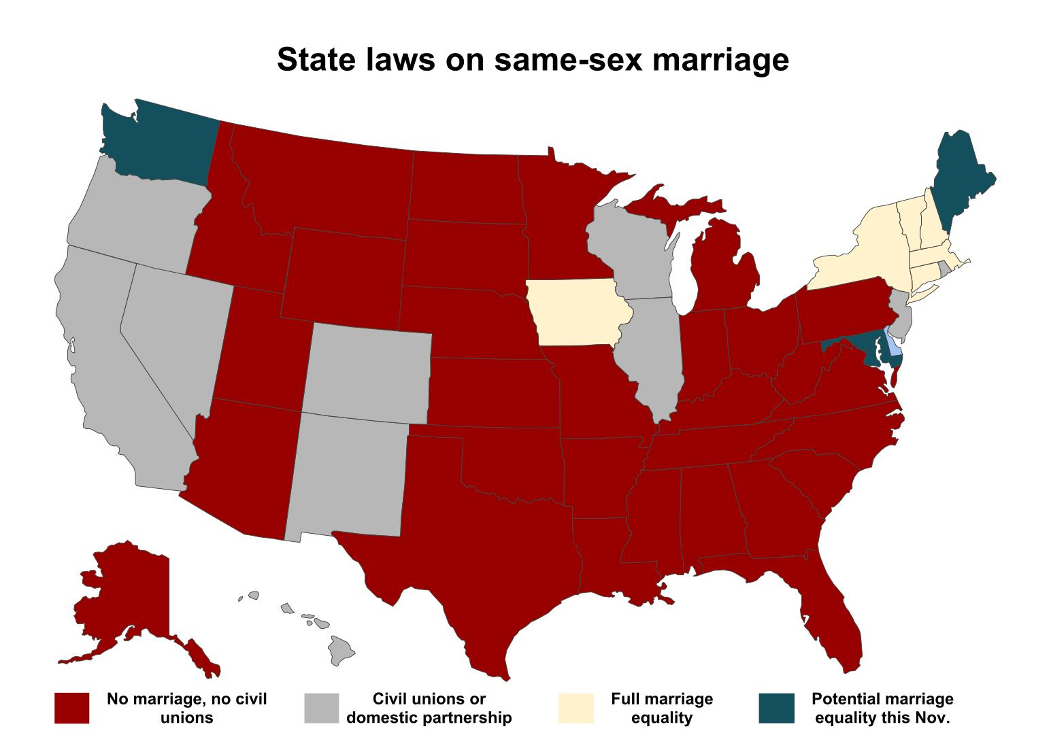
The World Distorts or Ignores the Facts

Slide 34
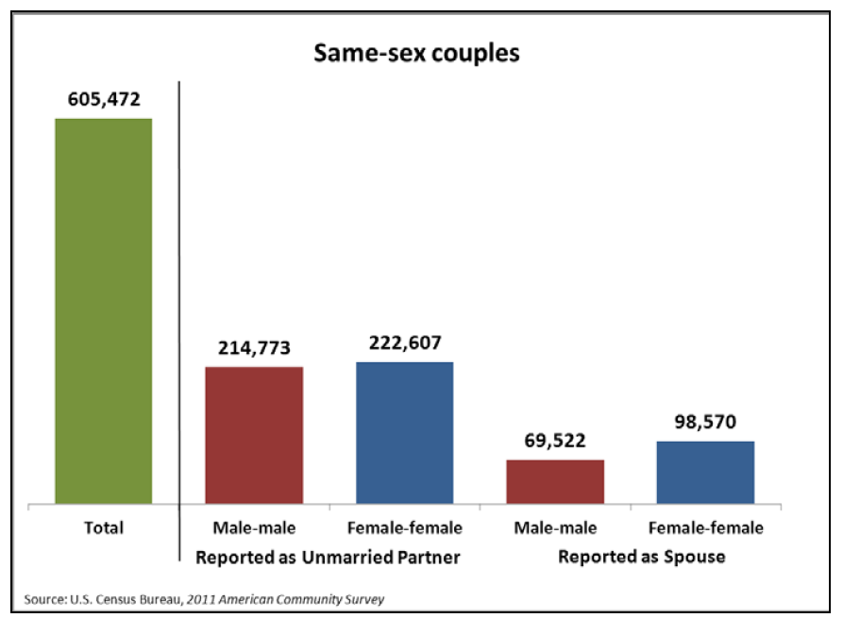
SOURCE: US Census, 2010

Slide 35
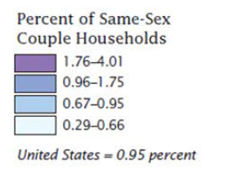
SOURCE: US Census, 2010

Slide 36
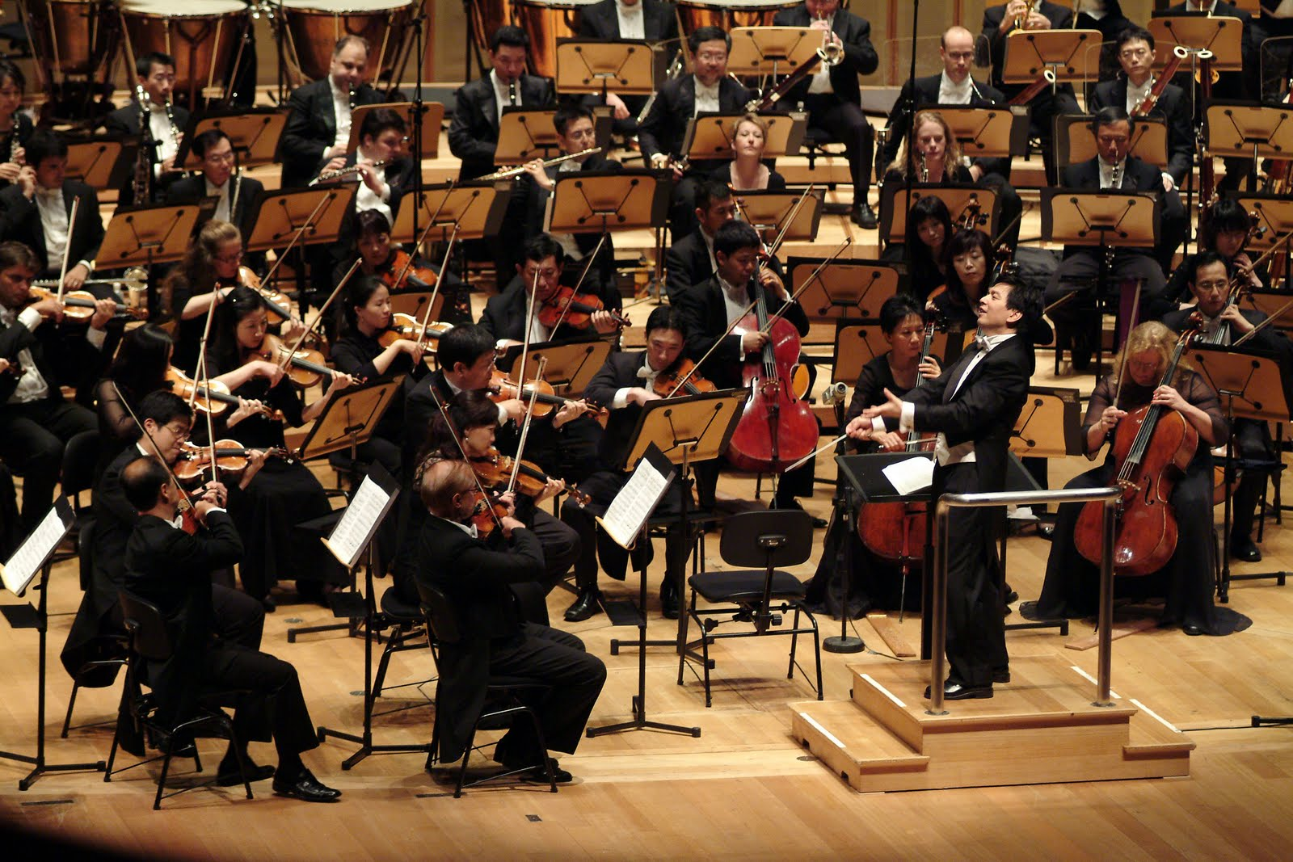

Slide 37
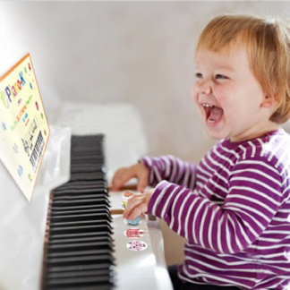

Slide 38
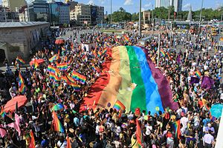
Chaos to Anarchy

Slide 39
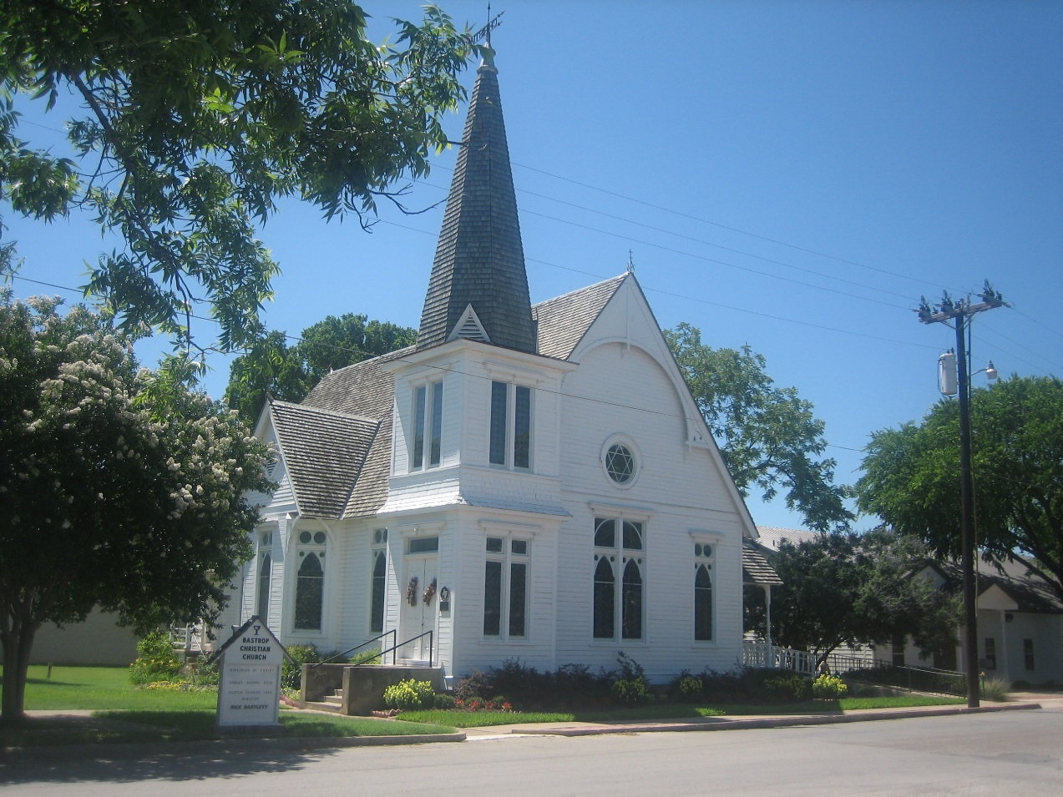
Loss of Religious Freedom

Slide 40
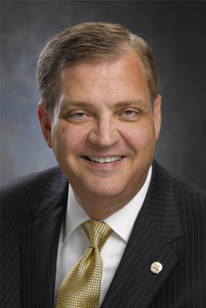
Chaos to Anarchy
Assurances to the contrary, the majority in this decision has placed every religious institution in legal jeopardy if that institution intends to uphold its theological convictions limiting marriage to the union of a man and a woman
Al Mohler,
Southern Baptist Seminary

Slide 41
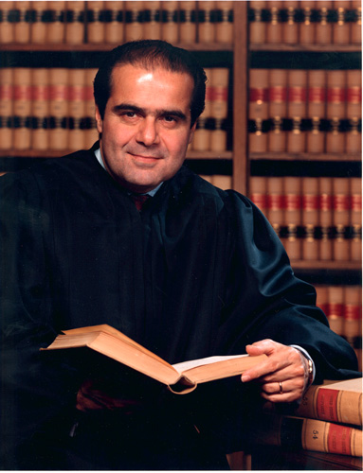
Chaos to Anarchy
“Today’s decree says that my Ruler, and the Ruler of 320 million Americans coast-to-coast, is a majority of the nine lawyers on the Supreme Court,
Justice Anthony Scalia

Slide 42
Chaos to Anarchy
This practice of constitutional revision by an unelected committee of nine, always accompanied (as it is today) by extravagant praise of liberty, robs the People of the most important liberty they asserted in the Declaration of Independence and won in the Revolution of 1776: the freedom to govern themselves.
Justice Anthony Scalia

Slide 43
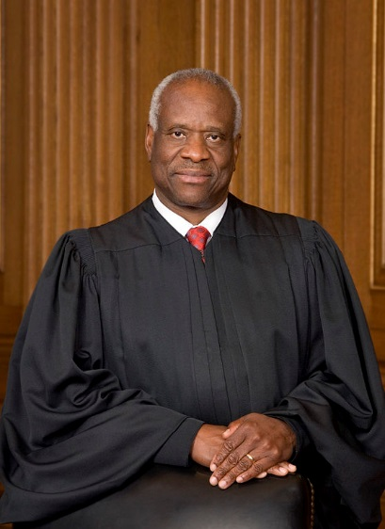
Chaos to Anarchy
The majority’s inversion of the original meaning of liberty will likely cause collateral damage to other aspects of our constitutional order that protect liberty.
Justice Clarence Thomas

Slide 45
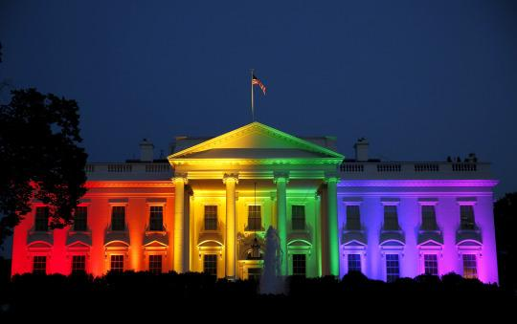
The White House, June 26, 2015

Slide 46
Response
Speak Truth
  Compassionately
  Correctly
  Courageously
Pray for Christ’s Return
Prepare for the next generation
Stay faithful!

