Slide 1
The Abrahamic Covenant:
Framework for
Redemption
Genesis 12:1-3

Slide 2
God’s Plan for Redemption
. “For in him all the fullness of God was pleased to dwell, and through him to reconcile to himself all things, whether on earth or in heaven, making peace by the blood of his cross.” (Colossians 1:19–20, ESV)

Slide 3
Early Prophecies
Jude 14-15
Job 19:25-27

Slide 4

People
Place
Law

Slide 5
RESTORING THAT WHICH WAS LOST
SEED
OF
THE
WOMAN
“SALVATION” = THE RESTORING OF ALL THAT WAS LOST IN EDEN
SEED
OF
ABE.
RESTORE &
RECONCILE
LINE
OF
DAVID
JESUS
Paul Benware – Used by Permission

Slide 6
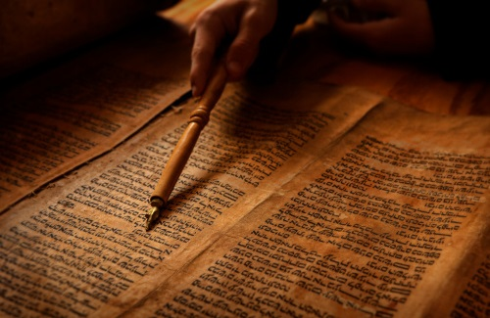
Defining Chapter of the OT?

Slide 7
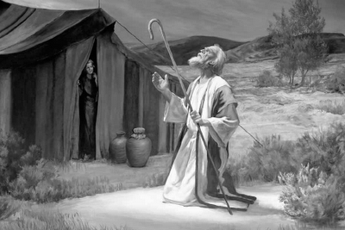
God’s Covenant with Abraham
People
Place
Promise

Slide 8
God’s Covenant with Abraham
Eternal
Unconditional

Slide 9
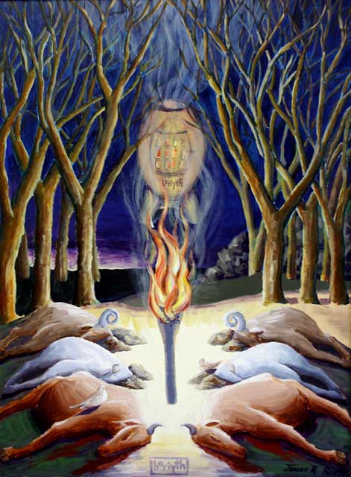

Slide 10
God’s Covenants with Israel
Promises
Made
Paul Benware – Used by Permission
Land
Covenant
Deut. 28
Promises
Fulfilled
Abrahamic
Covenant
Genesis 12
Davidic
Covenant
2 Sam. 7
Mosaic
Law Code
Ex. 20; Gal. 3
New
Covenant
Jer. 31
Formation
of Israel
Resto-
ration
Theocracy
Monarchy
Church Trib
Kingdom
Exile
Old Testament
New Testament

