Slide 1
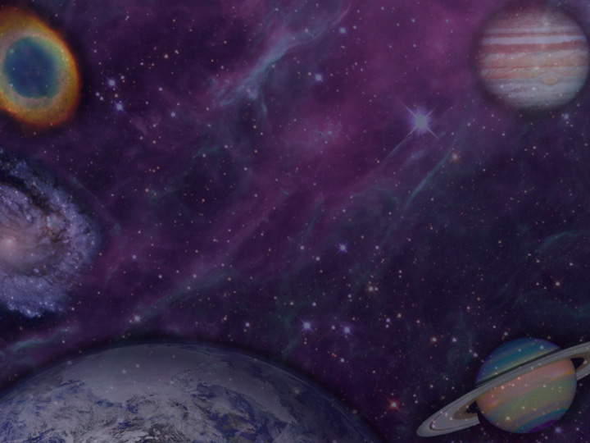
The First and
Greatest Prophesy
Genesis 3:!5

Slide 2
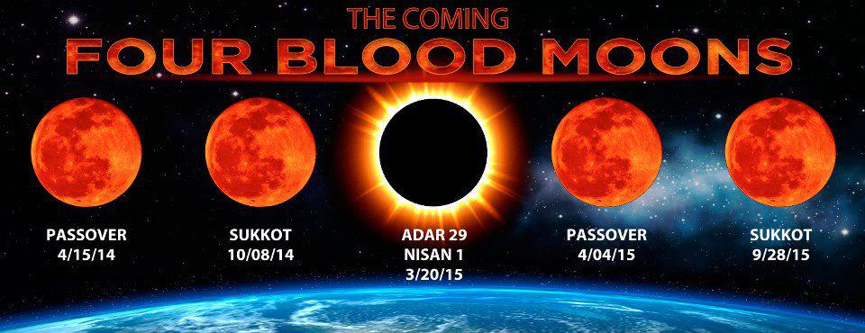




Slide 3
The First and
Greatest Prophesy
Genesis 3:!5

Slide 4
Genesis 3:15
Redemption:
The Central Theme of Prophesy

Slide 5

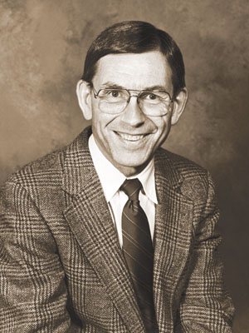

Slide 6
1 Timothy 1:17

Slide 7
Matthew 22:30; Hebrews 1:13-14

Slide 8
2 Samuel 14:20

Slide 9
Genesis 10:1-2

Slide 10
2 Peter 2:10-11

Slide 11
Genesis 19:1; Matthew 24:36

Slide 12
Daniel 10:13
Ephesians 1:21
Colossians 1:16

Slide 13
Daniel 7:10; Hebrews 12:22;
Revelation 5:11

Slide 14
Genesis 1:26, 28
Psalm 8:3-9

Slide 15
Genesis 2:7

Slide 16
Genesis 1:26-28

Slide 17
Genesis 1:31

Slide 18

Genesis 3:15
“I will put enmity between you and the woman, and between your offspring and her offspring; he shall bruise your head, and you shall bruise his heel.”

Slide 19
Genesis 3:15
Jesus Christ:
The Central Figure of Prophesy

Slide 20
Genesis 3:15
The Means by Which Redemption Would
Take Place

Slide 21
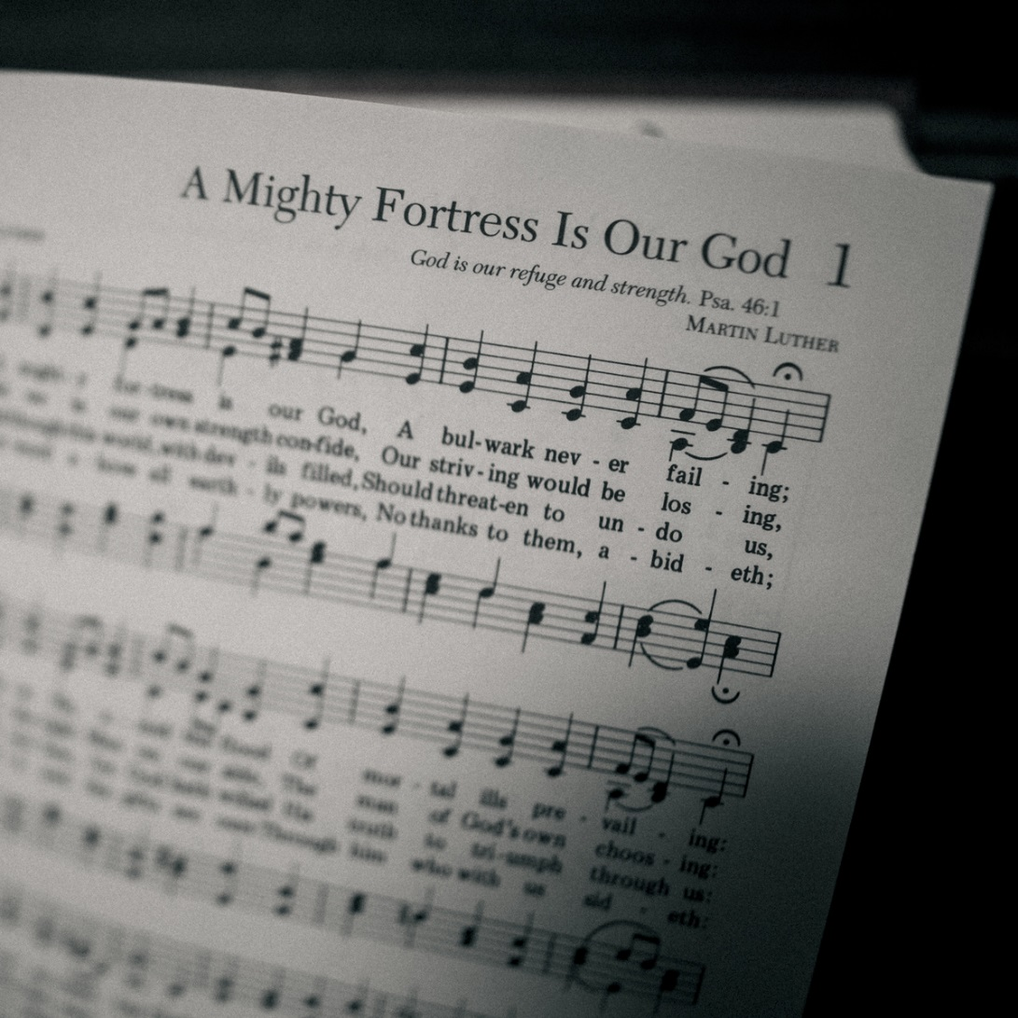

Slide 22


Slide 23
Genesis 3:15
The Grand Story of Humanity

