Slide 1

Should We All Be
PREPPERS?

Slide 2


Slide 3
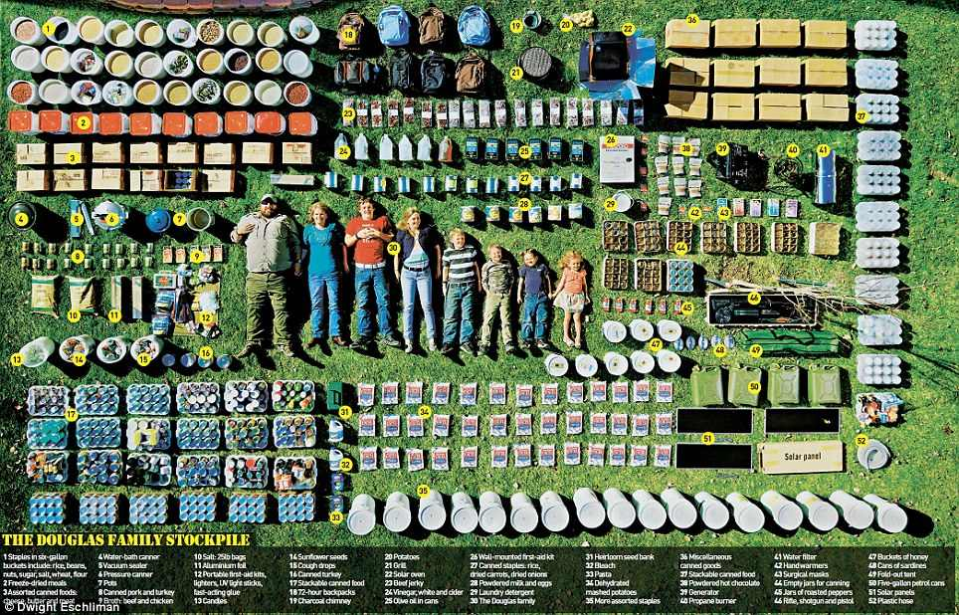

Slide 4
Should We All Be
PREPPERS?

Slide 5
Warnings Against FEAR
2 Timothy 1:7
Financial Gain. Acts 8:18-21; 1 Peter 5:2

Slide 6
Prepping Draws us Away from the Sufficiency and Beauty of Christ
We are liberated from focusing on earthly things. Mat 6:19-20
Confidence in wealth will always disappoint.
Seek to win people to heaven, not prolong life on earth

Slide 7
Godly Living Always Leaves us Prepared without Fear
Honor God. 1 Samuel 2:30
Guard your Heart. 1 Samuel 16:7
Be Content. Hebrews 13:5
Avoid/ Escape Debt. Prov 22:7; Rom 13:8
Save for yourself and others. 2 Cor 12:14; Prov 30:25
Keep God First in Finances
  Hag 2:5-8
  Mal 3:10
  2 Cor 9:6-7

