Slide 1
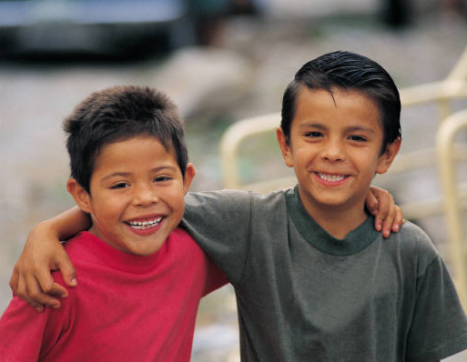
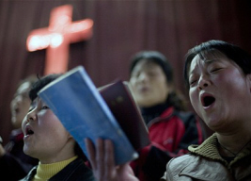


Jesus Christ
Disciple-Maker
How Does a Church
Make Disciples?
Acts 1:1-8

Slide 2
Review
How Jesus Made Disciples
What is a Disciple?
How Can I Make Disciples?
  Understand the instructions (Great Commission)
  Look for examples

Slide 3
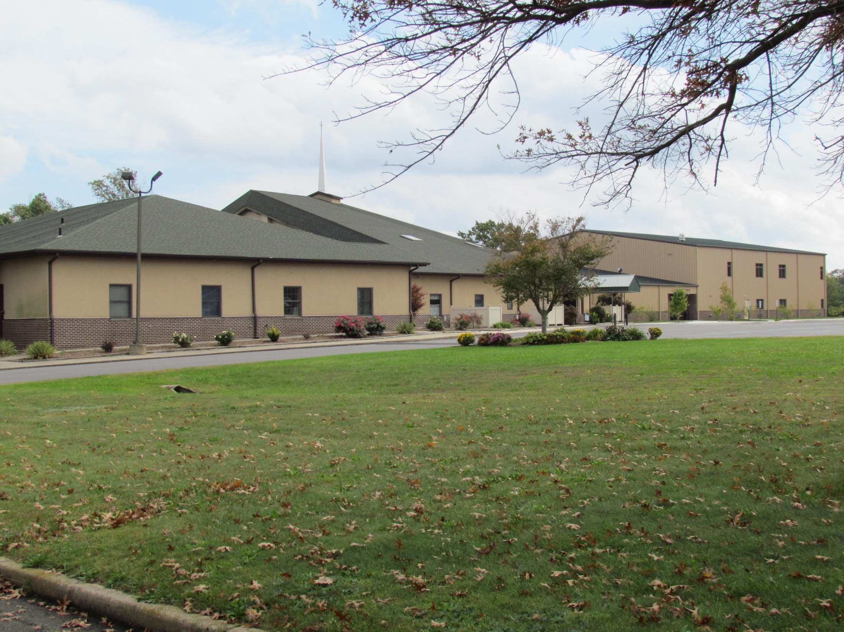
How Does a Church
Make Disciples?

Slide 4
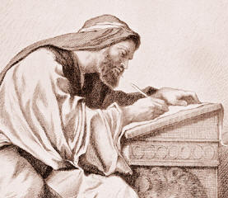
Corporate, Intentional
Matthew 28:19-20
Acts 1:1-8

Slide 5
“The book of Acts makes it very clear that the disciples took on the primary leadership role in the early church as apostles…and their mission, in turn, becomes the church's mission. What Jesus gave to them as disciples, he gives to all his disciples
Aubrey Malphurs, Strategic Disciple Making, p. 16

Slide 6

Preaching
Eph 4:11-13
1 Cor 4:17

Slide 7

Personal Faithfulness

Slide 8
Christian Home
2 Tim 1:5-6
Evangelism
Teaching
Fellowship
Worship
Prayer
Family: We are passionate about strengthening our children and young people to become mature Disciples of Christ.

Slide 9
 | Infant | Toddler | 3-4 yrs | 5 yrs | 1-2 grd | 3-4 grd | 5th grd
Sun Sch | 2 adults | 2 adults | 3 x 3 6 of 9 -3 | 3 x 2 6 of 6 | 3 x 2 4 of 6 -2 | 3 x 2 4 of 6 -2 | 2 x 1 1 of 2 -1

Slide 10
 | Infant | Toddler | 3-4 yrs | 5 yrs | 1-2 grd | 3-4 grd | 5th grd
Sun Sch | 2 adults | 2 adults | 3 x 3 6 of 9 -3 | 3 x 2 6 of 6 | 3 x 2 4 of 6 -2 | 3 x 2 4 of 6 -2 | 2 x 1 1 of 2 -1
AM Wor | 2 adults 1 teen | 2 adults 1 teen | 3 x 3 8 of 9 -1 | 3 x 3 9 of 9 | 3 x 2 4 of 6 -2

Slide 11
 | Infant | Toddler | 3-4 yrs | 5 yrs | 1-2 grd | 3-4 grd | 5th grd
Sun Sch | 2 adults | 2 adults | 3 x 3 6 of 9 -3 | 3 x 2 6 of 6 | 3 x 2 4 of 6 -2 | 3 x 2 4 of 6 -2 | 2 x 1 1 of 2 -1
AM Wor | 2 adults 1 teen | 2 adults 1 teen | 3 x 3 8 of 9 -1 | 3 x 3 9 of 9 | 3 x 2 4 of 6 -2
PM Wor | 2 adults |  | 3 x 3 2 of 6 -4 ! | 3 x 2 4 of 6 -2 | 3 x 2 6 of 6

Slide 12
 | Infant | Toddler | 3-4 yrs | 5 yrs | 1-2 grd | 3-4 grd | 5th grd
Sun Sch | 2 adults | 2 adults | 3 x 3 6 of 9 -3 | 3 x 2 6 of 6 | 3 x 2 4 of 6 -2 | 3 x 2 4 of 6 -2 | 2 x 1 1 of 2 -1
AM Wor | 2 adults 1 teen | 2 adults 1 teen | 3 x 3 8 of 9 -1 | 3 x 3 9 of 9 | 3 x 2 4 of 6 -2
PM Wor | 2 adults |  | 3 x 3 2 of 6 -4 ! | 3 x 2 4 of 6 -2 | 3 x 2 6 of 6
Wed | 2 adults |  | 2 x 2 H Bees 3 of 4 -1 | 2 x 3 Gophers 3 of 6 -3 | 10 Olympian Leaders 8 of 10 -2

Slide 13
 | Infant | Toddler | 3-4 yrs | 5 yrs | 1-2 grd | 3-4 grd | 5th grd
Sun Sch | 2 adults | 2 adults | 3 x 3 6 of 9 -3 | 3 x 2 6 of 6 | 3 x 2 4 of 6 -2 | 3 x 2 4 of 6 -2 | 2 x 1 1 of 2 -1
AM Wor | 2 adults 1 teen | 2 adults 1 teen | 3 x 3 8 of 9 -1 | 3 x 3 9 of 9 | 3 x 2 4 of 6 -2
PM Wor | 2 adults |  | 3 x 3 2 of 6 -4 ! | 3 x 2 4 of 6 -2 | 3 x 2 6 of 6
Wed | 2 adults |  | 2 x 2 H Bees 3 of 4 -1 | 2 x 3 Gophers 3 of 6 -3 | 10 Olympian Leaders 8 of 10 -2

Slide 14
Teachers/ Helpers Required
Nursery: 50 adults, 8 teens (once/ 4 weeks)
3 yrs – 5th Grade: 91 teachers/ helpers

Slide 15
Response?
Thank you FBC!
Thank you teachers!
Thank you P. Frank, Dorothy, Becky, Brittani B. and Doris!
See the big picture
Be reliable, be courteous
Flexibility (Sun, Wed Nursery)
2 team rotation vs. 3 team rotation
Can I be of service? Parents? Singles?

Slide 16
Mutual Edification
Col 2:6-7
2 Tim 2:1-2
  Paul
  Timothy
  Faithful men
  “others”

Slide 17
Relationship with Non-Christians
Luke 19:10 “For the Son of Man came to seek and to save the lost.”

