Slide 1
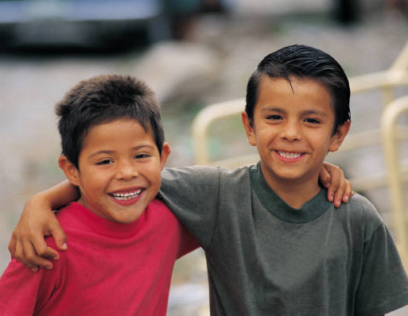
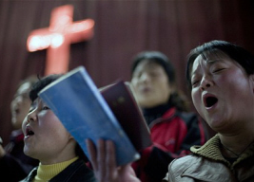
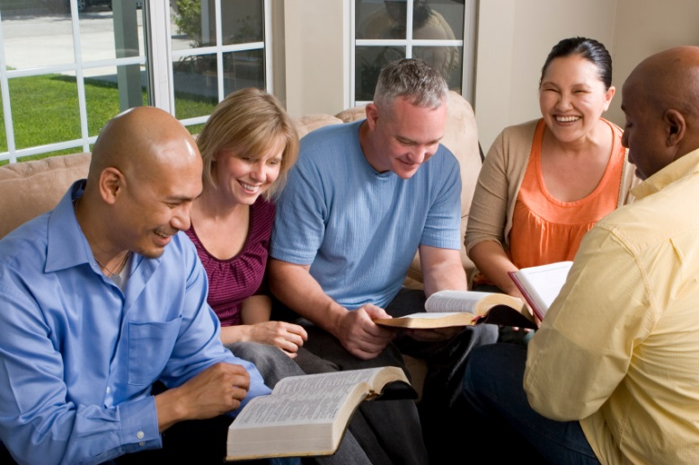

Jesus Christ
Disciple-Maker
How Can I Make Disciples?
Matt. 28:19-20; Acts 14:20-22

Slide 2
Review
How Jesus Made Disciples
What is a Disciple?
  Am I a Disciple?
    The Gospel Test
    The Following Test
    The Learning Test
    The Authentic Test
  Am I making disciples that are true disicples?

Slide 3
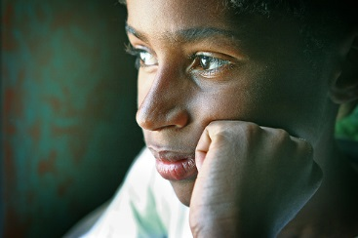
How can I make disciples?

Slide 4
Understand the Instructions!
“You’ve got to be very careful if you don’t know where you’re going, because you might not get there!”
Yogi Berra

Slide 5
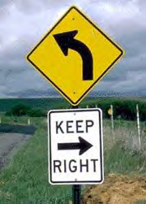
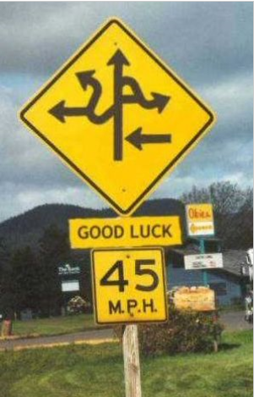

Slide 6
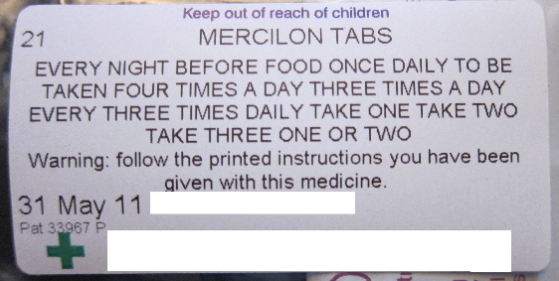

Slide 7
Greek mathetes
259
Gospels and Acts only

Slide 8
Greek matheteusate
(make disciples)
Matthew 13:52 (ESV) And he said to them, “Therefore every scribe who has been trained for the kingdom of heaven is like a master of a house, who brings out of his treasure what is new and what is old.
Matthew 27:57 (ESV) When it was evening, there came a rich man from Arimathea, named Joseph, who also was a disciple of Jesus.
Matthew 28:19 (ESV) Go therefore and make disciples of all nations, baptizing them in the name of the Father and of the Son and of the Holy Spirit,
Acts 14:21 (ESV)

Slide 9
Understand the Instructions!
ENGLISH “go and make disicples”
Compound verb

Slide 10
“Disciple”
In the Gospels and Acts

Slide 11
Disciple: FOLLOWER
Matthew 4:19
Matthew 8:22
Matthew 9:9
Matthew 10:38
Matthew 19:21
Matthew 19:28

Slide 12
Disciple: FOLLOWER
John 1:38-40
John 8:12
John 10:27
John 12:26
John 21:19
John 21:21

Slide 13
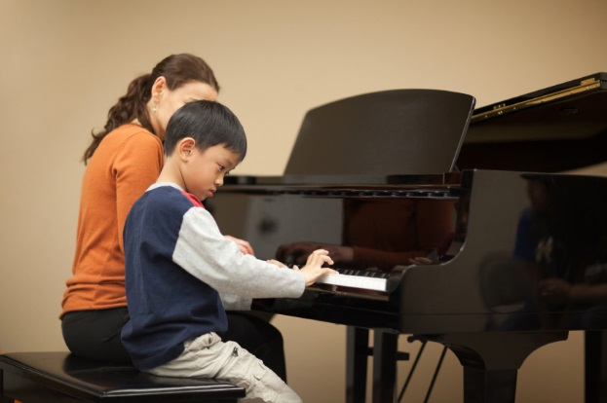
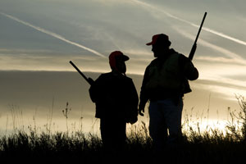
Disciple: LEARNER
Matthew 11:29
Matthew 7:21
Luke 6:46
John 3:36
John 5:24

Slide 14
Four Characteristics of Jesus’ Disciples
A true disciple puts Jesus first in his/her life. Luke 14:26
A true disciple loves and obeys the teachings of Jesus. John 8:31
A true disciple loves other disciples. John 13:35
A true disciple bears fruit that is produced through the power of the indwelling Christ. John 15:8

Slide 15
Questions for Me

Slide 16
Am I a Disciple?
Test 1. Do you believe?
Test 2. Are you a follower?
Test 3. Are you a learner?
Test 4. Are you authentic?
  Jesus first?
  Love and obey Jesus’ teaching?
  Loves other disciples?
  Bearing fruit?

Slide 17
Am I Making Disciples that are True Disciples

