Slide 1
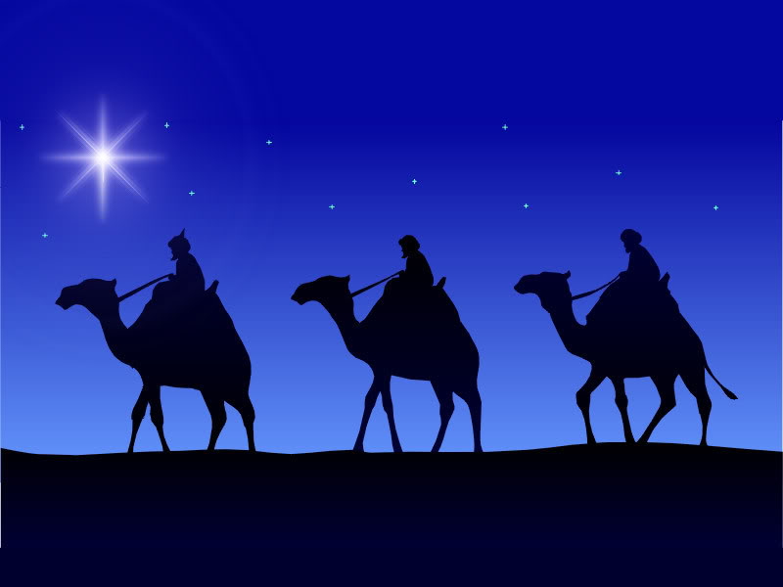
The Wise Men:
How Seekers
Find Jesus
Matthew 2:1-15

Slide 2


Slide 3
Wise Men - SEEKERS
“Where is he who has been born king of the Jews? For we saw his star when it rose and have come to worship him.”” (Matthew 2:2, ESV)

Slide 4
Principle: You will always find what you are looking for!

Slide 5



Things We Seek

Slide 6
Seek the Lord

Slide 7
Who is Seeking?
“The LORD looks down from heaven on the children of man, to see if there are any who understand, who seek after God.” (Psalm 14:2, ESV)

Slide 8

Who is Seeking?

Slide 9

How Do I Seek after God?

Slide 10
What Happens When You Seek?
“But from there you will seek the LORD your God and you will find him, if you search after him with all your heart and with all your soul.” (Deuteronomy 4:29, ESV)

Slide 12
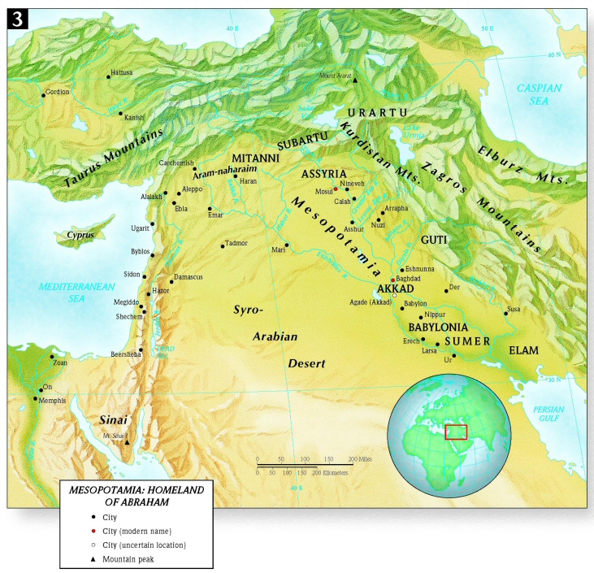
1500 + Miles
500 miles

