Slide 1
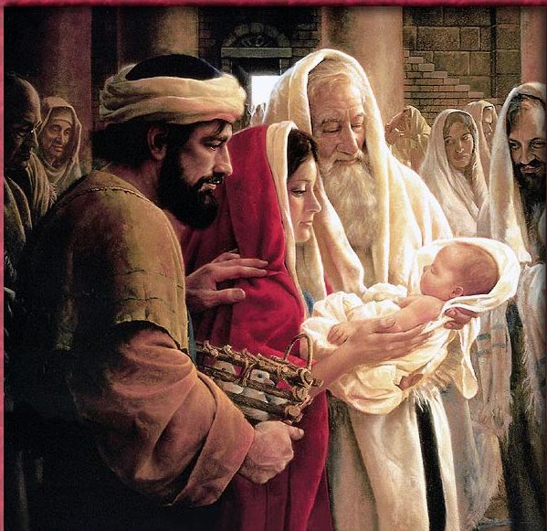
Simeon and Anna How the Watchful Find Jesus
Luke 2:21-38

Slide 2
Simeon and Anna How the Watchful Find Jesus
Circumcision
of Jesus
Luke 2:21-

Slide 3
Simeon and Anna How the Watchful Find Jesus
Purification
Of Mary
Luke 2:22

Slide 4
Simeon and Anna How the Watchful Find Jesus
Presentation
Of Jesus
Luke 2:22-23

Slide 5
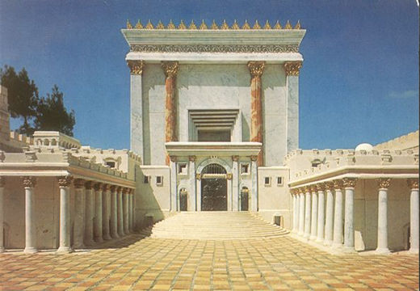
Visit to the Temple
Purification. Leviticus 12:2-8
Presentation. Exodus 13:2

Slide 6
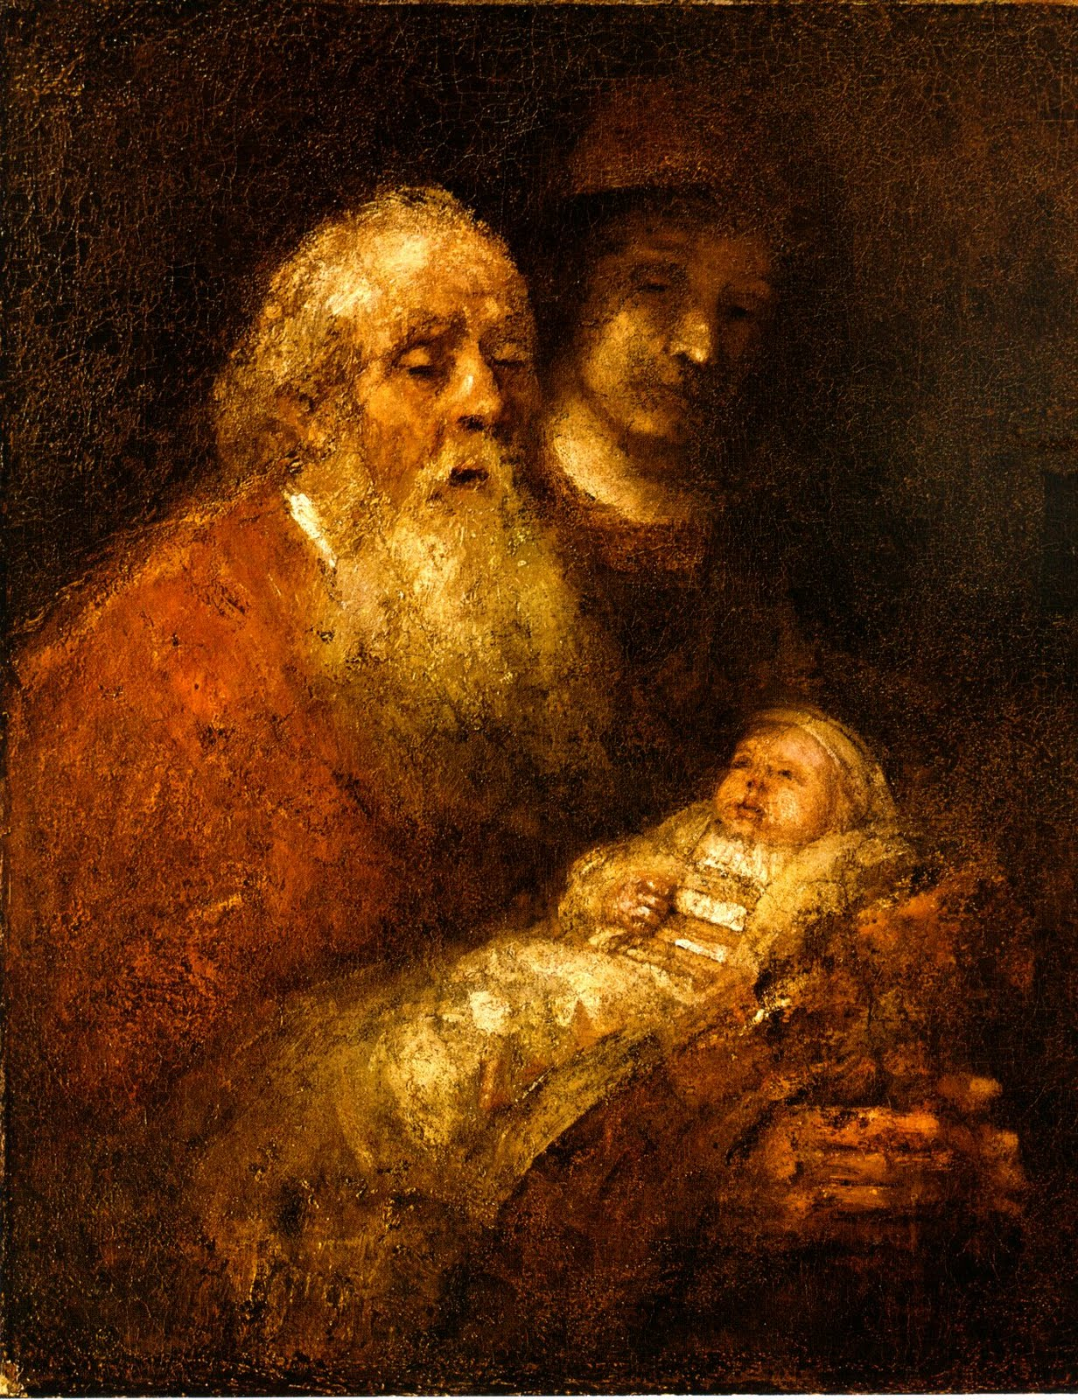
Simeon
Spirit Filled
Righteous
Devout
Waiting

Slide 7

Simeon

Slide 8
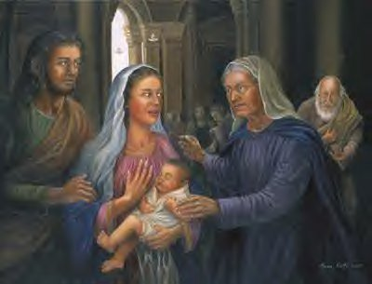
Anna
Israelite
Prophetess
84
Watchful

Slide 9
Common Theme

Slide 10
First Advent/Second Advent

