Slide 1

Biblical Manhood and Womanhood

Slide 2

Where are all the real men?” is regular fare for talk shows and new books. You asked them to be women, I want to say. The result is a gender confusion never experienced at such a wide level in the history of the world.

Slide 3
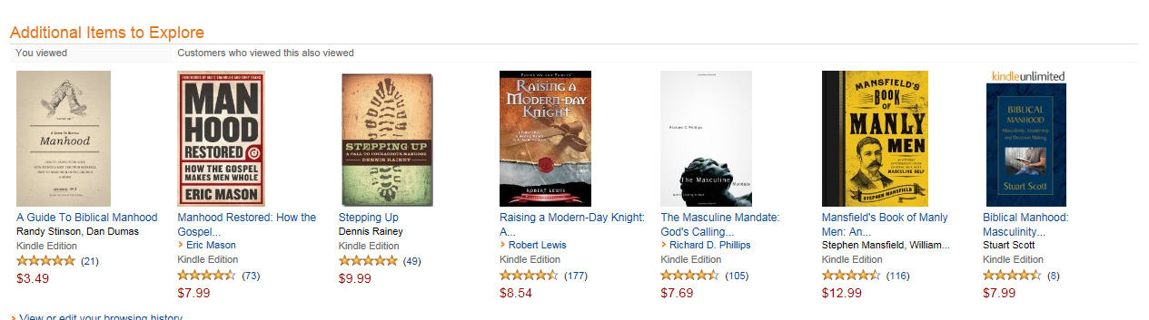

Slide 4
“Jesus - Our Model for Manhood”
A Comparison of
Jesus- the Ultimate Man and
Samson – the Unbiblical Male

Slide 5
Jesus- the Ultimate Man
1 Peter 2:21
A common man.
A man of skill and strength
A sinless man
  ANGER. 1 Peter 2:23
  PRIDE. Philippians 2:6-7; John 13:2-5
  LUST. Hebrews 4:15

Slide 6
Traits of a Godly Man
Sacrificial Love
Purifying Love
Caring Love
Permanent Love
Source: Dwight Peterson, Baptist Bible Seminary

Slide 7
Traits of an unbiblical Male
Lives for the moment
Controlled by his flesh
Allows himself to be manipulated
Source: Dwight Peterson, Baptist Bible Seminary

Slide 8
Samson – the unbiblical Male
Great Parents. Judges 13:2-3, 8-9
Great Potential.
Great Start. Judges 13:24-25

Slide 9
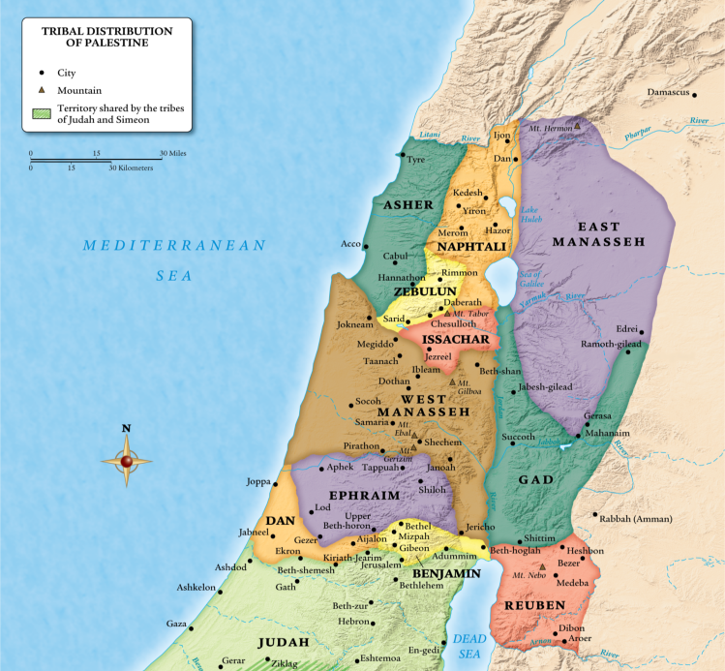
Philistines

Slide 10
Samson – the unbiblical Male
LUST. Judges 14:1-3
PRIDE. Judges 14:8-9
ANGER. Judges 14:10-14

Slide 11

“that according to the riches of his glory he may grant you to be strengthened with power through his Spirit in your inner being, so that Christ may dwell in your hearts through faith—that you, being rooted and grounded in love, may have strength to comprehend with all the saints what is the breadth and length and height and depth, and to know the love of Christ that surpasses knowledge, that you may be filled with all the fullness of God.” (Eph3:16–19)

