Slide 1
Friend of God

Slide 2
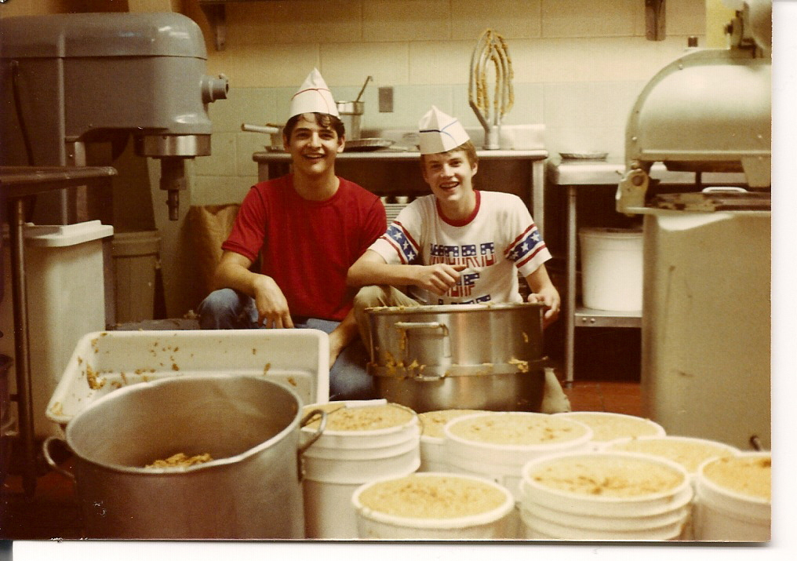

Slide 3


Slide 4
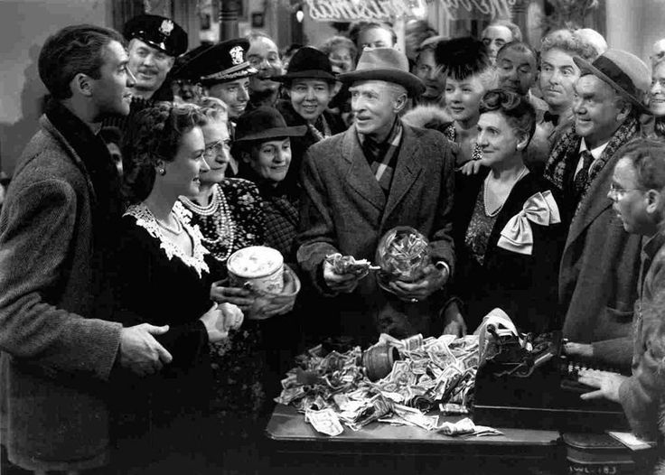
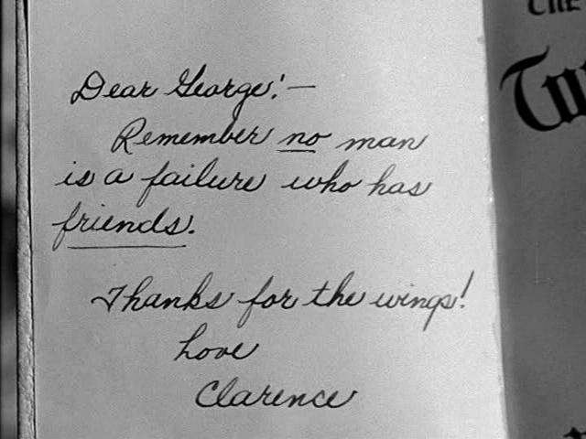

Slide 5
Friend of God
“and the Scripture was fulfilled that says, “Abraham believed God, and it was counted to him as righteousness”— and he was called a friend of God.” (James 2:23, ESV)

Slide 6
Friend of God
God’s PERSON
God’s PROVISION
God’s PROMISE

Slide 7
God’s PERSON
God is INFINATE. Psalm 90:2
God is HOLY. 1 Timothy 6:16
We are SINFUL. James 4:4

Slide 8
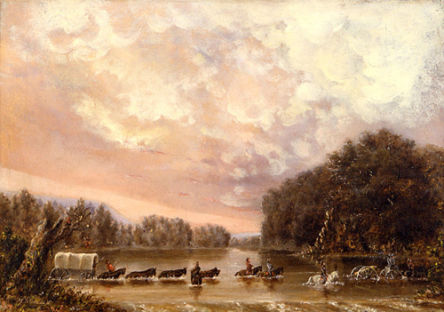

Slide 9
God’s PROVISION
God initiates friendship with us through His Son. Romans 5:8

Slide 10
God’s PROMISE
John 6:28-29
John 15:14
John 10:10
John 15:11

Slide 11
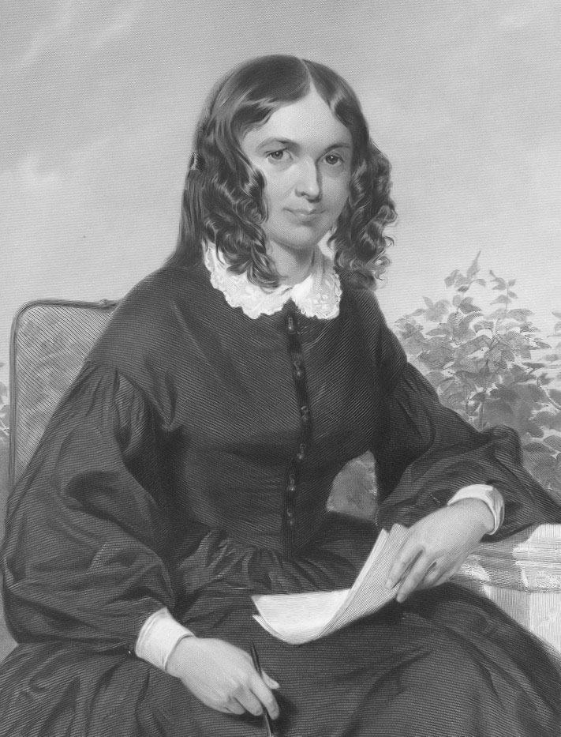
Elizabeth Barrett Browning
1806-1861

Slide 12
Friend of God

