Slide 1
Open Our Eyes,
Lord
2 Kings 6:8-23

Slide 2
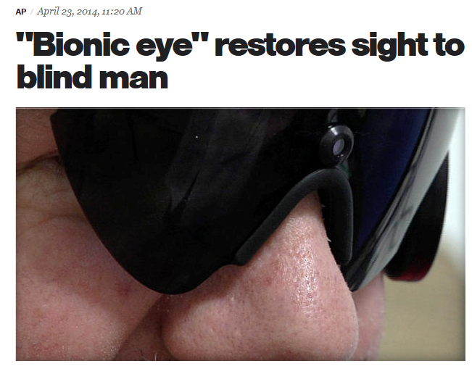

Slide 3
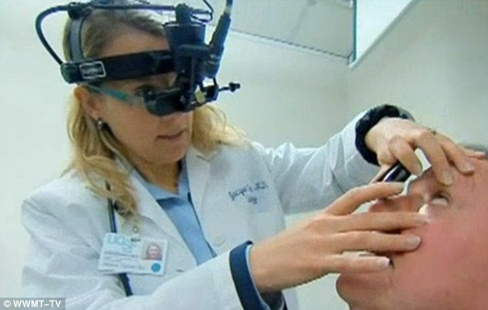

Slide 4
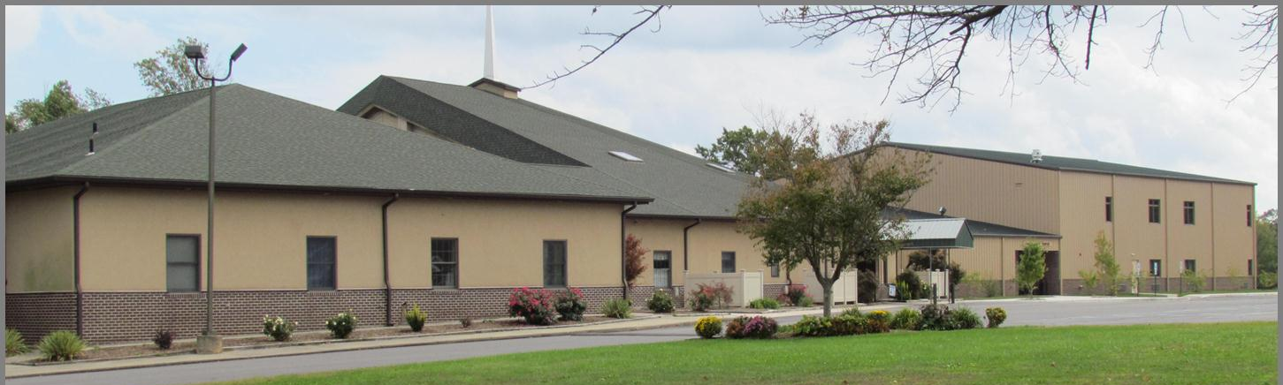
Faith Bible Church
Mission Statement:
Present Christ as Savior,
Pursue Christ as Lord,
Praise God as King

Slide 5
Faith Bible Church
Values Statement
Evangelism: We are passionate about reaching our community and people around the world with the gospel of Jesus Christ.

Slide 6
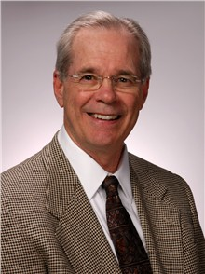
VISION:
“A vision is a clear and challenging picture of a future of a ministry as you believe that it can and must be.”
Aubrey Malphurs

Slide 7

2 Kings 6:8-23

Slide 8
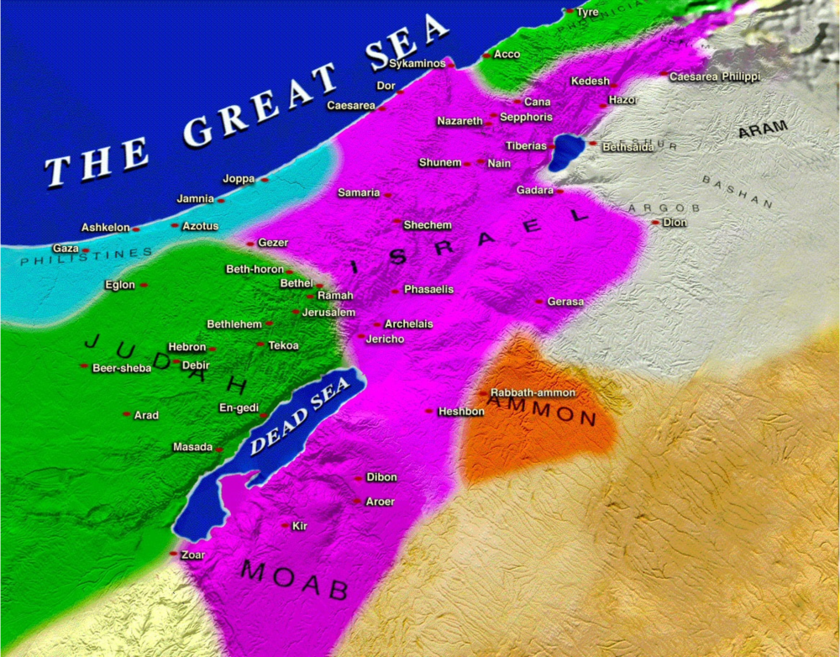

Slide 9
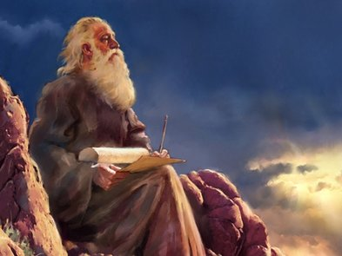
Elisha

Slide 10
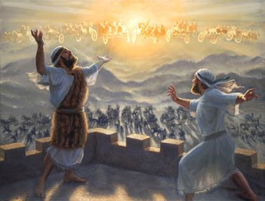

Slide 11

Dotham
12 miles

Slide 12
Why Couldn’t Gehazi See?
Man’s efforts

Slide 13
Why Couldn’t Gehazi See?
Seriousness of sin
Confidence in the flesh
Measure of success

Slide 14
Faith Bible Church Vision
The VISION of Faith Bible Church is our understanding of where we believe the Lord is leading us in the days ahead. Our VISION reflects the unique VALUES of Faith Bible Church and is the outworking of the MISSION we believe God has given to His Church.

Slide 15
Faith Bible Church Vision
We embark to fulfill this VISION in FAITH “Let us hold fast the confession of our hope without wavering, for he who promised is faithful.” (Hebrews 10:23, ESV)

Slide 16
Faith Bible Church Vision
We recognize that God can redirect our paths. “The steps of a man are established by the Lord, when he delights in his way.” (Psalm 37:23, ESV)

Slide 17
Faith Bible Church Vision
We seek His Glory. “To him be glory in the church and in Christ Jesus throughout all generations, forever and ever. Amen.” (Ephesians 3:21, ESV)

Slide 18
Faith Bible Church Vision
We submit to His Sovereignty. “I charge you in the presence of God, who gives life to all things, and of Christ Jesus, who in his testimony before Pontius Pilate made the good confession,” (1 Timothy 6:13, ESV)

Slide 19
Faith Bible Church Vision
We accept the responsibility of obedience and leave the results with God alone. “He who plants and he who waters are one, and each will receive his wages according to his labor.” (1 Corinthians 3:8, ESV)

Slide 20
