Slide 1
Keep Humility in your Plans
James 4:13-17

Slide 2

Performance Against Goals
Goal: state original goal or goals of project
  List key metrics (items for measuring success)
Actual: summarize what really happened in relationship to goals
  List progress against metrics

Slide 3
Presumptions (lack of humility)
James 4:11-12 | James 4:13-17
Presuming other’s MOTIVES | Presuming the certainty of our PLANS

Slide 4

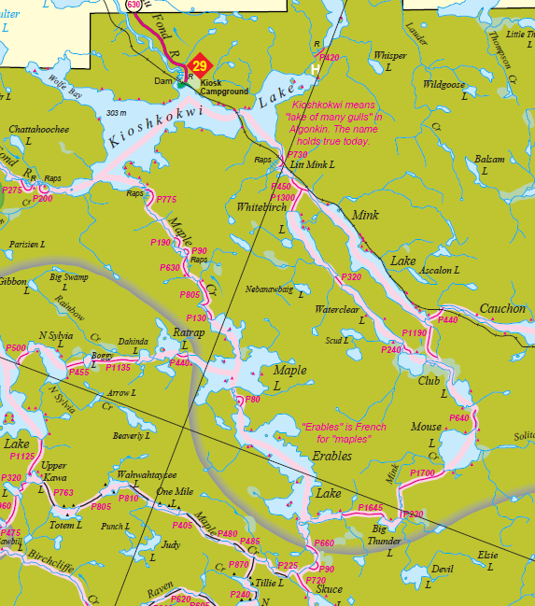


Planning Without God
Everyday business
God approves planning
  Proverbs 12:24
  Proverbs 21:5

Slide 5
The Warning. James 4:14

Slide 6
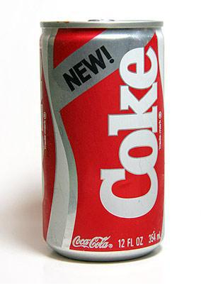
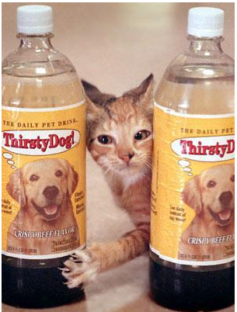

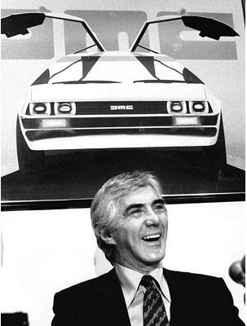
Product Failures

Slide 7

The Warning. James 4:14
Only God knows the future. Psalm 139:4, 16
God will accomplish his purposes
  Isaiah 46:10
  Job 42:2
Life is a vapor!

Slide 8
A Better Way. James 4:15
God’s Sovereignty
“If the Lord Wills”
  Acts 18:21
  Romans 15:32
  1 Corinthians 16:7
  Hebrews 6:1-3

Slide 9
Do the Right Thing. James 4:17

Slide 10

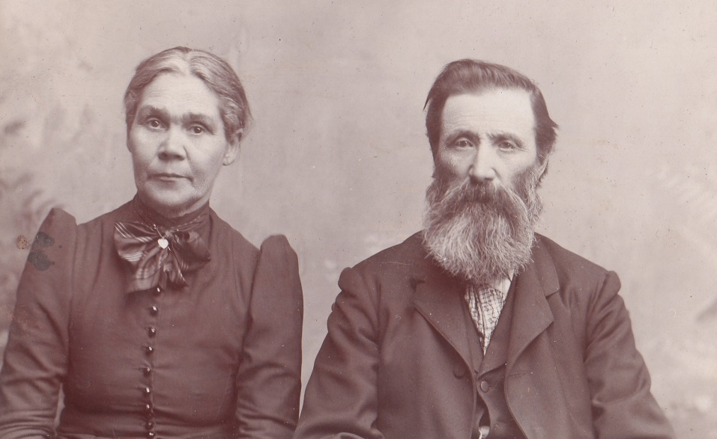

Recognizing God’s Sovereignty
Finances
Retirement
Education

