Slide 1
Be Steadfast Because the Lord is Near
James 5:7-11

Slide 2
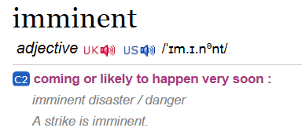
Be Steadfast Because the Lord is Near
James 5:7-11

Slide 3

Christ’s Imminent Return Motivates us to Remain Faithful in the Trials of life. James 5:7-8a
“be patient”
Illustration

Slide 4
Christ’s Imminent Return Motivates us to Strengthen our Hearts to Serve the Lord . James 5:8

Slide 5
The Doctrine of Imminency
Matthew 24:42-43
1 Thessalonians 5:2
Romans 13:12; Philippians 4:7
1 John 2:18
Revelation 3:11; 22:7, 10, 20

Slide 6
Index of Leading Prophetic Indicators
The world is
focused on Israel
Daniel 9:24-27

Slide 7
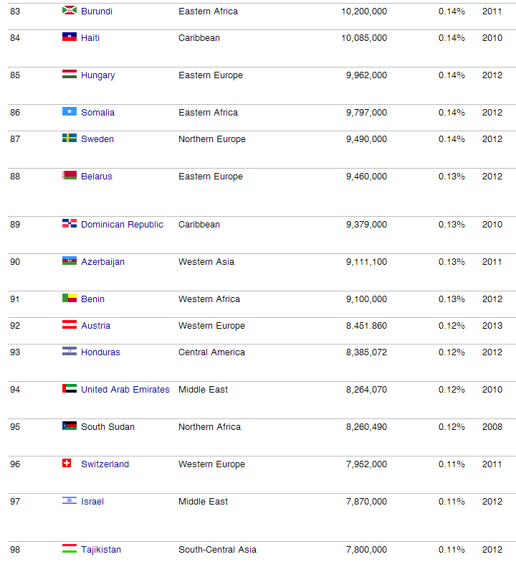

Slide 8
Index of Leading Prophetic Indicators
The world is
focused on the End of the World! Romans 8:22-23

Slide 9
Index of Leading Prophetic Indicators
Growing Apostasy in the Church.
1 Timothy 4:1

Slide 10
Index of Leading Prophetic Indicators
Growing Wickedness in the World.
2 Timothy 3:1-5

Slide 11
Index of Leading Prophetic Indicators
One World Economy is in Sight
Revelation 13:13, 17

Slide 12
Index of Leading Prophetic Indicators
Continual Surveillance of everyone on the Planet

Slide 13
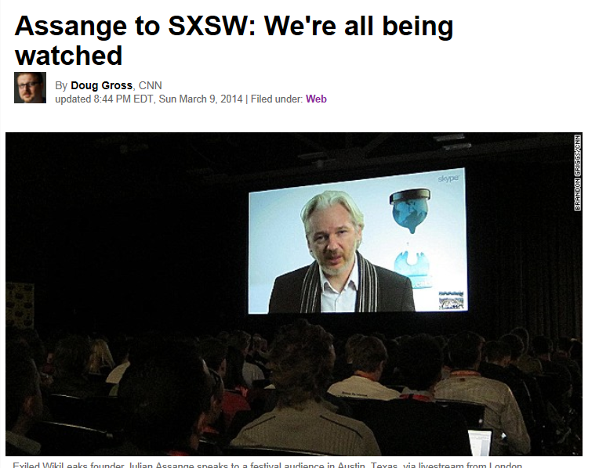

Slide 14
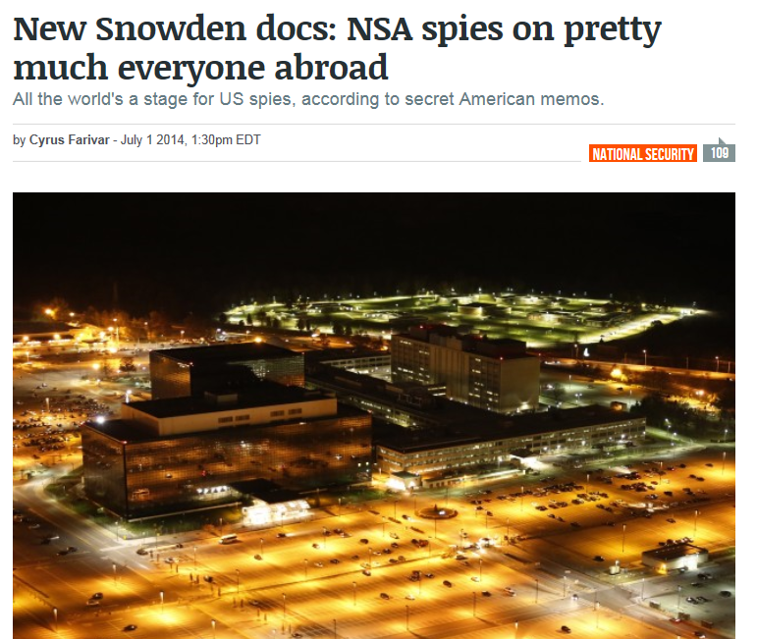

Slide 15
Index of Leading Prophetic Indicators
One World Government is in Sight

Slide 16
Index of Leading Prophetic Indicators
Satan’s Post-Rapture Propaganda has already begun
2 Thessalonians 2:11

Slide 17
Christ’s Imminent Return Motivates us to Spiritual Unity so we can Evangelize the Lost. James 5:9

