Slide 1
God’s Provision for a
Peaceful Heart
James 1:13-18

Slide 2


Slide 3
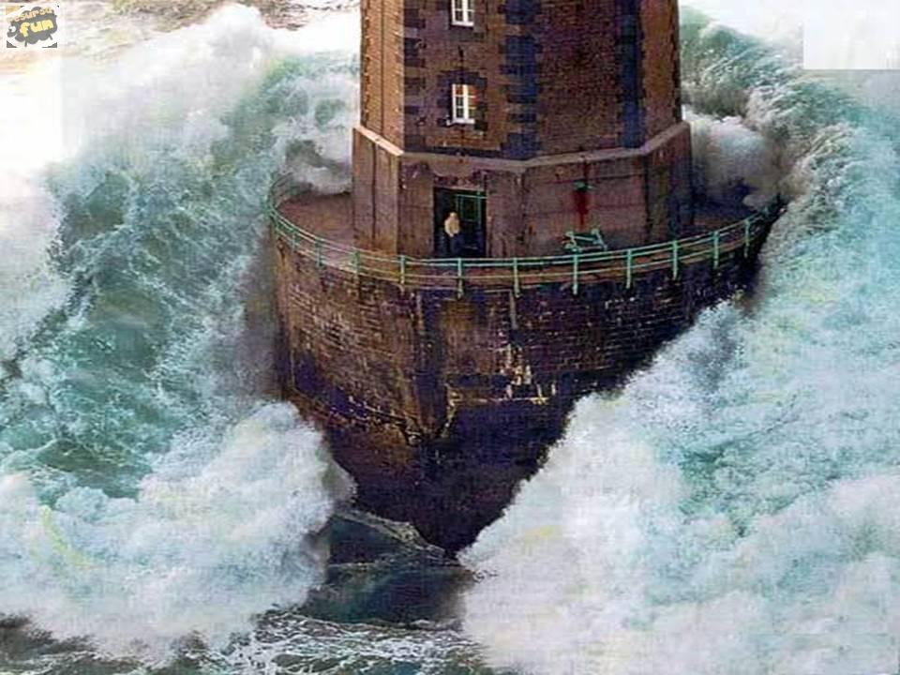

Slide 4
God’s Provision for a
Peaceful Heart
James 1:13-18

Slide 5
 | Earthly Wisdom | Heavenly Wisdom
Description | Bitter jealousy Selfish ambition

Slide 6


Slide 7
 | Earthly Wisdom | Heavenly Wisdom
Description | Bitter jealousy Selfish ambition
Source | Earthly Unspiritual Demonic

Slide 8
 | Earthly Wisdom | Heavenly Wisdom
Description | Bitter jealousy Selfish ambition
Source | Earthly Unspiritual Demonic
Results | Disorder Every evil practice

Slide 9
 | Earthly Wisdom | Heavenly Wisdom
Description | Bitter jealousy Selfish ambition | Pure , peaceable, gentle, open to reason, full of mercy, full of good fruits, impartial, sincere
Source | Earthly Unspiritual Demonic
Results | Disorder Every evil practice

Slide 10
 | Earthly Wisdom | Heavenly Wisdom
Description | Bitter jealousy Selfish ambition | Pure , peaceable, gentle, open to reason, full of mercy, full of good fruits, impartial, sincere
Source | Earthly Unspiritual Demonic | “From above”
Results | Disorder Every evil practice

Slide 11
 | Earthly Wisdom | Heavenly Wisdom
Description | Bitter jealousy Selfish ambition | Pure , peaceable, gentle, open to reason, full of mercy, full of good fruits, impartial, sincere
Source | Earthly Unspiritual Demonic | “From above”
Results | Disorder Every evil practice | Harvest of righteousness Peace

