Slide 1

Tests for the Tongue

Slide 2
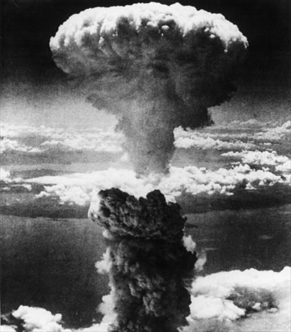

Slide 3
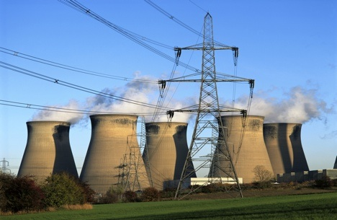

Slide 4
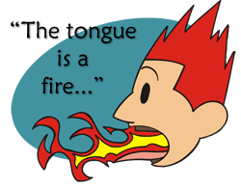
Eight Unflattering Descriptions

Slide 5
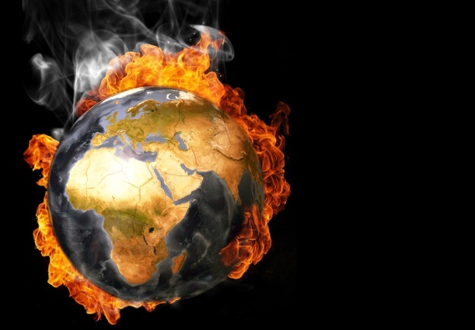
Eight Unflattering Descriptions
A word of unrighteousness (James 3:6)

Slide 6
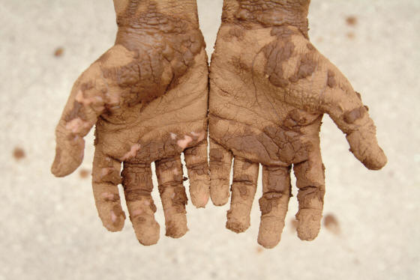
Eight Unflattering Descriptions
Staining the whole body (James 3:6)

Slide 7
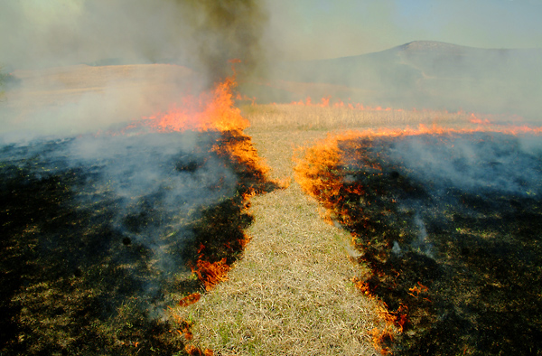

Eight Unflattering Descriptions
Setting on fire the course of life (James 3:6)

Slide 8
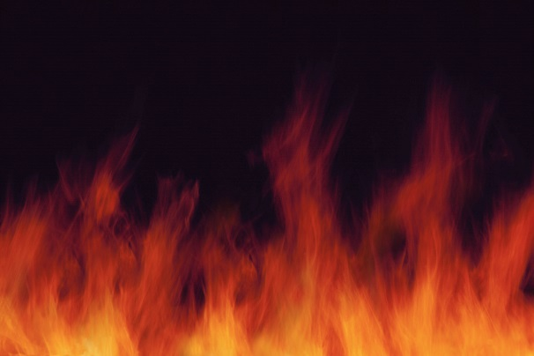
Eight Unflattering Descriptions
Set on fire by hell

Slide 9
Progressive Destruction
Staining the whole body
Corrupt lives
Satanic origin

Slide 10
Eight Unflattering Descriptions
A restless evil (James 3:8)

Slide 11
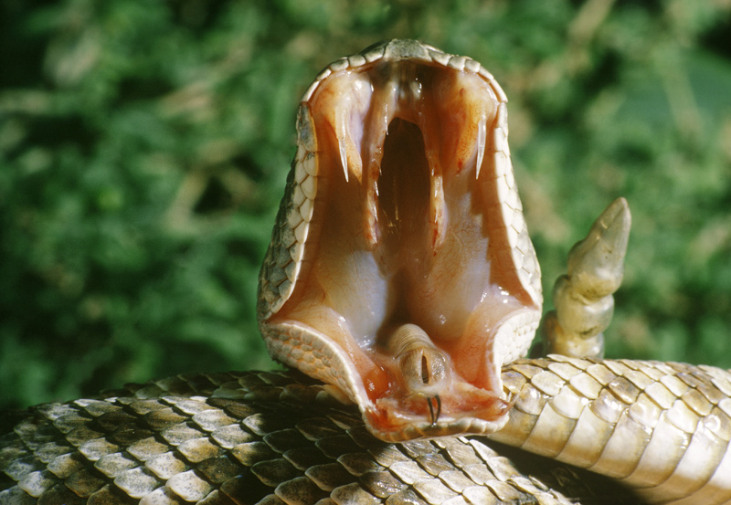
Eight Unflattering Descriptions
Full of deadly poison (James 3:8)

Slide 12
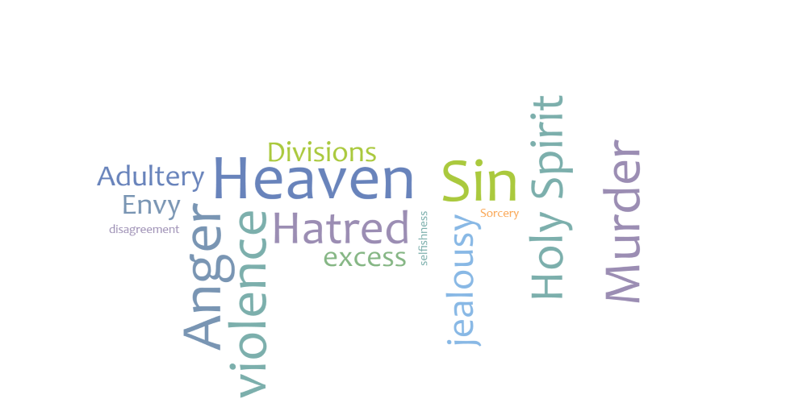
Conclusion: Our Word Betray Us

Slide 13
Tests to See What Your Words are Telling You
Are my words angry?
Am I self-deceived?
Are my words praise worthy?
Am I a quarreler?
Am I a bragger?
Do I swear?

