Slide 1
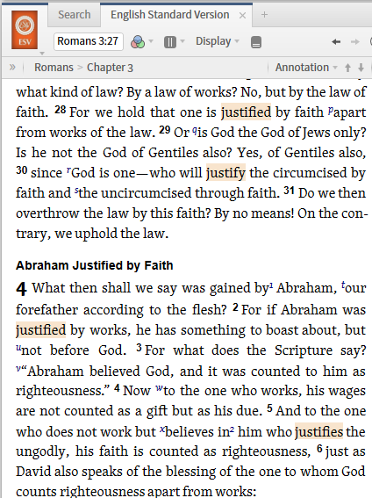
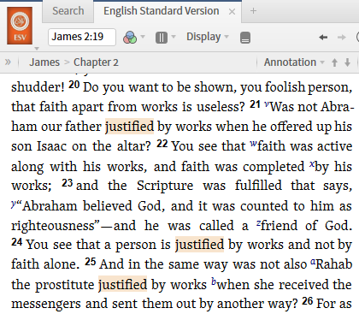
Romans 3
James 2

Slide 2
Apparent Contradiction?
 | James | Paul
Justification | Romans 3:28-4:5 “To declare righteous” Justified by faith apart from works | James 2:20-25 “To declare righteous” Justified by works, and not faith alone

Slide 3
Apparent Contradiction?
 | James | Paul
Justification | Romans 3:28-4:5 “To declare righteous” Justified by faith apart from works | James 2:20-25 “To declare righteous” Justified by works, and not faith alone

Slide 4
Apparent Contradiction?
 | James | Paul
Faith | Faith and works do not mix (3:27) Faith apart from works (3:28) | Faith apart from works is dead Faith by works (James 2:21, 24)

Slide 5

God’s Perfection

Slide 6
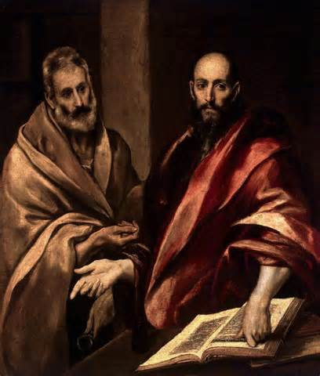
James and Paul on Justification
James and Paul knew each other
James defends faith alone
Paul warns against false faith

Slide 7
Compliment – not Contradiction
 | Paul | James
Works | When Paul speaks of works, he is speaking about the works of an unbeliever that cannot save. Eph 2:9 | When James speaks of works, he is speaking about the works of a believer that are produced by salvation. James 2:21

Slide 8
Compliment – not Contradiction
 | Paul | James
Faith | When Paul speaks of faith, he is speaking about the act of trusting in the work of Christ for salvation from sins. Eph 2:8-9 | When James speaks about faith, he is speaking of the ongoing evidence of salvation that faith produces. James 2:18

Slide 9
Compliment – not Contradiction
 | Paul | James
Abraham | Abraham was justified when he believed God’s promise (Rom 4:10-12) | Abraham’s faith was made evident when he offered Isaac (James 2:21)

Slide 10

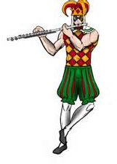

A Tudor who tooted the flute
Tried to tutor two tooters to toot
Said the two to the Tudor,
“Is it harder to toot, or to tutor two tooters to toot?”

Slide 11
Two Meanings of Justification
Paul: Faith in Christ for salvation
James: the evidence of faith that demonstrates salvation

