Slide 1

The Value of a
Mother’s Faith
Matthew 15:21-28

Slide 2
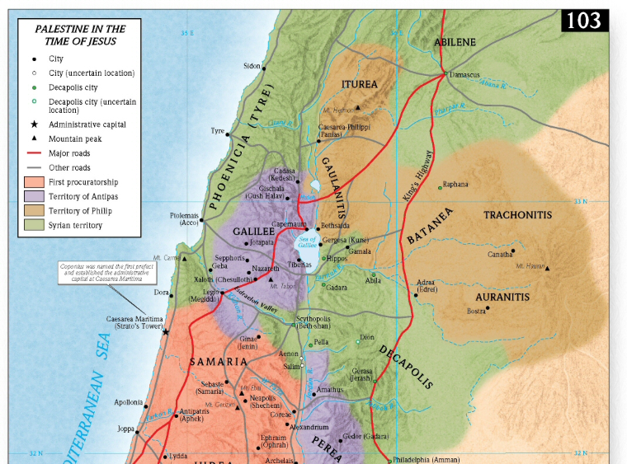

Slide 3

A Faithful Mother Finds her Strength in the Lord. Matthew 15:22

Slide 4
A Faithful Mother Knows the Spiritual Needs of her Children. Matthew 15:22

Slide 5
A Faithful Mother Prays Earnestly for her Children. Matthew 15:23

Slide 6
A Faithful Mother is Satisfied with Gods’ Provision. Matthew 15:26-27

Slide 7
A Faithful Mother is Satisfied with Gods’ Person. Matthew 15:26-27

Slide 8
A Faithful Mother Brings God’s Blessing on her Family. Matthew 15:26-27

Slide 9
M

Slide 10
M O

Slide 11
M O T

Slide 12
M O T H

Slide 13
M O T H E

Slide 14
M O T H E R

