Slide 1
Things That Matter Most
Acts 2:43-47
Faith Bible Church
2014 - Year of Vision

Slide 2
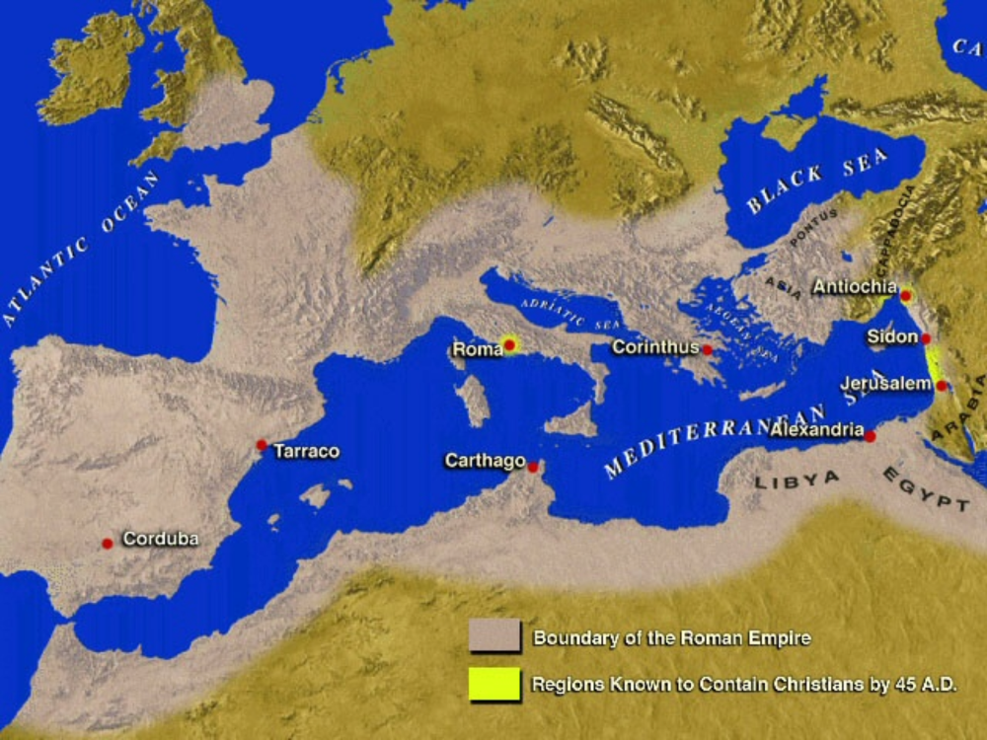
ANTIOCH
Mission
PHILIPPI
Generous
BEREA
Diligent
EPHESUS
Faith, Love
JERUSALEM
Selfless
THESSALONICA
Testimony

Slide 3
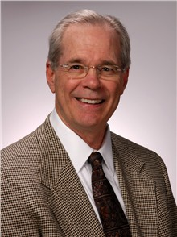
VALUES:
“The constant, passionate, biblical core beliefs that drive the ministry.”
Aubrey Malphurs

Slide 4

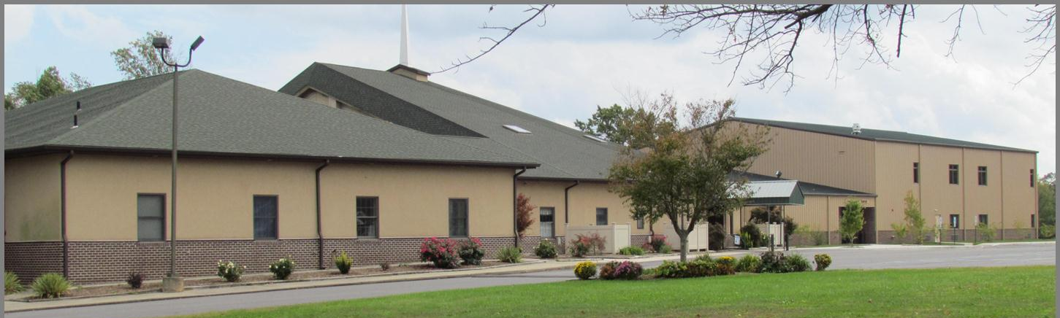
Faith Bible Church
Values Statement
Evangelism: We are passionate about reaching our community and people around the world with the gospel of Jesus Christ.

Slide 5
Faith Bible Church
Values Statement
Teaching: We are passionate about Biblical preaching and teaching.

Slide 6
Faith Bible Church
Values Statement
Fellowship: We are passionate about a church family that actively encourages one another in love and shares the blessings, joys and struggles of the Christian life.

Slide 7
Faith Bible Church
Values Statement
Worship: We are passionate about a church that expresses our love for God through personal and corporate worship elevating God’s greatness while restoring the human soul.

Slide 8
Faith Bible Church
Values Statement
Prayer: We are passionate about a church that believes in the power of fervent prayer.

Slide 9
Faith Bible Church
Values Statement
Family: We are passionate about strengthening our children and young people to become mature Disciples of Christ.

Slide 10
Faith Bible Church
Mission Statement:
Present Christ as Savior,
Pursue Christ as Lord,
Praise God as King

