Slide 1
Why “Noah?”
Cultural significance
Equipped to share

Slide 2
Darren Aronofsky
“To the delight of the atheist and the concern of the pious however, Aronofsky's film is pushing an environmentalist rather than religious agenda.” …"the least biblical biblical film ever made", and sees its protagonist (played by Russell Crowe) as the "first environmentalist". Independent.co.uk

Slide 3
Flood
“Noah” film | Bible
Humans ruining the environment

Slide 4
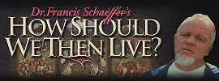
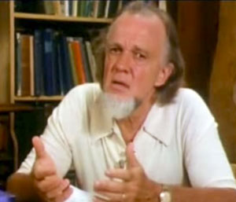
“As Christian consensus dies, there are not many sociological alternatives.... In the days of a more Christian culture, a lone individual with the Bible could judge and warn society, regardless of the majority vote, because there was an absolute by which to judge. ... But to the extent that the Christian consensus is gone, this absolute is gone as a social force..... Some group of some person will fill the vacuum.

Slide 5
The central message of biblical Christianity is the possibility of men and women approaching God through the work of Christ. But the message also has secondary results, among them the unusual and wide freedoms which biblical Christianity gave to countries where it supplied the consensus.

Slide 6
When these freedoms are separated from the Christian base, however, they become a force of destruction leading to chaos. When this happens, as it has today, then, to quote Eric Hoffer, “When freedom destroys order, the yearning for order will destroy freedom

Slide 7
At that point ..... [Authoritarianism] .... will gradually [increase] so that [society] will not go on to chaos. And most people will accept it - from the desire for personal peace and affluence, from apathy, and from the yearning for order to assure the functioning of some political system, business and the affairs of daily life.

Slide 8
Flood
“Noah” film | Bible
Humans ruining the environment | Wickedness. Gen 6:5 Corruption, violence. Gen 6:11-13

Slide 9
How Many People?
“Noah” film | Bible
Seven | Eight Genesis 7:6; 8:16-18; 9:1-, 8-9 1 Peter 3:20; 2 Peter 2:4-5 Hebrews 11:7

Slide 10
The God of Noah?
“Noah” film | Bible
Creator Mystical A Force, not a Person | Knowable Communicative Elohim, YHWH, numerous names!

Slide 11
“Sons of God,” Nephilim
“Noah” film | Bible
“The Watchers” Fallen, but “good” They are redeemed | Fallen angels? 2 Peter 2:4-5 Jude 6

Slide 12
Was the Flood Real?
“Noah” film | Bible
Mythology | Genesis 6-9 as history Jesus: Mat 5:18; 11:13; 24:38-39 A warning. Mat 24:37-40; 2 Peter 5:9

Slide 13
Evidence for the Flood
200 + Flood cosmologies
95% have common elements with Genesis
No literary or historical connection
Underground water

Slide 14
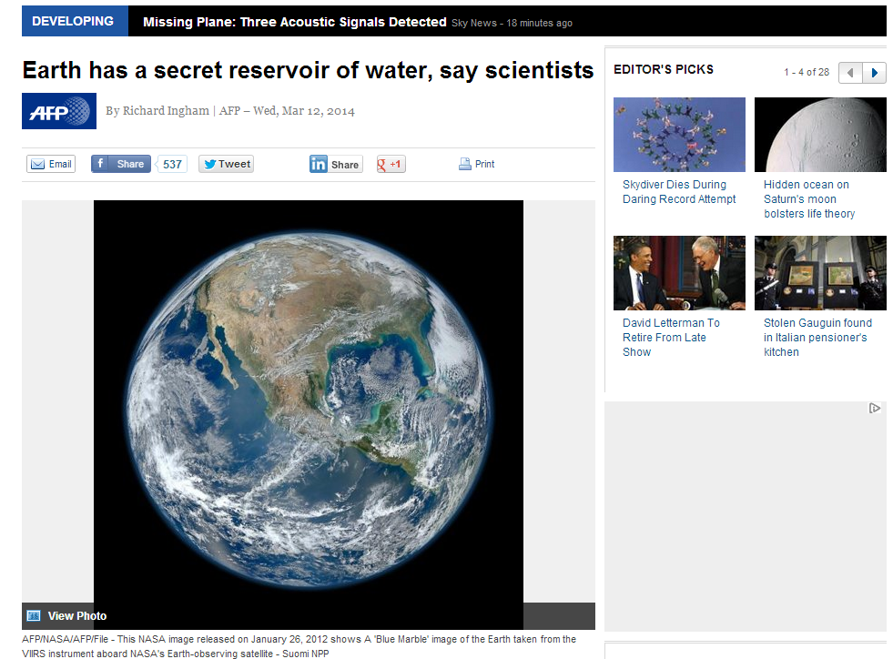

Slide 15
Message of Noah
“Noah” film | Bible
Destruction, not redemption | Redemption

