Slide 1
Mercy Triumphs!
James 2:10-13

Slide 2
God Treats Us With Mercy
James 2:13; 5:11; Daniel 9:9; Ephesians 2:4
Mercy in the Old Testament

Slide 3
JAMES: Mercy vs. Law
MERCY | LAW
1:25 “Law of Liberty” (2x) | 2:9 “Convicted by the Law”
2:8 “Royal Law” | 2:10 “Keeps the whole Law”
2:12 “Law of Liberty” | 4:11 (4x) “you are not a doer of the law but a judge”

Slide 4
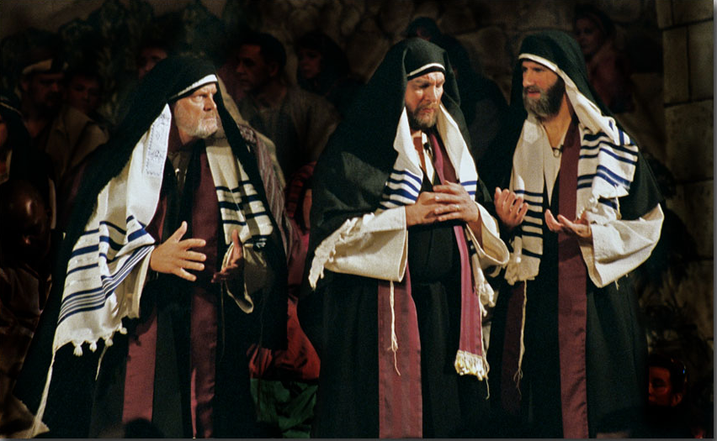
How Did James’ Audience View the Law?
Avoid the Big Sins
Do more good than bad
Go to Church
Religious Ritual

Slide 5
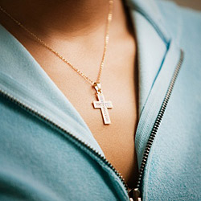
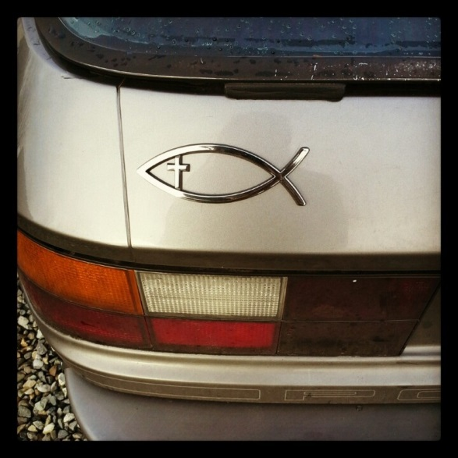
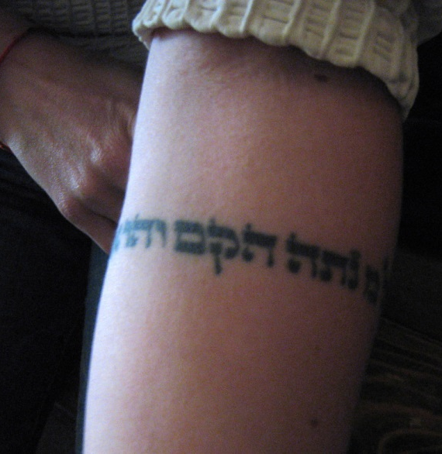
Today
Avoid the Big Sins
Do more good than bad
Go to Church
Religious Ritual

Slide 6
Mercy Received = Mercy Given
Two examples of Mercy
Two examples of Law

Slide 7
Reasons Mercy Triumphs
God’s mercy to us
In condemning others, we condemn ourselves
We understand our need for mercy
Mercy motivates
Mercy is greater

