Slide 1
JAMES
Keep the Faith
James 1:26-27
How True Faith Helps those in Need

Slide 2
James 1:27
James 1:27 “Religion that is pure and undefiled before God, the Father, is this: to visit orphans and widows in their affliction, and to keep oneself unstained from the world."

Slide 3
What Does Christian Compassion Look Like in NJ in 2014?
How American Politics create a barrier to Christian compassion
How All Believers Should Respond to the Needy
Expressing Christ-like Compassion in our Culture Today

Slide 4
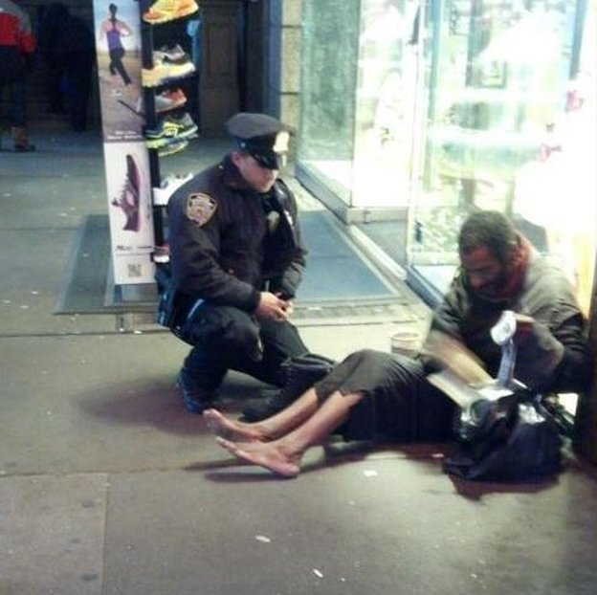
Problem Speech

Slide 5
A Failed “War On Poverty”
Money is not the answer
Buying the votes of the poor
Removing personal accountability through “anonymous” Federal Programs

Slide 6
How Should We Respond?
“True religion”
Follows Salvation
“Pure and Undefiled”
Christ-like Conduct
Christ-like Character

Slide 7
Expressing Christ-like
Compassion Today
NT Widows
NT Orphans
Today

Slide 8
Expressing Christ-like
Compassion Today
Have the Mind of Christ
Develop and Others-First Lifestyle
Help without Creating Dependency
Become Self-Reliant
A Vision to Help One Family

