Slide 1
JAMES
Keep the Faith
James 1:13-18
“Where Are Your Passions?”

Slide 2
Victory is Possible Because TEMPTATION
Does Not Come from God. Jam 1:13
God is Supreme
Temptation is limited. 1 Cor 10:13
God is for us!
  Rom 8:31-32
  Rom 6:14

Slide 3
Victory is Possible Because
Your Heart is a Movable Object
James 1:14
“Desire” (NIV “evil desire,” NAS and KJV “lust”) boils up, rising smoke.
“Own desire”
“Drawn out” (NIV “dragged away)
“Lured”

Slide 4


Slide 5


Slide 6
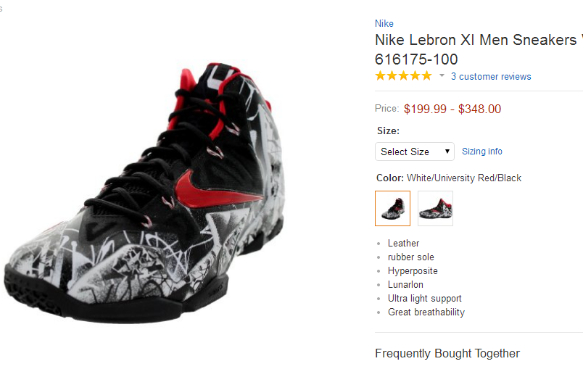

Slide 7
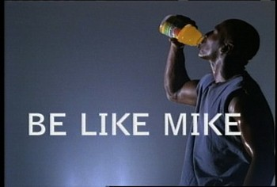

Slide 8


Slide 9
Victory is Possible Because
Failure Brings Death
James 1:15

Slide 10
How Do I Move my Heart?
Brutal Honesty
Sincere Confession
Fearless Renunciation

Slide 11
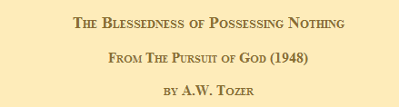
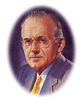

Slide 12
How Do I Move my Heart?
Brutal Honesty
Sincere Confession
Fearless Renunciation
Accept God’s Forgiveness
Value Future Blessings

