Slide 1
Keep the Faith Studies in James

Slide 2
James 1:3-4
KJV Knowing this, that the trying of your faith worketh patience. 4 But let patience have her perfect work, that ye may be perfect and entire, wanting nothing.
NIV84 because you know that the testing of your faith develops perseverance. 4 Perseverance must finish its work so that you may be mature and complete, not lacking anything.
NASB knowing that the testing of your faith produces endurance. 4 And let endurance have its perfect result, so that you may be perfect and complete, lacking in nothing.

Slide 3
James 1:12
KJV Blessed is the man that endureth temptation: for when he is tried, he shall receive the crown of life, which the Lord hath promised to them that love him.
NIV84Blessed is the man who perseveres under trial, because when he has stood the test, he will receive the crown of life that God has promised to those who love him.
NASB95 Blessed is a man who perseveres under trial; for once he has been approved, he will receive the crown of life which the Lord has promised to those who love Him.

Slide 4
James 5:11
KJV Behold, we count them happy which endure. Ye have heard of the patience of Job, and have seen the end of the Lord; that the Lord is very pitiful, and of tender mercy.
NIV84As you know, we consider blessed those who have persevered. You have heard of Job’s perseverance and have seen what the Lord finally brought about. The Lord is full of compassion and mercy.
NASB We count those blessed who endured. You have heard of the endurance of Job and have seen the outcome of the Lord’s dealings, that the Lord is full of compassion and is merciful.

Slide 5
ESV
James 1:3-4 “for you know that the testing of your faith produces steadfastness. 4 And let steadfastness have its full effect, that you may be perfect and complete, lacking in nothing.”
James 1:12 Blessed is the man who remains steadfast under trial, for when he has stood the test he will receive the crown of life, which God has promised to those who love him.
.James 5:11 Behold, we consider those blessed who remained steadfast. You have heard of the steadfastness of Job, and you have seen the purpose of the Lord, how the Lord is compassionate and merciful.

Slide 6
Recipients
James 1:1 “in the dispersion”
Acts 4:1-3. Persecution
Acts 7:59. Stoning
Acts 8:4. Scattered
Acts 12:1-2 Martyred
Acts 14:19. Stoning

Slide 7
Chapter Themes
Keep the Faith when Trials Come 1:3
Keep the Faith by Doing Good Works” 2:17
Keep the Faith by Speaking Good Words. 3:2
Keep the Faith by Separating from Sin. 4:8
Keep the Faith and Receive God’s Blessing. 5:11

Slide 8
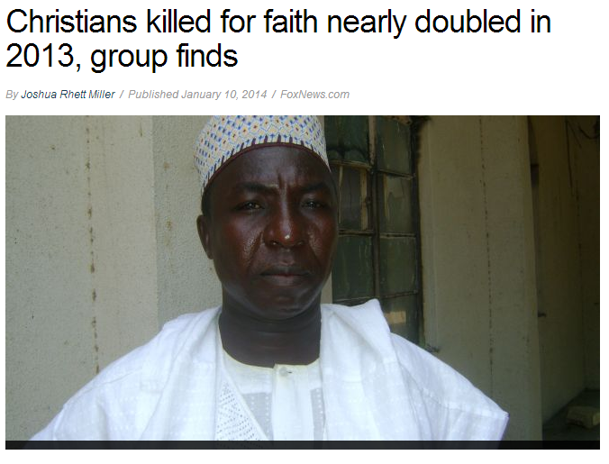
Persecution Today

Slide 9
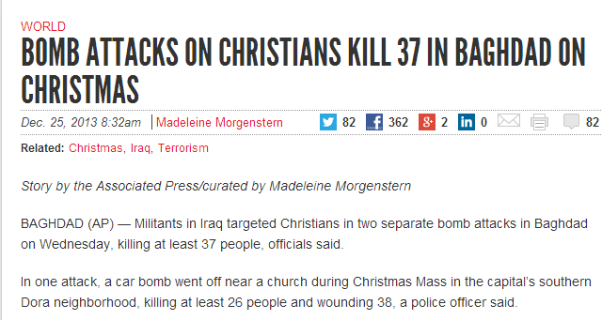
Persecution Today

Slide 10
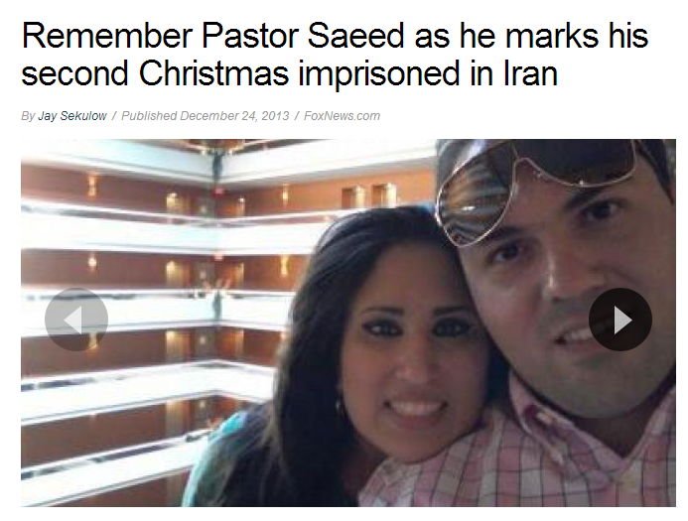
Persecution Today

Slide 11
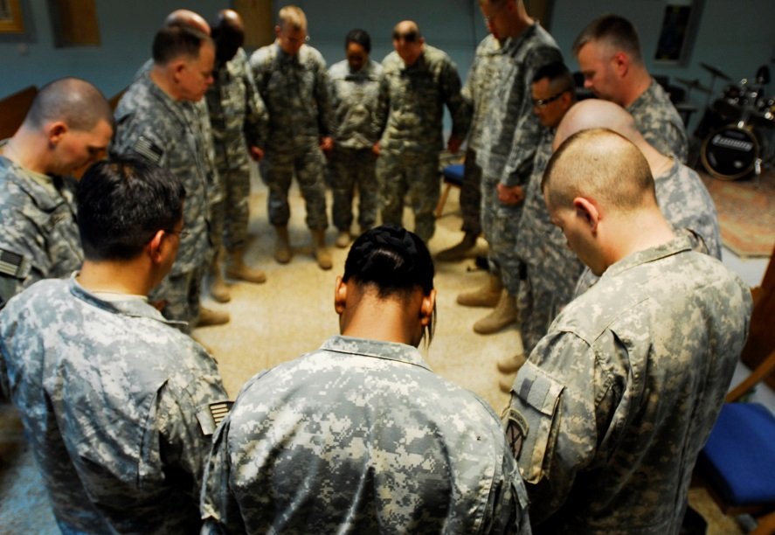

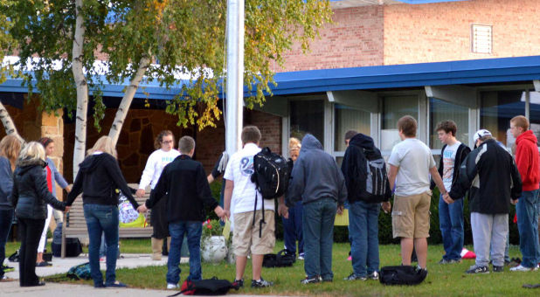

Persecution Today

Slide 12
Keep the Faith

