Slide 1
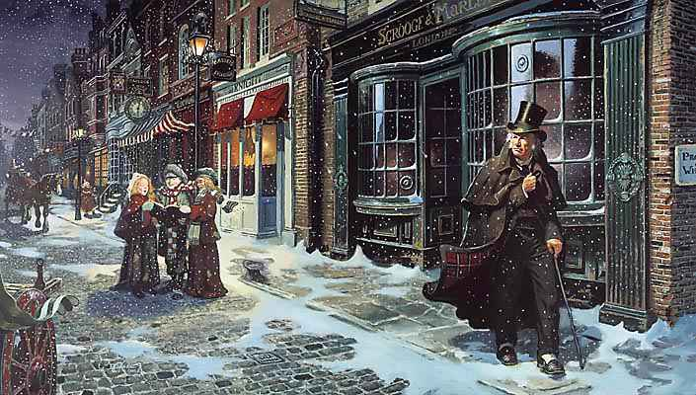
1800’s - A Dicken’s Christmas

Slide 2
Ecclesiastes 5:10-12
Ecclesiastes 6:1-2

Slide 3
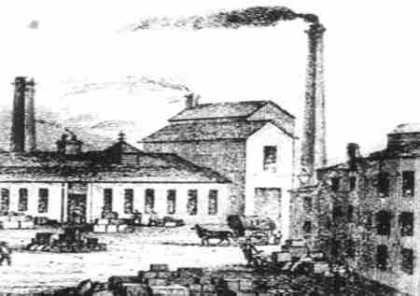

Slide 4
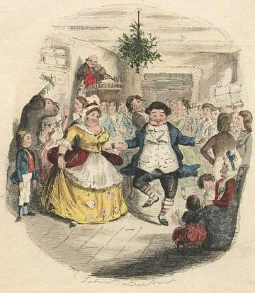

Slide 5
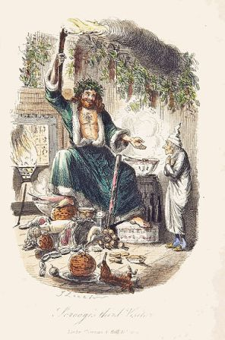

Slide 6
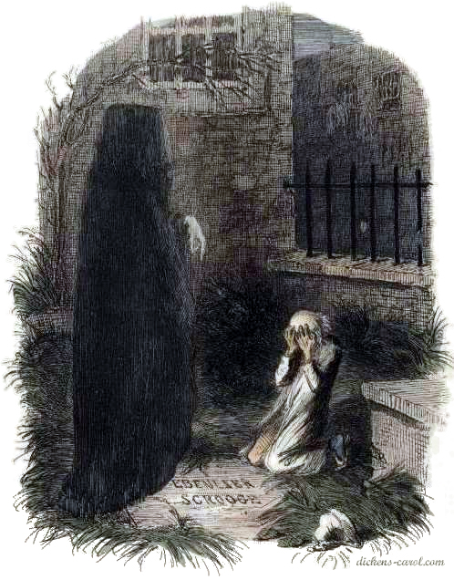

Slide 7
Luke 12:16-21

