Slide 1


Slide 2
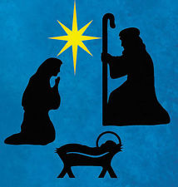

Slide 3
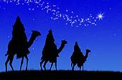

Slide 4
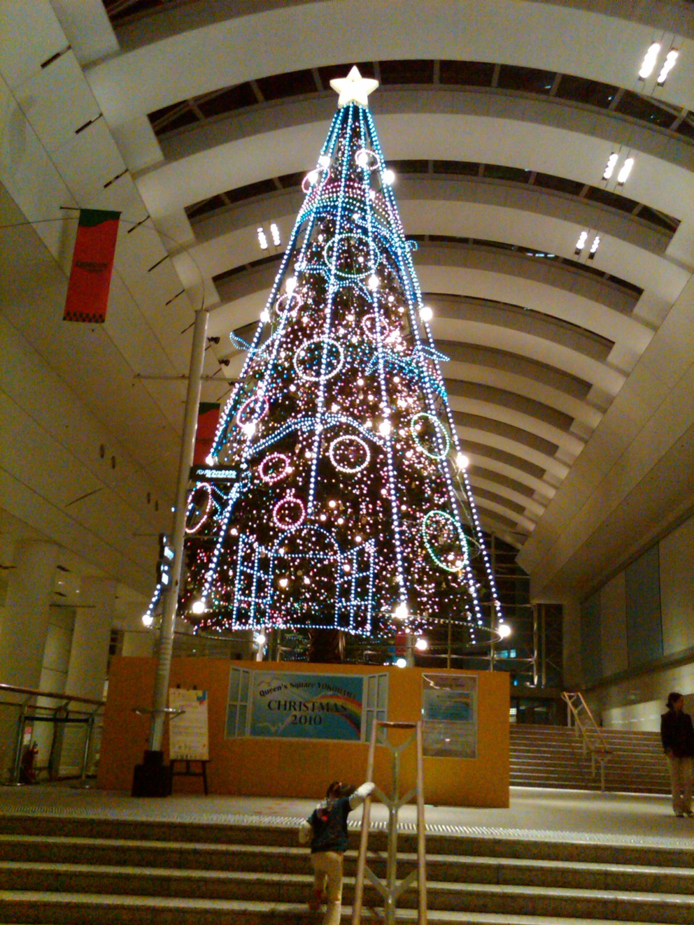

Slide 5

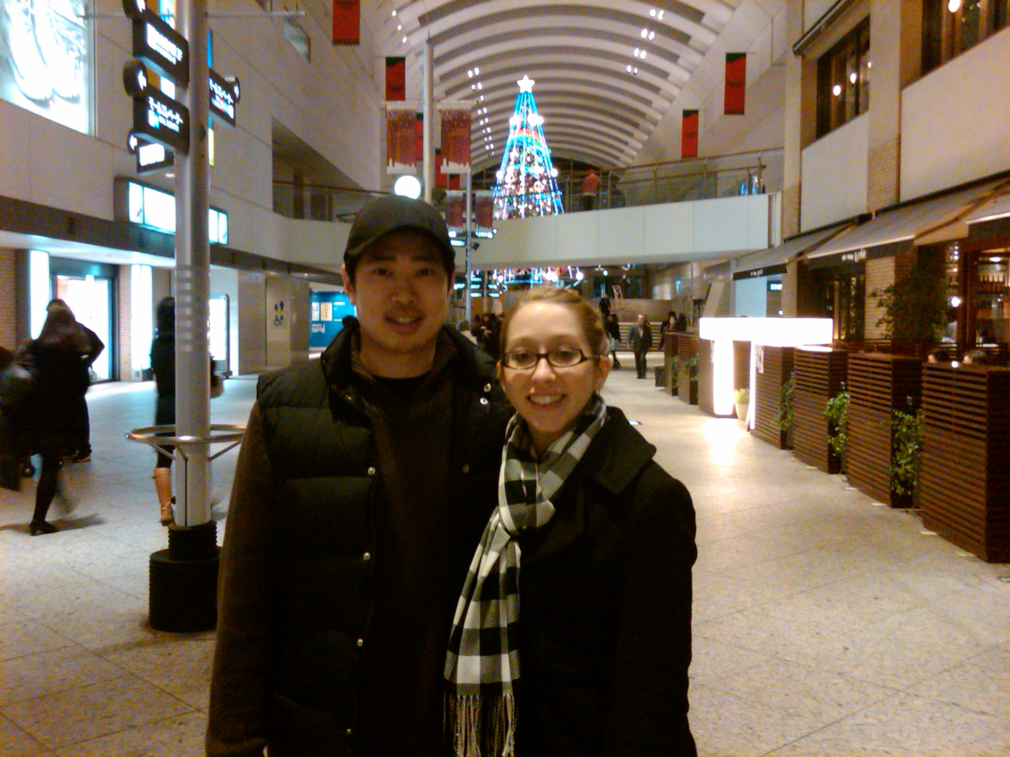

Slide 6
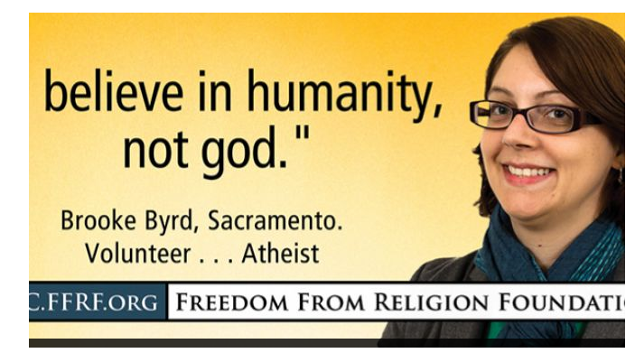

Slide 7
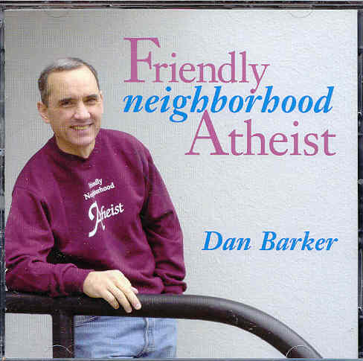
SHOCK: Federal court rules parsonage allowance is unconstitutional.
Atheist Dan Barker: “May we say hallelujah!”

Slide 8
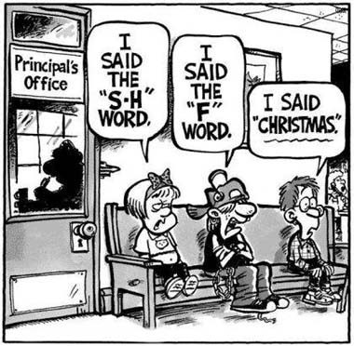

Slide 9
How Something HOLY
Can Become an IDOL

Slide 10
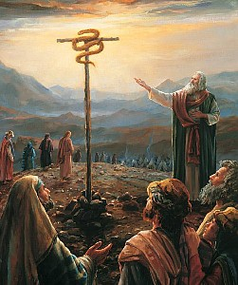
How Something HOLY
Can Become an IDOL
2 Kings 18:1-4

Slide 11

Christmas Hijackers
Greed

Slide 12
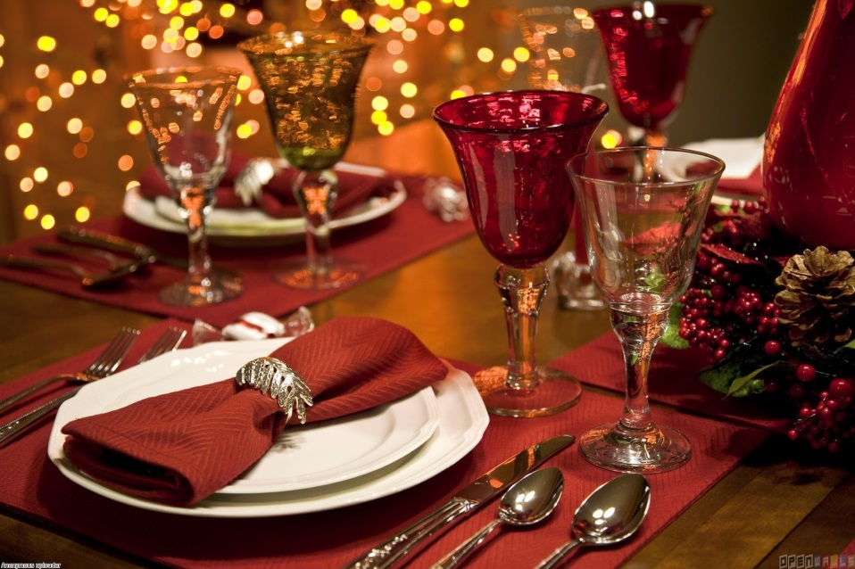
Christmas Hijackers
Traditions

Slide 13

Christmas Hijackers
Electronics

Slide 14

Christmas Hijackers
Obligation

Slide 15

Christmas Hijackers
HEAT: Obligation to give
THORNS: giving with wrong motives
ROOT:
a LIE!
CROSS: Blessing the giver with Grace

Slide 16
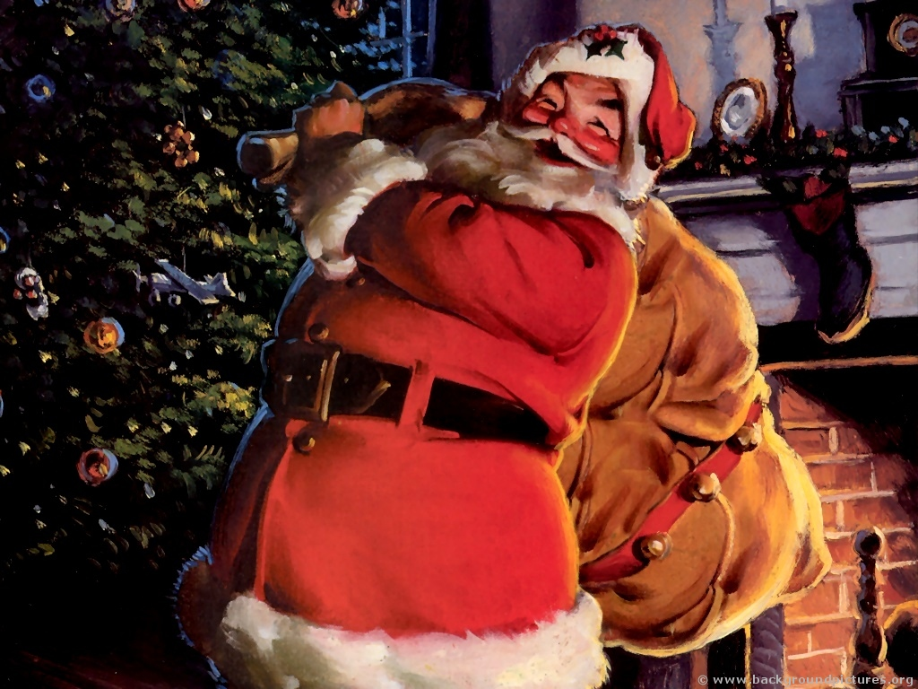
Christmas Hijackers
Santa

Slide 17
Santa Claus is Comin’ to Town | Acts 1:11

Slide 18
Santa Claus is Comin’ to Town | Acts 1:11
He’s makin’ a list, and checking it twice | Rev 20:12

Slide 19
Santa Claus is Comin’ to Town | Acts 1:11
He’s makin’ a list, and checking it twice | Rev 20:12
Gonna find out who’s naughty and nice | Jeremiah 11:20

Slide 20
Santa Claus is Comin’ to Town | Acts 1:11
He’s makin’ a list, and checking it twice | Rev 20:12
Gonna find out who’s naughty and nice | Jeremiah 11:20
He sees you when you’re sleeping | Proverbs 15:3

Slide 21
Santa Claus is Comin’ to Town | Acts 1:11
He’s makin’ a list, and checking it twice | Rev 20:12
Gonna find out who’s naughty and nice | Jeremiah 11:20
He sees you when you’re sleeping | Proverbs 15:3
He knows if you’ve been bad or good | Psalm 1:6

