Slide 1

Living in Harmony with One Another
Romans 15:5

Slide 2

Spiritual Harmony is Determined by Your Attitude

Slide 3
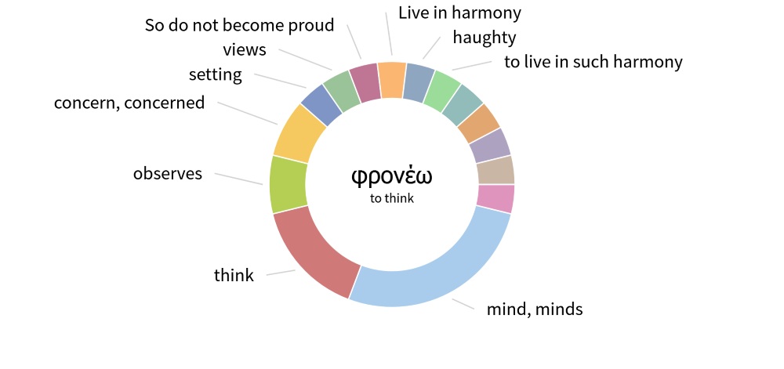
“Live in harmony” Rom 15:5
Literally: “think together
with one another”

Slide 4
Spiritual Harmony is Determined by Your Attitude
Philippians 2:1-5 | Romans 15:1-7
Mind of CHRIST “yours in Christ Jesus…” (2:5) | “Christ did not please himself” (15:2-3)
Live in HARMONY “be of the same mind” (2:2) | “live in harmony” (15:5)
GLORY of God “to the glory of God the Father” (2:11) | “for the glory of God” (15:7)

Slide 5
Spiritual Harmony Makes the Gospel Believable
John 17
Parallel between MIRACLES and UNITY
Satan’s attack
The Early Church

Slide 6
Statement of Unity | Result
Acts 2:46 | Acts 2:47
Acts 4:32 | Acts 4:33

Slide 7
Satan’s Attack | Result
Acts 5. Annanias and Syphira | Acts 5:14
Acts 6. Conflict over favoritism | Acts 6:7

Slide 8
Keys to a Harmonious Attitude
God’s Plan
Part of Evangelism
Give up being first
Forgive
Servant Leadership
Joyful Followership
Holiness

