Slide 1
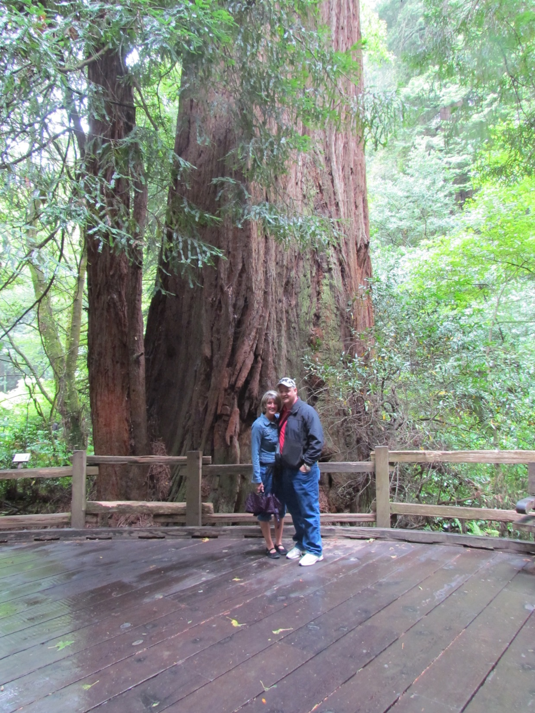

Slide 2


Slide 3


Slide 4


Slide 5


Slide 6


Slide 7


Slide 8


Slide 9

Romans
Members… 12:5
Love… 12:10
Honor…12:10
Live in harmony… 12:16
Encourage… 1:12
Build up…14:19
Welcome… 15:7
Instruct…15:14
Greet… 16:16

Slide 10
1 Corinthians
Wait for… 11:33
Care for… 12:25

Slide 11
Galatians
Serve… 5:13
Do not bite and devour… 5:26
Do not envy… 5:26

Slide 12
Ephesians
Bear with… 4:2
Be kind… 4:32
Submit… 5:21

Slide 13
Philippians
Count one another more significant than yourself. .. 2:3

Slide 14
Colossians
Do not lie…. 3:9

Slide 15
1 Thessalonians
Do good…. 5:15

Slide 16
Hebrews
Stir up …. 10:24

Slide 17
James
Do not speak evil… 4:11
Do not grumble… 5:9
Confess your sins… 5:16
Pray for… 5:16

Slide 18
1 Peter
(love – 1:22)
(greet – 5:14)
Clothe yourselves with humility toward one another…. 5:5

Slide 19
The Meaning of Membership
One Body
Functions of the church

Slide 20
How?
Every believer belongs
Equal worth
Spiritual gifts of equal importance
Don’t quit the body

