Slide 1
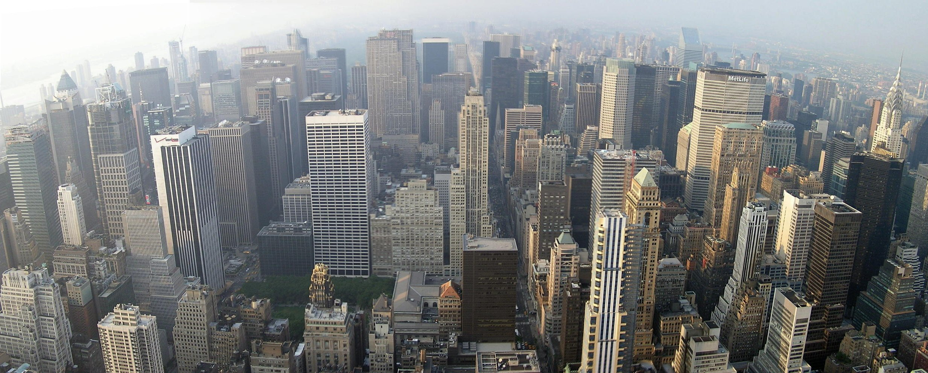

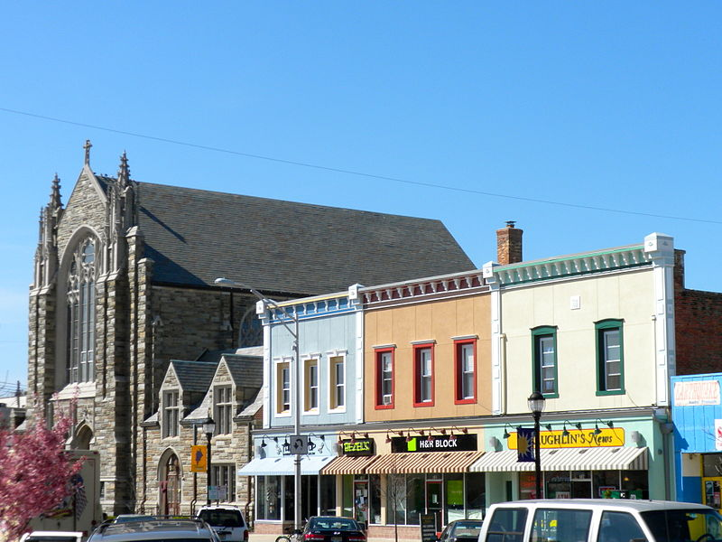
God Loves Cities!
Acts 8:4-8

Slide 2
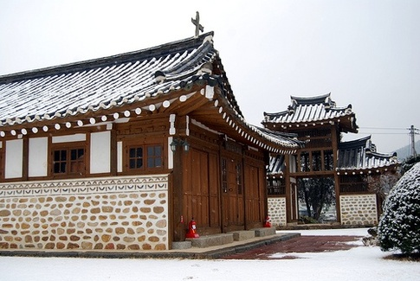
Revival: KOREA - 1907

Slide 3
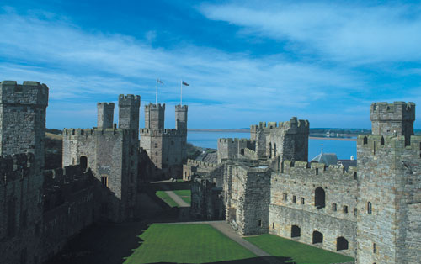
Revival: WALES - 1904

Slide 4
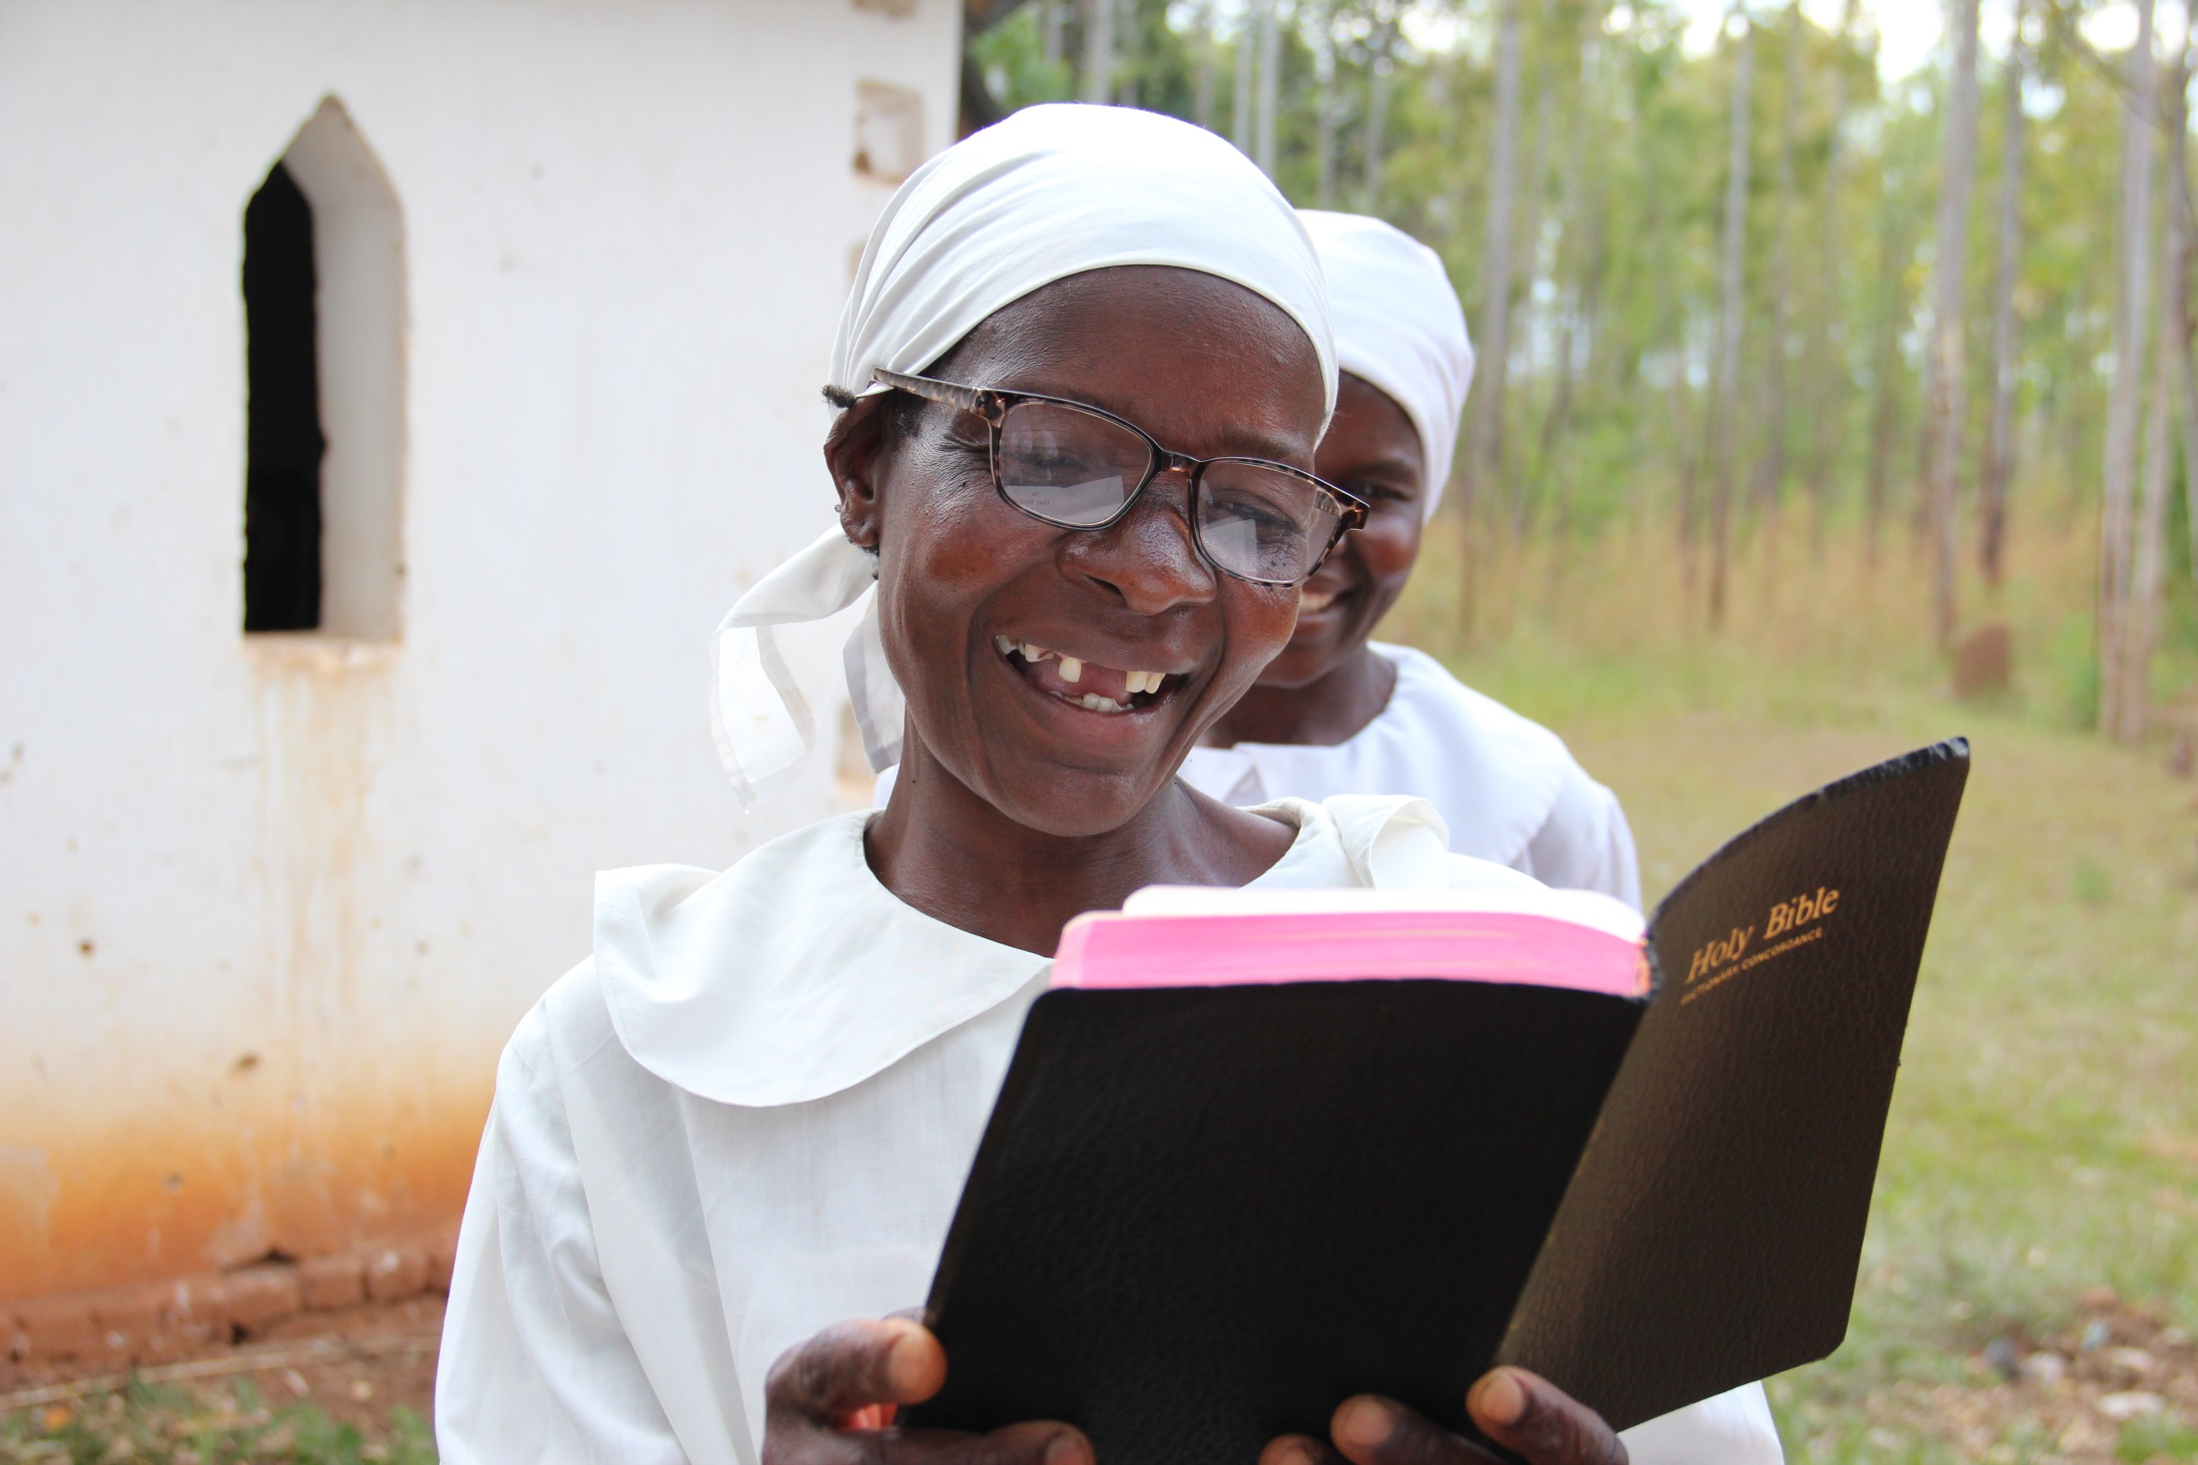
o
Revival: MALAWI- 1910

Slide 5
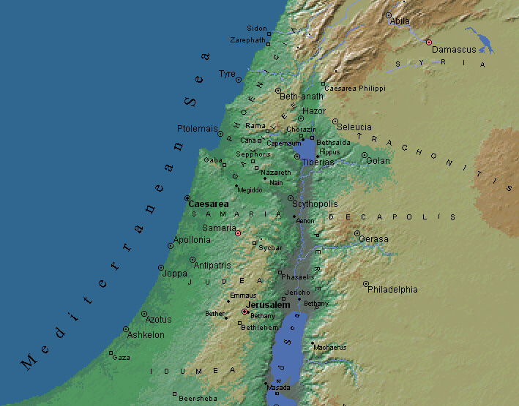
o
Christianity Spread One City at a Time
Antioch
Samaria
Jerusalem

Slide 6
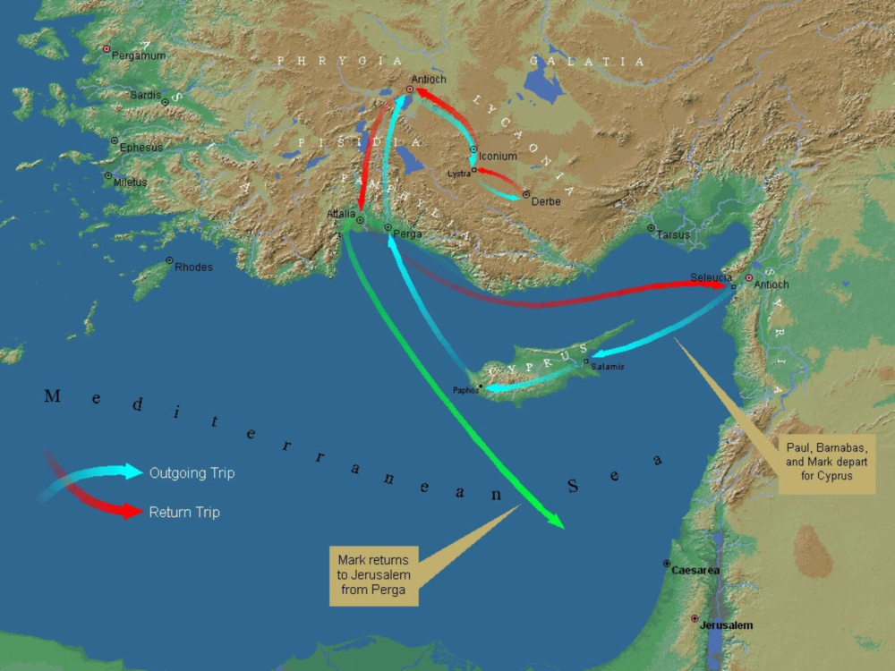
o
Christianity Spread One City at a Time
Iconium, Derbe
Perga
Cyprus

Slide 7
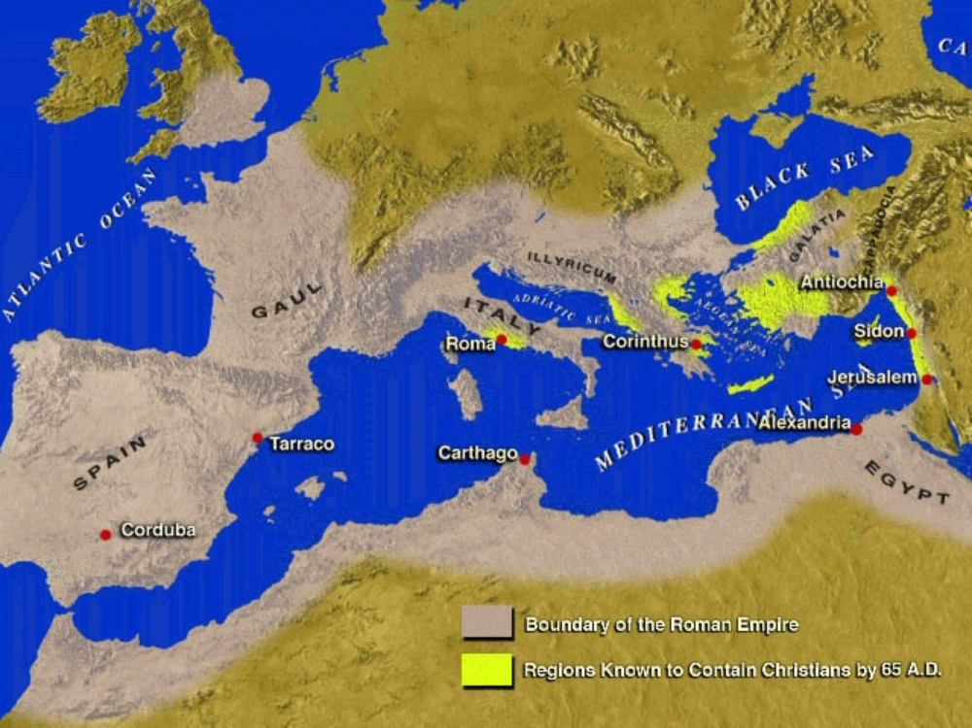
o
The Epistles
Romans
Corinthians
EPISTLES
Romans
Corinthians
Galatians
Ephesians
Philippians
Colossians
Thessalonians
Timothy (Ephesus)
Titus (Crete)
Philemon (Colossae)
Ephesians

Slide 8
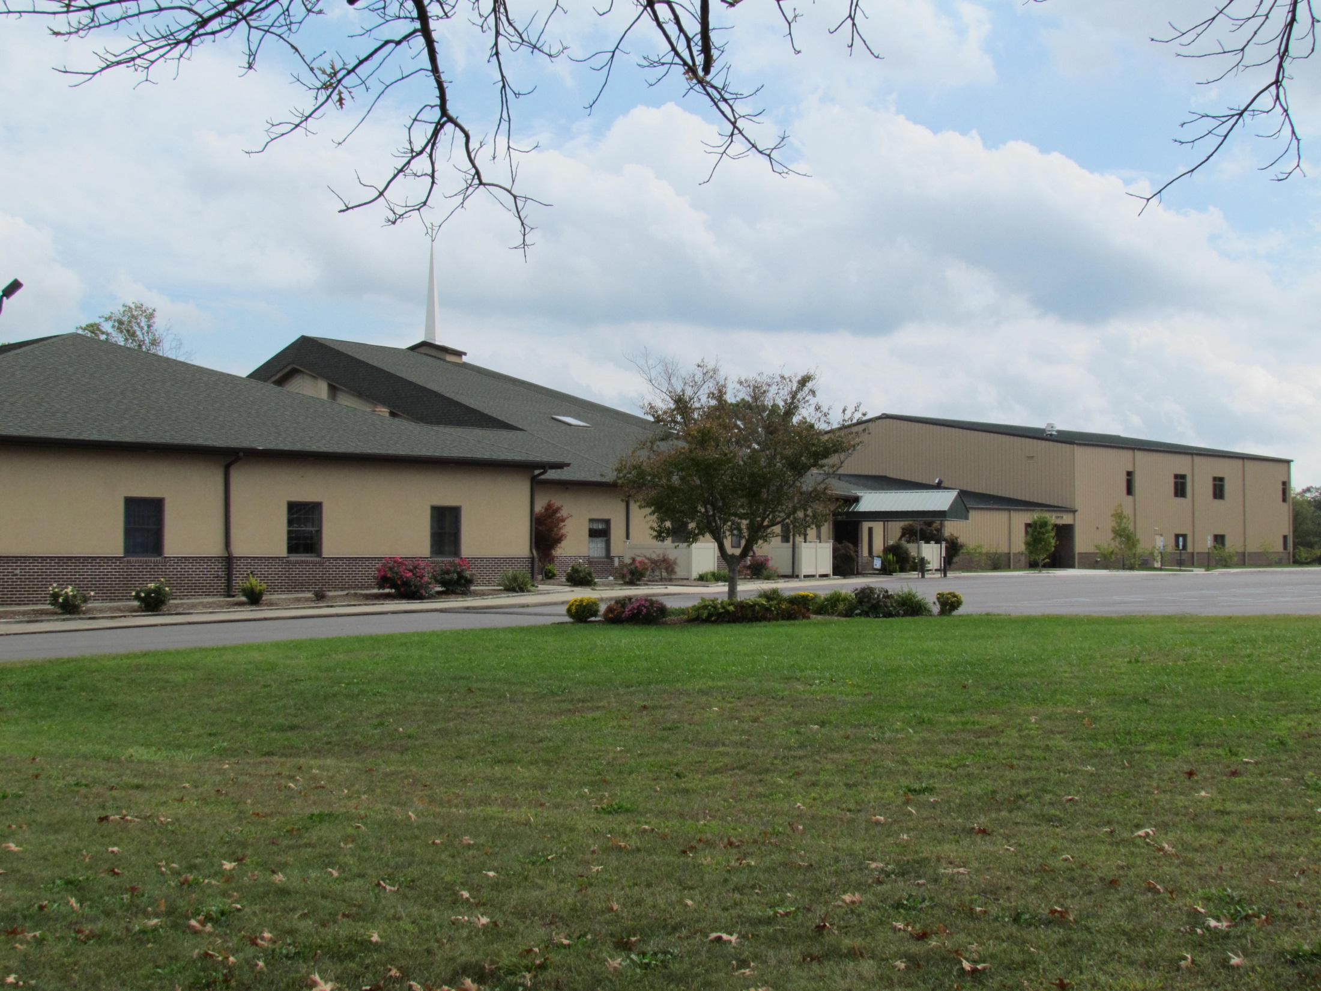
What About Faith Bible Church?
A Called People, reaching a Needy City,
at a Specific Time

Slide 9
A Called People

Slide 10
A Needy City

Slide 11

Today
Tomorrow?

Slide 12
A Specific Time

Slide 13
Function

Slide 14
Function
Form

Slide 15
Function
Form
Freedom

Slide 16

God Loves Cities!

