Slide 1
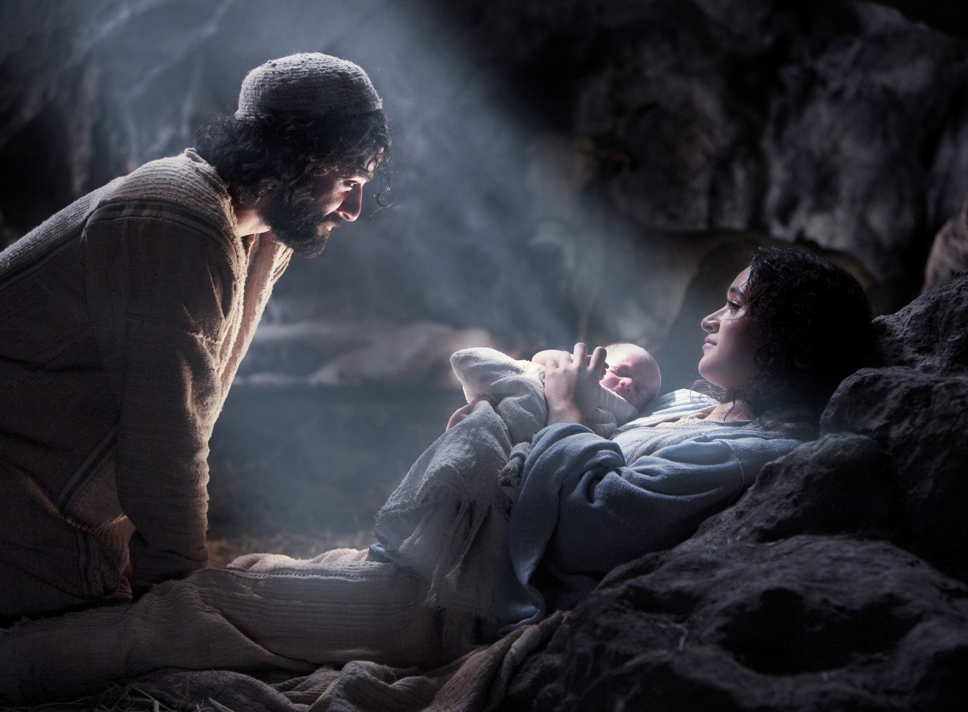
Zechariah’s Song
GOD Has COME
Luke 1:68-79

Slide 2
Zechariah’s Song
GOD Has COME
Luke 1:68 “Praise be to the Lord, the God of Israel, because he has come and has redeemed his people.“
Luke 1:78 "because of the tender mercy of our God, by which the rising sun will come to us from heaven"

Slide 3
Zechariah’s Song
GOD Has COME
Luke 1:68 “Praise be to the Lord, the God of Israel, because he has come and has redeemed his people.“
Luke 1:78 "because of the tender mercy of our God, by which the rising sun will come to us from heaven"

Slide 4
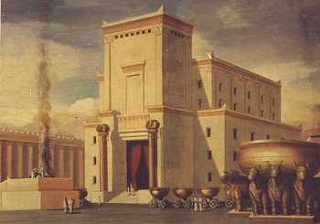
Reasons for Zech’s Praise
He knew God was at work in his life.

Slide 5
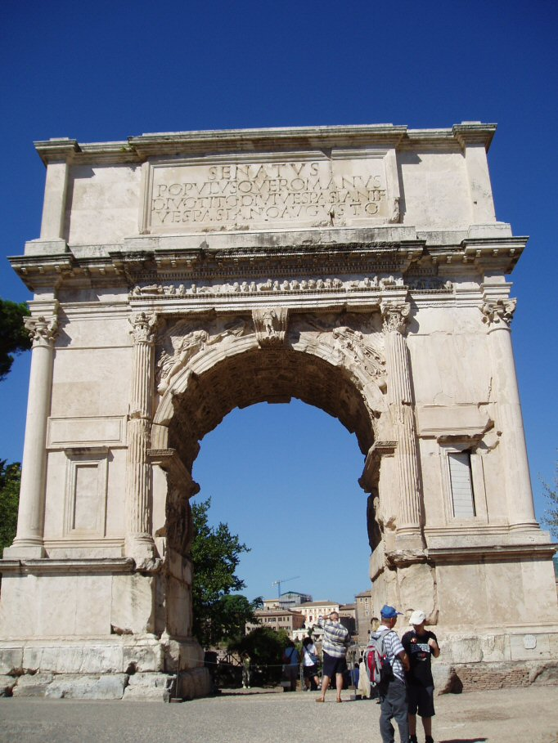

Slide 6
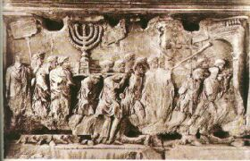

Slide 7
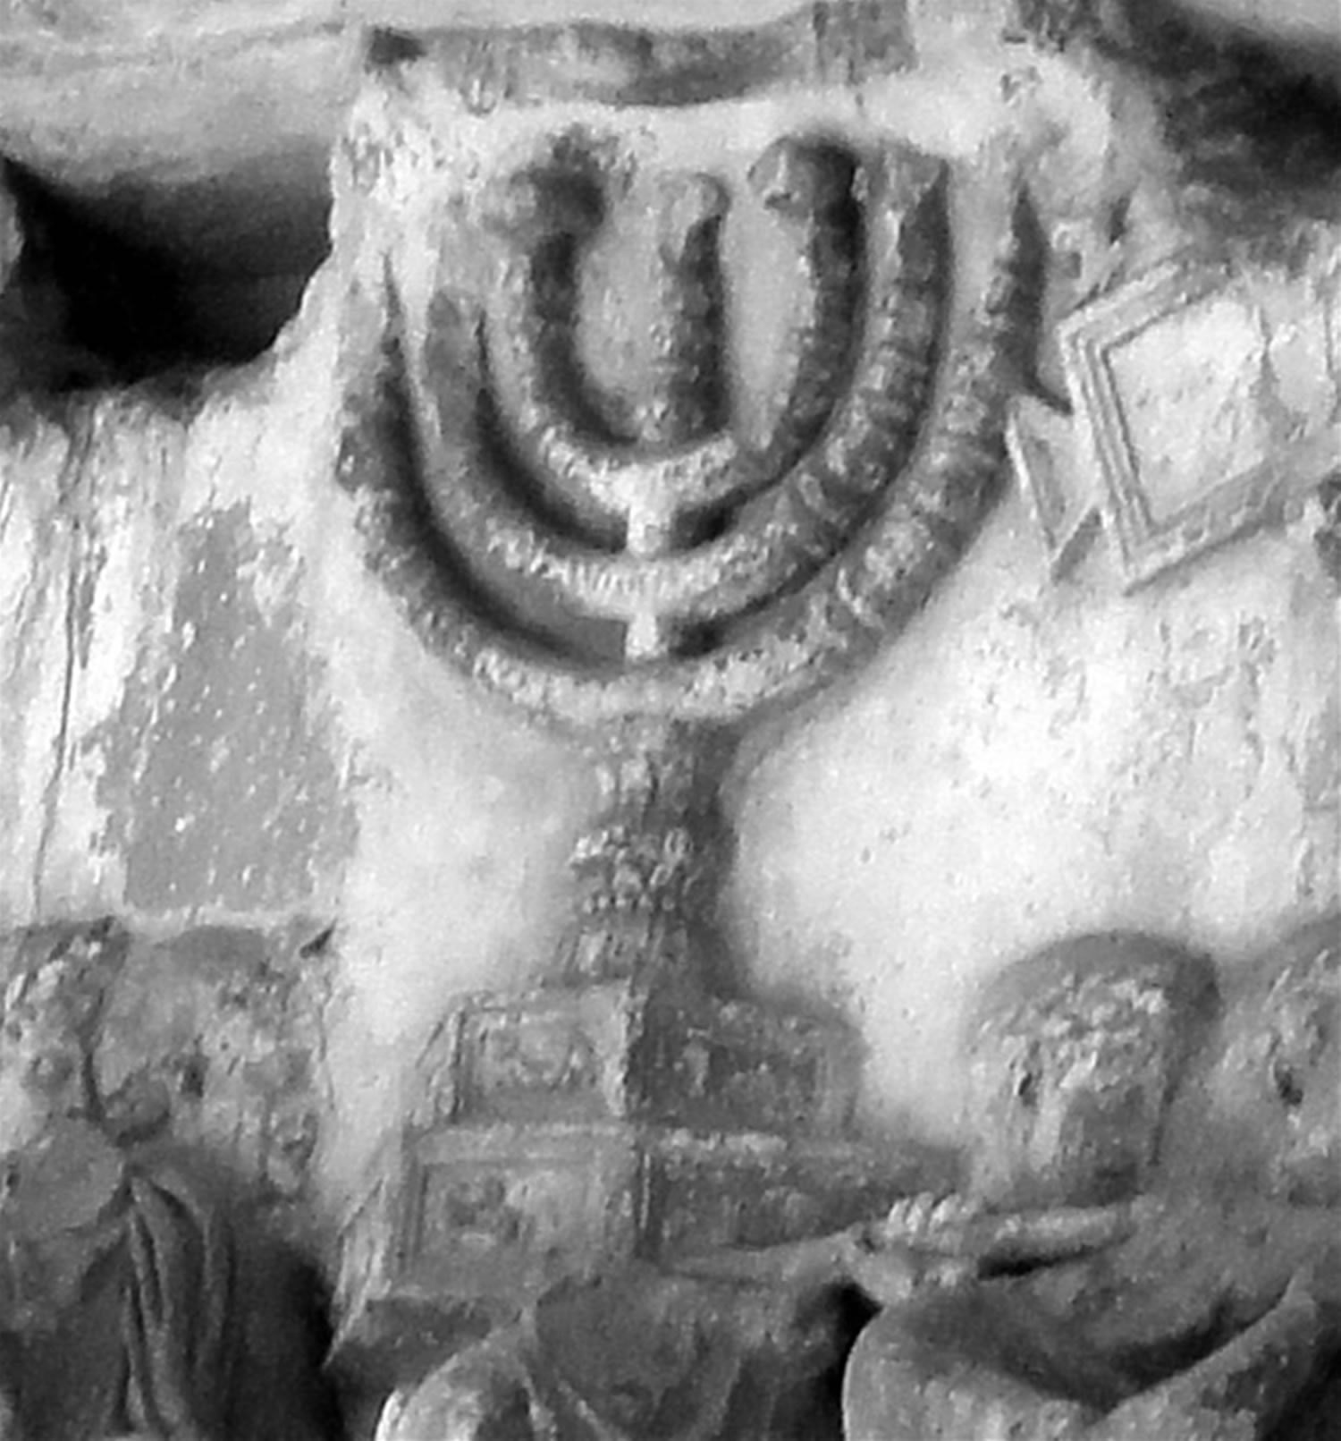

Slide 8
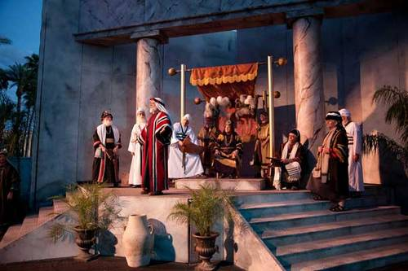
Reasons for Zech’s Praise
He knew God was at work in his life.

Slide 9
Reasons for Zech’s Praise
He knew God was at work in his life.
He knew God’s Word
  Luke 1:76 FROM Isaiah 40:3; Malachi 3:1
  Luke 1:78-79 FROM Isaiah 9:2; 58:8

Slide 10
GOD Has COME

