Slide 1
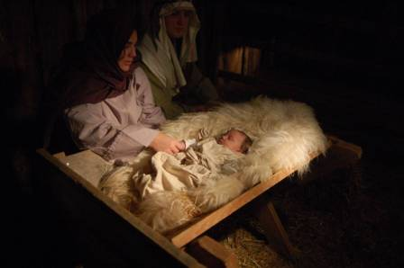
Isaiah 9:6
Jesus, Prince of Peace

Slide 2
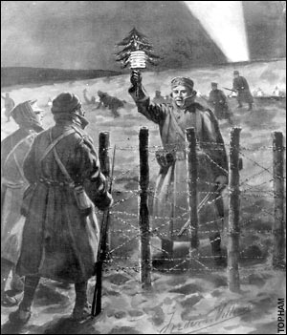

Slide 3
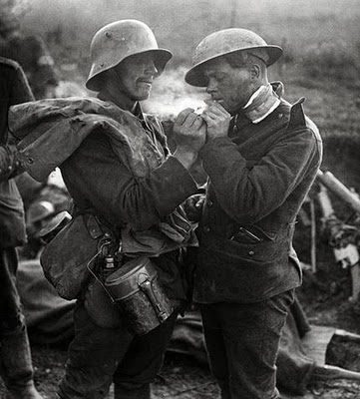

Slide 4
Isaiah 9:6
Jesus, Prince of Peace

Slide 5
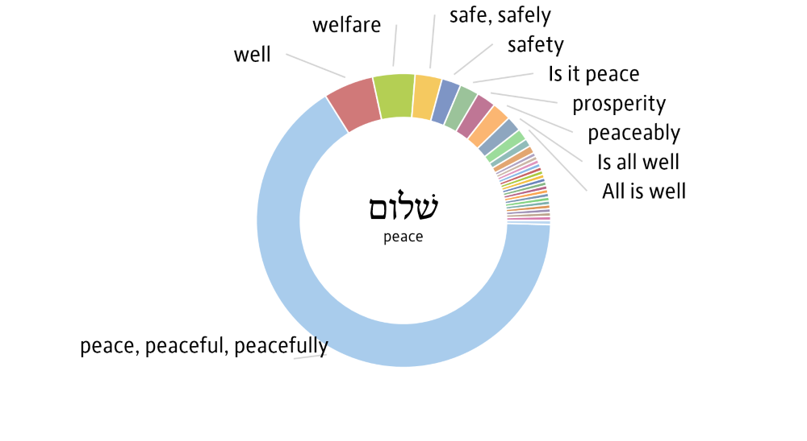

Slide 6
“Shalom”
Welfare. Gen 43:27
Safety. 1 Samuel 20:13
Well Being. 2 Kings 4:25-26
Prosperity. Psalms 72:3
Perfect Peace. Isa 26:3

Slide 7
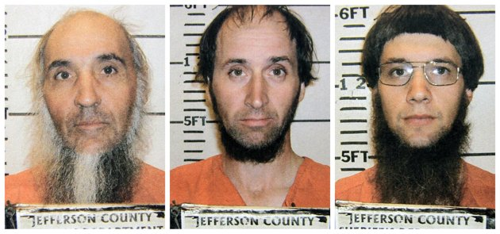

Slide 8
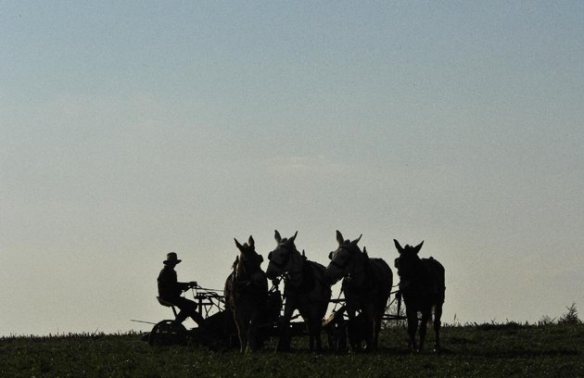

Slide 9
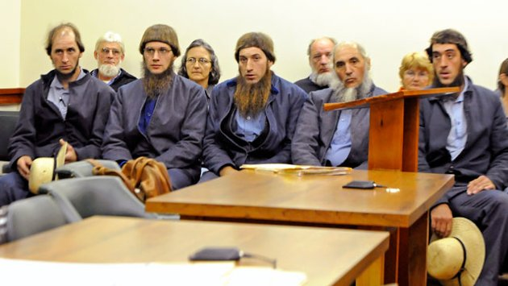

Slide 10
Jesus, Prince of Peace
Luke 2:14
John 14:27

Slide 11
How Can We Find Peace?
Through His Blood.
  Colossians 1:19-22
  Romans 3:23-25
Walking with God
  Philippians 4:7
  Romans 8:6

